Slide 1

LEADERSHIP & TRANSFORMATION CURRICULUM:
BUILDING & MANAGING SOCIAL PROTECTION FLOORS IN AFRICA
DAY 4
MIS / FINANCE

Slide 2
DAY 4 – Morning Session
SP MIS

Slide 3


Leadership & Transformation Journey check-in

Slide 4
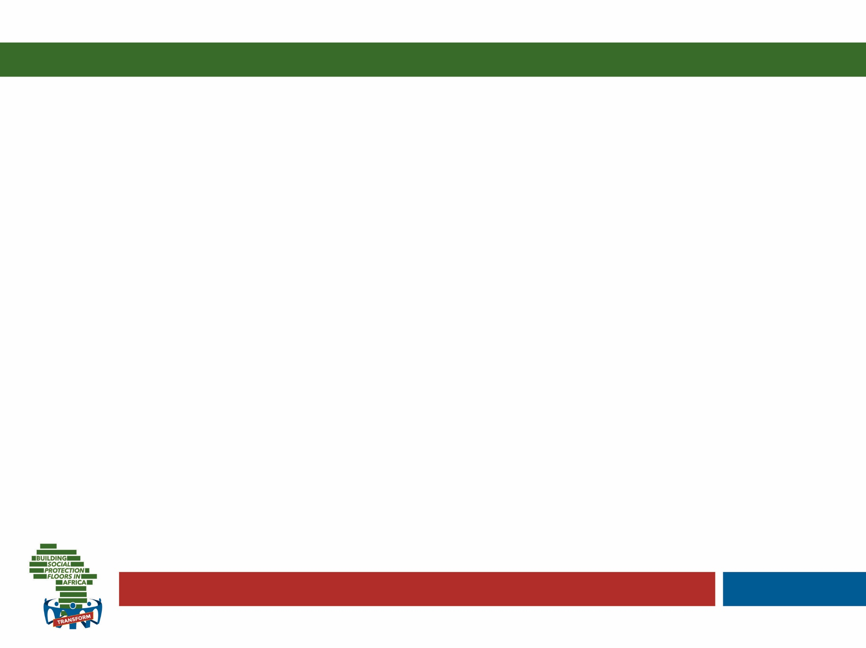

L&T Journaling
From that future place (where you ended the journaling yesterday, your legacy and what you would like to be remembered for), look back at your current situation as if you were looking at a different person. Now if you were to try to help that other person, what advice would you give?
Think of the advice you would give and write it down. (about 4 min.)
Adapted by Catherine Widrig Jenkins (IPK) from Theory U by Otto Scharmer
Notes:
Invite participants to take out their journals and spend a few moments going over the notes of the journaling done on the prior day to reconnect to where they left it off
Then talk and guide them through today’s set of questions on this and the next slides – always allowing for about as much time as indicated behind each question in brackets
Finish this activity off by allowing them to turn to the person next to them and take about 5 minutes to share a few insights relating to the journaling experience

Slide 5

L&T Journaling
Now returning again to the present ask yourself: What vision and intention do you have for yourself in your work? What are the essential core elements of the future that you want to create in your professional life? Describe the images and aspects that you can think of with as much detail as possible. (about 4 min.)
Adapted by Catherine Widrig Jenkins (IPK) from Theory U by Otto Scharmer

Slide 6

L&T Journaling
What do you have to let go of in order to bring your vision into reality? What is the old stuff that must die? What is the old skin (behaviors, thought processes, etc.) that you need to get rid of?
(about 3 min.)
Adapted by Catherine Widrig Jenkins (IPK) from Theory U by Otto Scharmer

Slide 7

L&T Journaling
What in your current work life or context provides the seeds for the future you want to create? Where do you see your future beginning? (about 3 min.)
Adapted by Catherine Widrig Jenkins (IPK) from Theory U by Otto Scharmer

Slide 8

What is a Management
Information System (MIS) with reference to Social Protection Programs?
A system that retrieves data
from a program’s database (or in some cases different databases) into information that can be used for efficient and effective
management.
Notes:
Note this definition is specific to social protection (refers to social protection program), while the word MIS has much wider use in business world etc..
And also note we are now focusing on the PROGRAMME LEVEL.. We will discuss integration across programmes later..

Slide 9
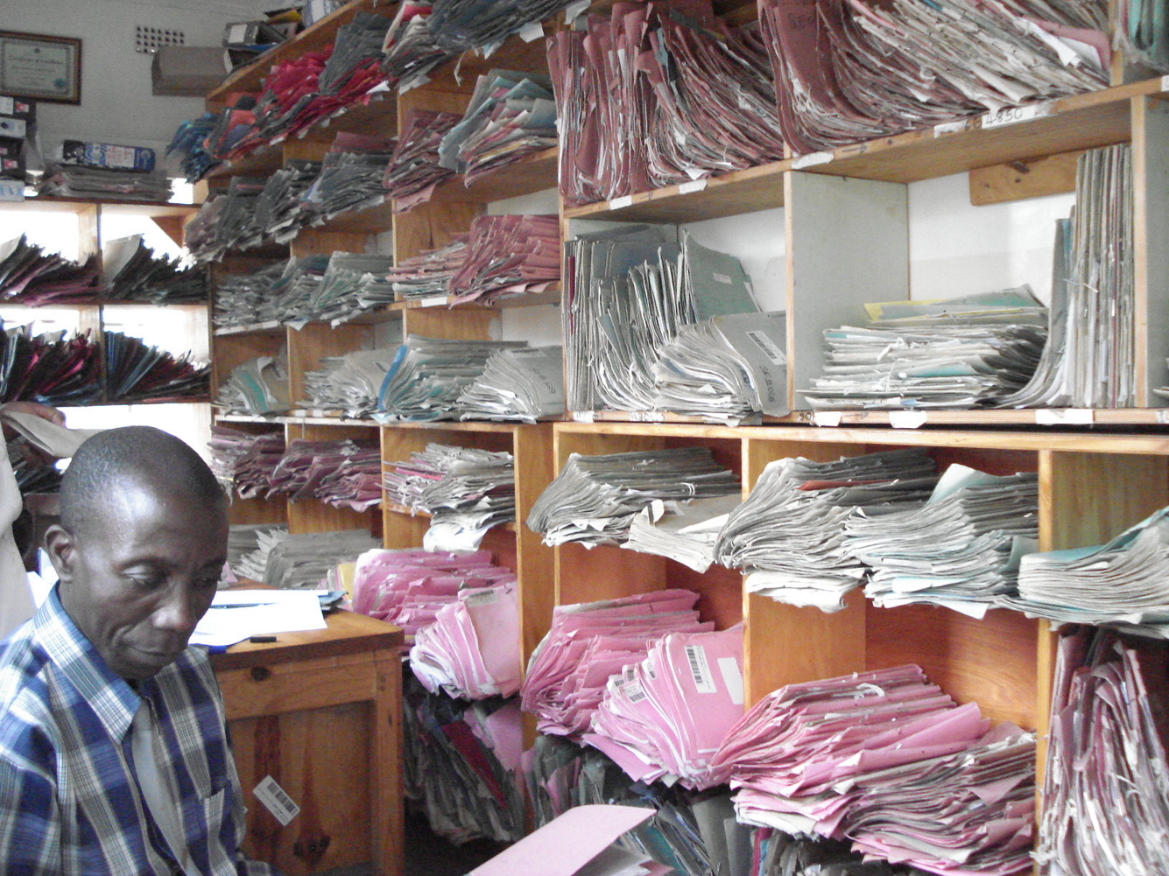
To avoid this!
Notes:
Explain paper is fine if well organised… yet much less easy to retrieve, organise and transform into information

Slide 10
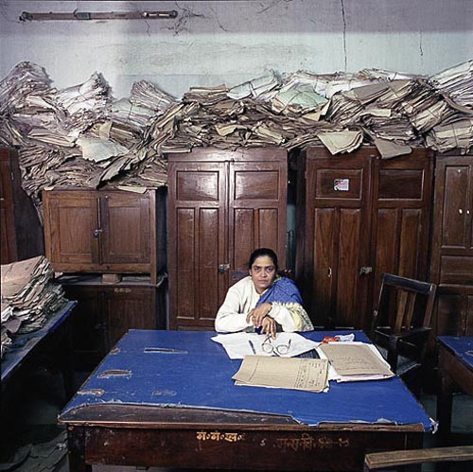
Or this!

Slide 11


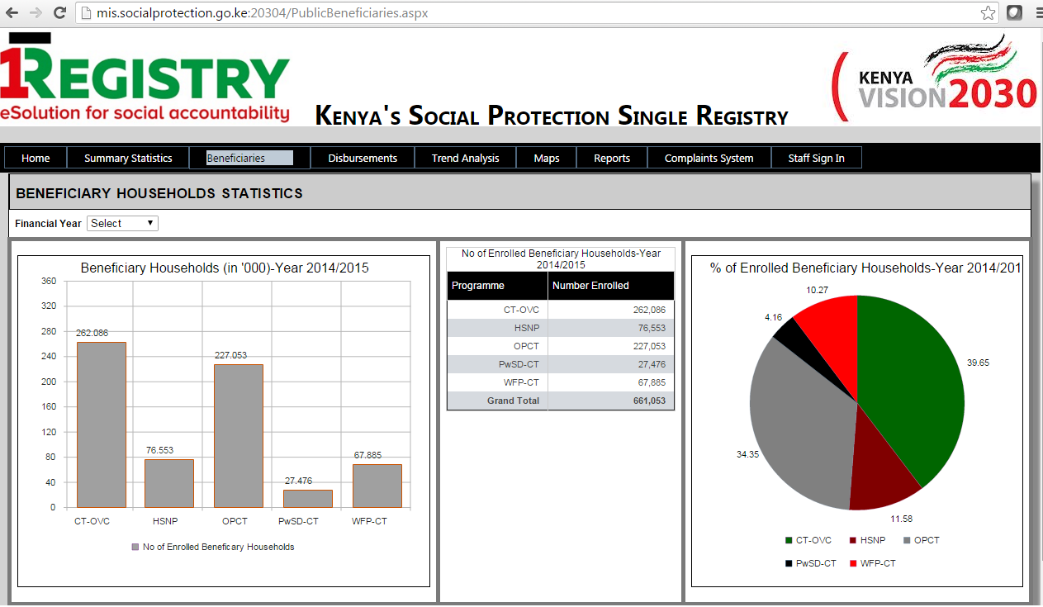
Filing cabinet = Database
Office Manager = The MIS
Notes:
Your programme database is like a filing cabinet – it stores information (it is static!).. Officially: a system intended to easily organize, store and retrieve large amounts of data
Your Management Information System (MIS) is like your office manager - the brains that control the filing cabinet. These brains decide what data should be retrieved, the brains turn the data into information and channel it to the right source so that it can be used. In practice, an SP programme’s MIS is a tailored software application that transforms retrieved data from a program’s database into information that can be used for efficient and effective management
These two elements work together to support the administration of social protection programs, we will look at this in detail later.
….NOTE that data and information can also be managed on paper… (as the photo before).. Or on Excel… but a software application that acts as an office manager can be much more effective…
Example:
Say for example he /she was asked to go to the filing cabinet and extract from the red file information on who is over 65 and who has disability and then compile a list containing the names of those individuals. That would represent the role of the MIS – i.e. retrieve data from the database and compile it into something that can be used.

Slide 12
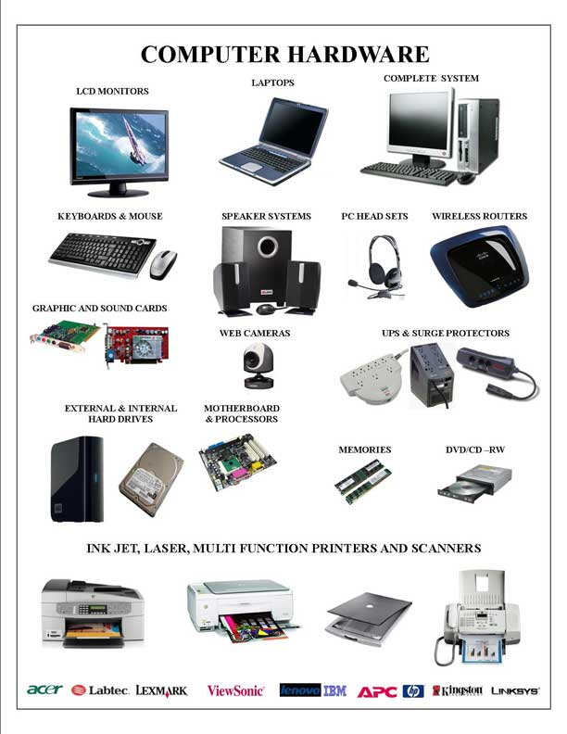

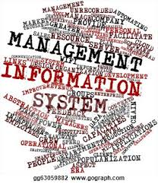
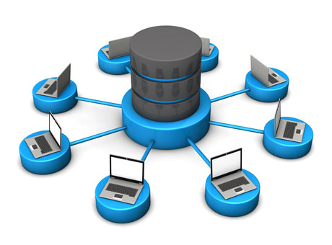
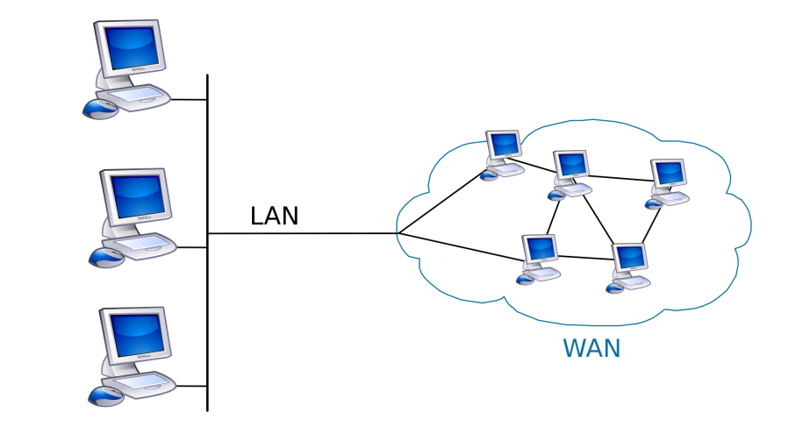
The key components of a functional electronic program MIS
Hardware
Database
People: setting information requirements
Application software (MIS)
Telecommunication systems
Notes:
If we take another step back… you can see here your application software (MIS) and database in green (we have already talked about these).. But in the background there are other elements to what IT people would call the wider ‘Information System’..
The starting point is the people setting the ‘information requirements’ based on their needs (as we discussed for M&E!): i.e. programme staff choose the data that needs to be stored and managed on the basis of program objectives and the core functions that need to be supported. Garbage in Garbage out!!
For example, an MIS supporting a complaints and appeals process or a comprehensive M&E system will have additional information requirements compared to a program that uses and MIS for registration, enrolment and payment purposes.
Software application (MIS) and Database: we know about now..
But let’s remember that SP programs can either use proprietary databases and application software (microsoft, access or oracle) or open source.. Which is ideal to prevent the risk of ‘vendor lock-in’ (many countries fall into this trap thinking there will only be a one-off development! But this is an iterative process!)
Hardware infrastructure: This refers to the necessary infrastructure to securely collect and store large amounts of data (computers, PDAs, servers etc) Options for hardware technology vary depending on the size of schemes, the overall context (power supply, remoteness etc), levels of security guaranteed and the particular operations to be undertaken.
Telecommunication system: this includes the network infrastructure – Local area network (LAN) and wide area network (WAN) – that enables the links between the software and the databases that feed into it. The choice of such a system depends on the local context (e.g. availability and reliability of the internet)… though note that information can flow in the absence of these as well.. Using compact disks, USB, etc! But higher security risks..

Slide 13

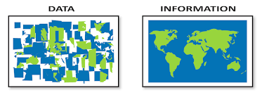
Registry vs
Database
Data vs Information
Program MIS
Integrated system for Information management
Clarifying
important
terms:
Notes:
And to go over a few more words that may be useful as we go along…
Registry = An official written record of names/ events or transactions (this word has Pre-ICT origin!)
vs Database = These two words mean exactly the same thing these days.. So a ‘Registry’ is no different from a ‘database’.. Though these could be organised quite differently (e.g. a database could even be stored on excel!)
Data: Simply the facts on an individual level e.g. Tsapo: 17: Mother of 1.
vs Information = when that data gets turned into something useful that can be used to base decisions on. e.g. 50% of girls between 14 and 18 are mothers. 95% are single mothers.
The program MIS = we have seen this
Integrated system for Information Management – Refers to the broader system that enables the flow and management of information within the SP sector and sometimes beyond… we’ll talk about this later

Slide 14
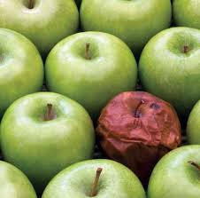
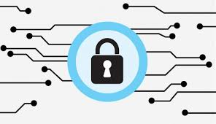
Interoperability
Data integrity
Data privacy and security
Understanding
Some important
terms:
Notes:
Interoperability: A characteristic of a product or system, whose interfaces work with other products or systems, present or future, in either implementation or access, without any restrictions
Data integrity: the overall completeness, accuracy and consistency of data. This can be indicated by the absence of alteration between two instances or between two updates of a data record, meaning data is intact and unchanged
Data privacy: System for ensuring data/information is not misused or lost, potentially exposing households to further vulnerability

Slide 15
MIS terminology – Tread with caution!
There is a lack of acknowledgement that there are two key components involved: The database i.e. the filing cabinet and the MIS i.e. the office manager’s brain that transforms the data into information.. Plus the other elements of the wider ‘information system’
The same words are used to refer to program level solutions and integrated solutions (which are often called ‘registries’ for some reason!)
Terminology between countries is not consistent and often the same word in one country is used to refer to a completely different thing in another country: it is not about the word but about what the system does (its functions)

Slide 16
The core functions of a program MIS
in a Social Protection System:
To enable the flow and management of information to support key processes
To enable streamlined monitoring and implementation of programs
To ensure transparency and good governance
To support cost effective program expansion
A pre-requisite for cross program integration
Notes:
So what are the core functions of a programme level MIS?
To enable the flow and management of information to support key processes
Example of this = Check how many families with over 4 children are being paid. Look at average time delay between processing and payment
To enable streamlined monitoring and implementation of programs
Example of monitoring = Running pre-populated monitoring reports on a regular basis (e.g. no. of recipients paid per district)
Example of implementation = Automatic generation of payment list for payment delivery. Data entry platform for program enrolment
To ensure transparency and good governance
Example of this = Payment list and reconciliation (less chance for corruption). Lower chance of manipulating eligibility determination
To support cost effective program expansion
Example of this = The initial cost of developing the MIS is high but once it is in place, expansion is much easier / faster.
A pre-requisite for cross program integration
Example of this = Integration of data requires an electronic platform. Integration can only be achieved if data from individual programs is stored on a database and managed through MIS

Slide 17
Monitoring & Evaluation and other management support functions
Validation
Exit …Graduation
Identification and registration
Eligibility determination
Enrolment
Payments/ delivery
Beneficiary and Case Management
Conditionality
Complaints and appeals
Notes:
Remember this slide we analysed when we looked at administration?
Explain – there are two key things to note:
Not all of the functions listed above are always supported by program MIS. The functions that are supported depend on the program objectives, set up and what modules are prioritised during the MIS design. Overall a program MIS is a reflection of the operations manual of the program supported by the appropriate technology. The Social Protection MIS cannot be used for functions beyond those set out in the manual of procedures.
BUT this does not mean that processes are fixed in time. MISs can be adapted to follow changing program requirements.. In a modular fashion – e.g. increasingly moving core processes from a paper-based to an electronic platform.
For example.. Think of the flagship social protection programme in your country…
M&E system… – is it possible at the press of a button to get the information you need eg. To compare inputs vs outputs eg number of days taken to process an application?
Are you using the system to validate and authenticate your data.. Potentially against other databases i.e. data checks, consistency checks, outlier checks – e.g. are your ghost beneficiaries being paid?
Conditionality: do you have a system that allows you to automatically monitor conditionality?
Is your complaints and appeals system monitored electronically and does it categorize complaints and aggregate them upwards?

Slide 18

What’s working well and what’s not?
Notes:
As we have discussed, this curriculum is called Transform and one of the key pieces to transformation is that we start to look at the beliefs we hold around certain issues. The beliefs we hold on something depend so much on our context and past experience that most beliefs can be argued from two perspectives i.e. there’s not necessarily a wrong or a right. What’s important is that we check in with our beliefs so that we can ascertain if our beliefs are still valid. This checking in is key to transformation. And so we are going to do an activity now that enables us to check in with our beliefs.

Slide 19
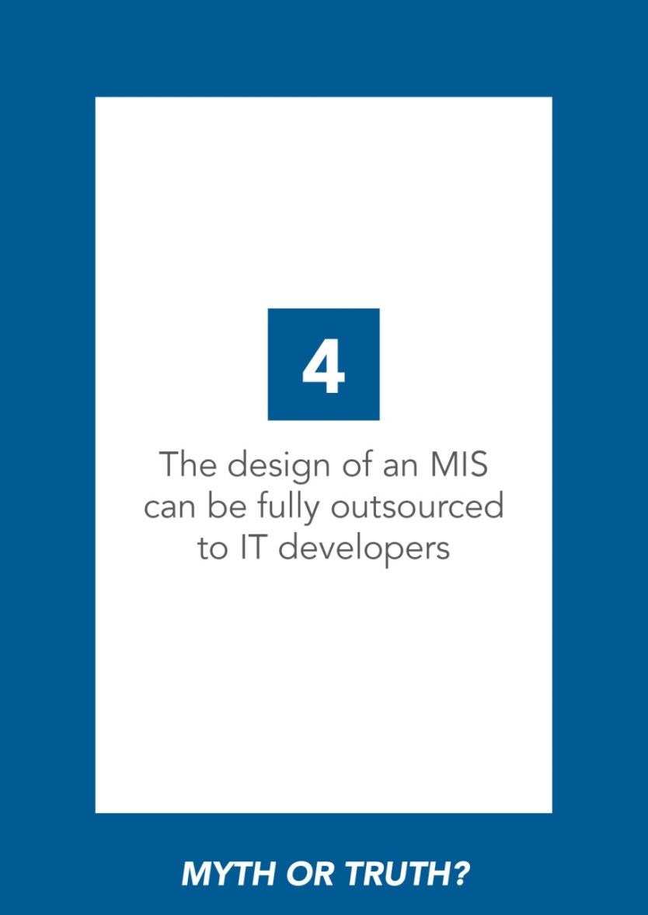

DEMONSTRATION

Slide 20
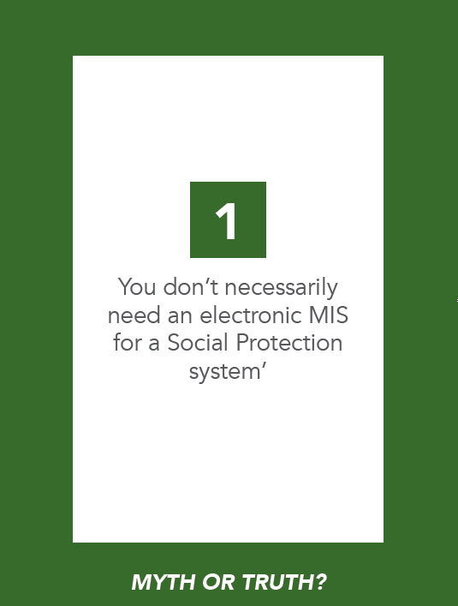
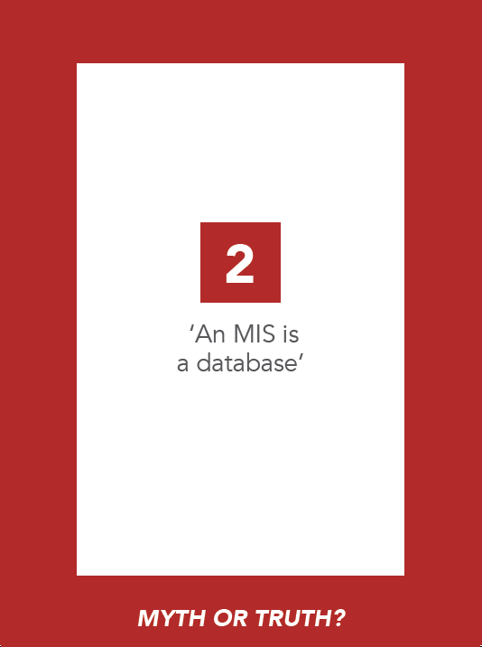
Notes:
Go through the slides to establish which cards the groups agreed (i.e. truth) with and which ones the groups thought were a myth. Use Cheat Sheet to guide answers

Slide 21
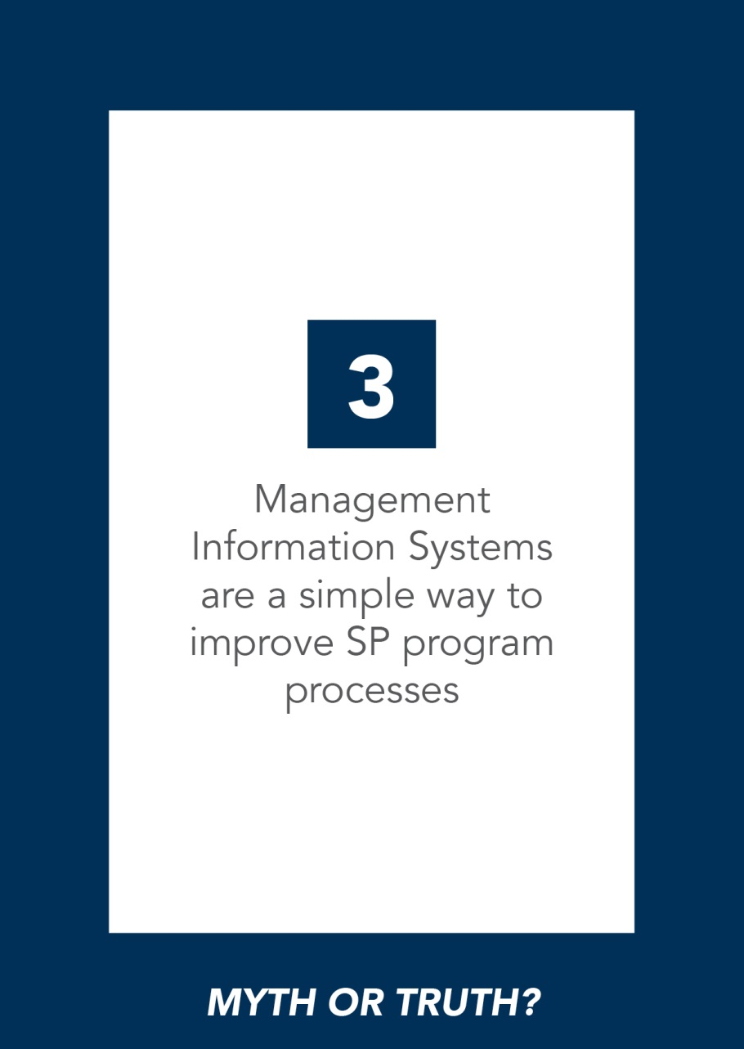
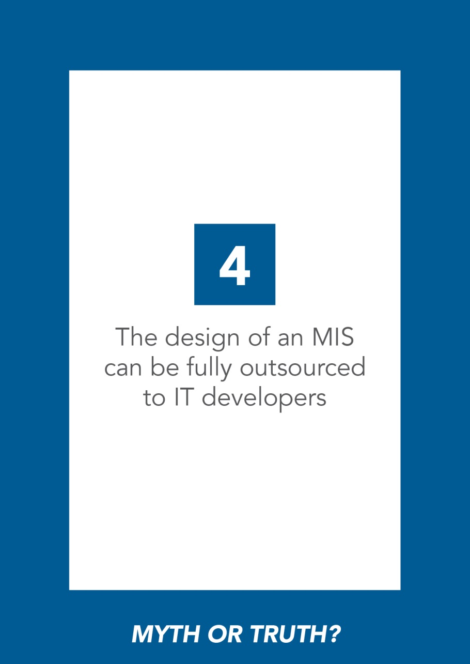
Notes:
Go through the slides to establish which cards the groups agreed (i.e. truth) with and which ones the groups thought were a myth. Use Cheat Sheet to guide answers

Slide 22
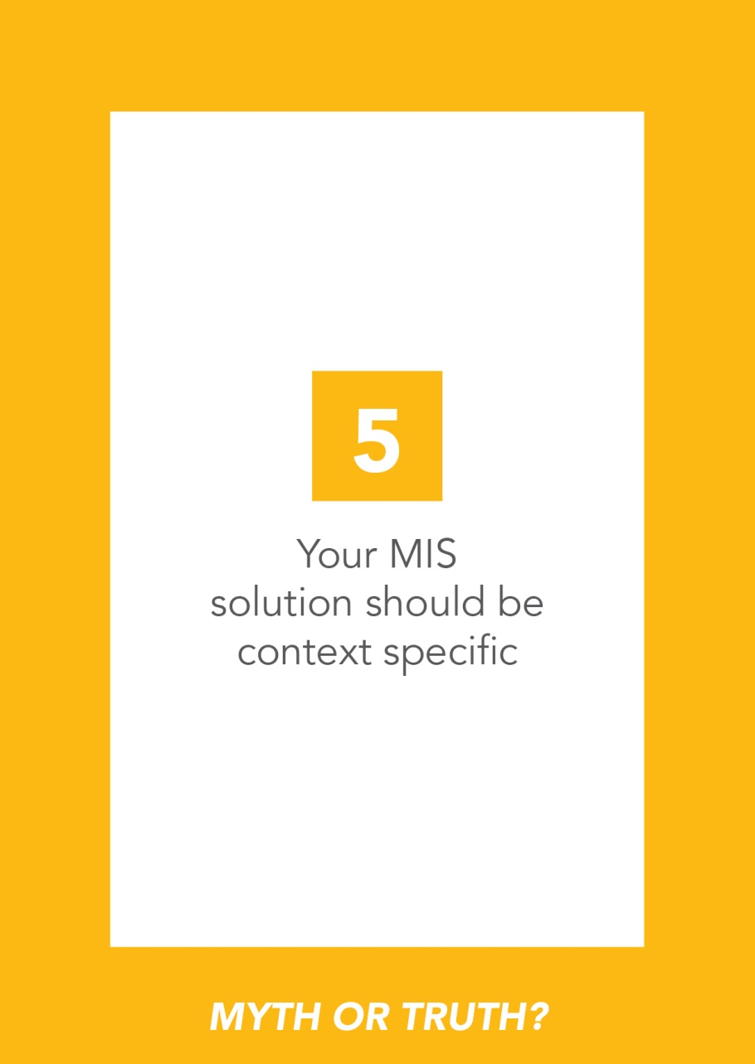
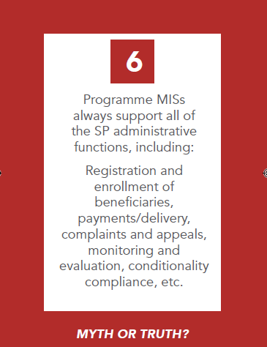
Notes:
Go through the slides to establish which cards the groups agreed (i.e. truth) with and which ones the groups thought were a myth. Use Cheat Sheet to guide answers

Slide 23

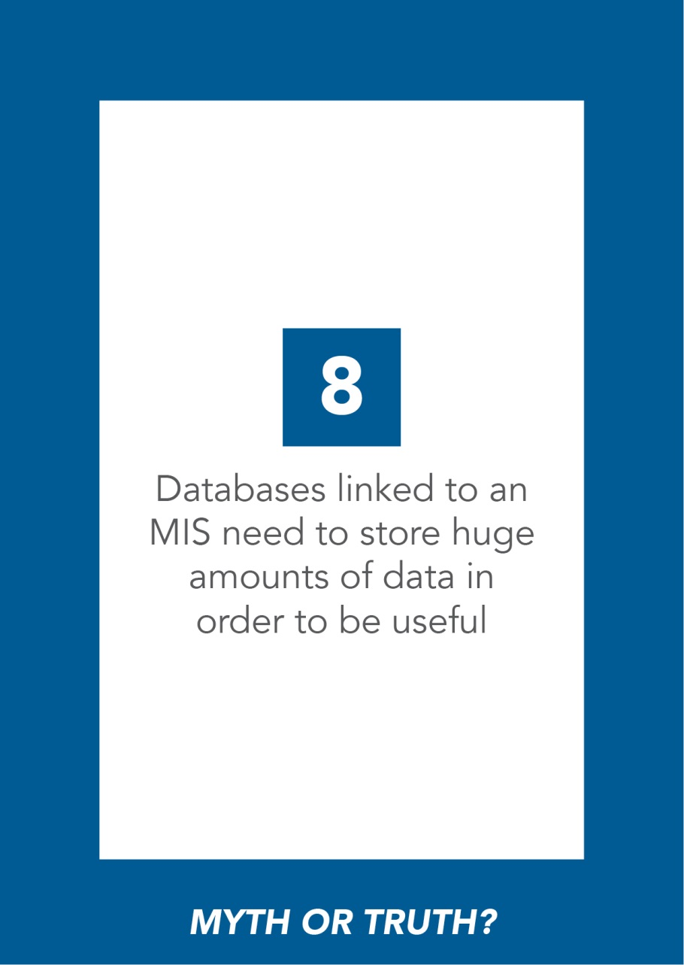
Notes:
Go through the slides to establish which cards the groups agreed (i.e. truth) with and which ones the groups thought were a myth. Use Cheat Sheet to guide answers

Slide 24
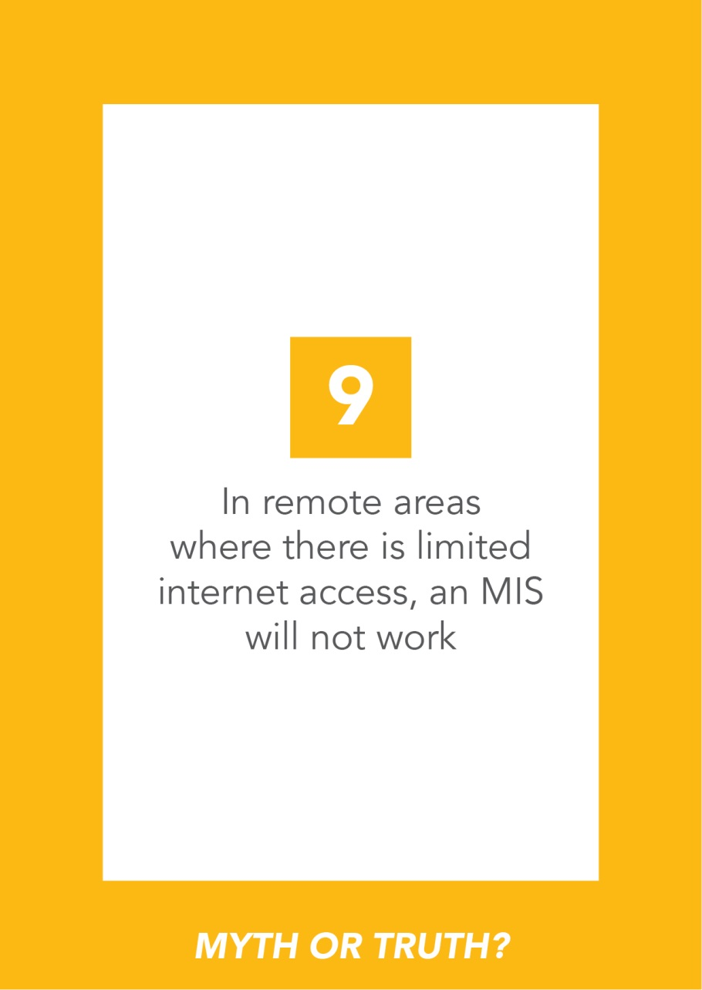
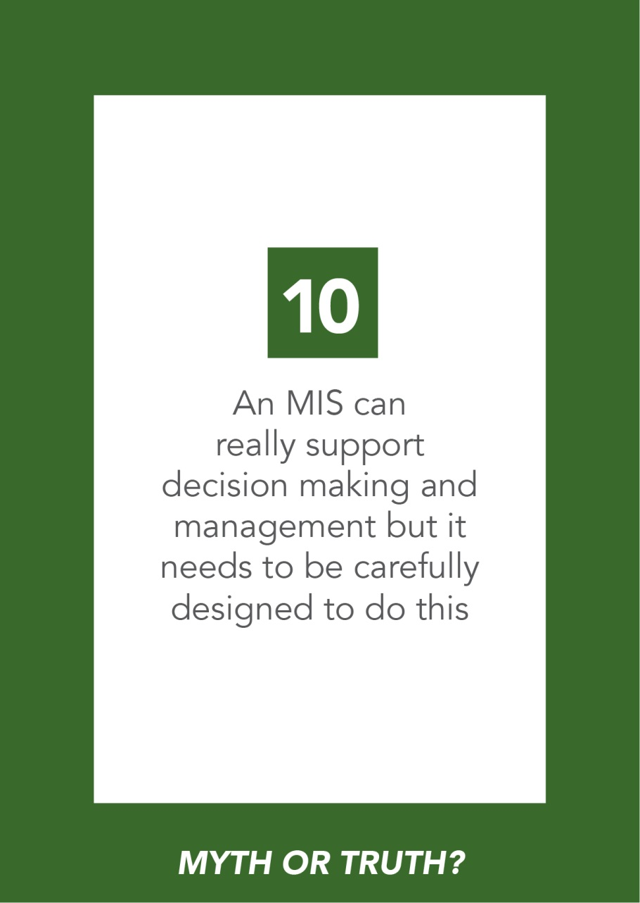
Notes:
Go through the slides to establish which cards the groups agreed (i.e. truth) with and which ones the groups thought were a myth. Use Cheat Sheet to guide answers

Slide 25
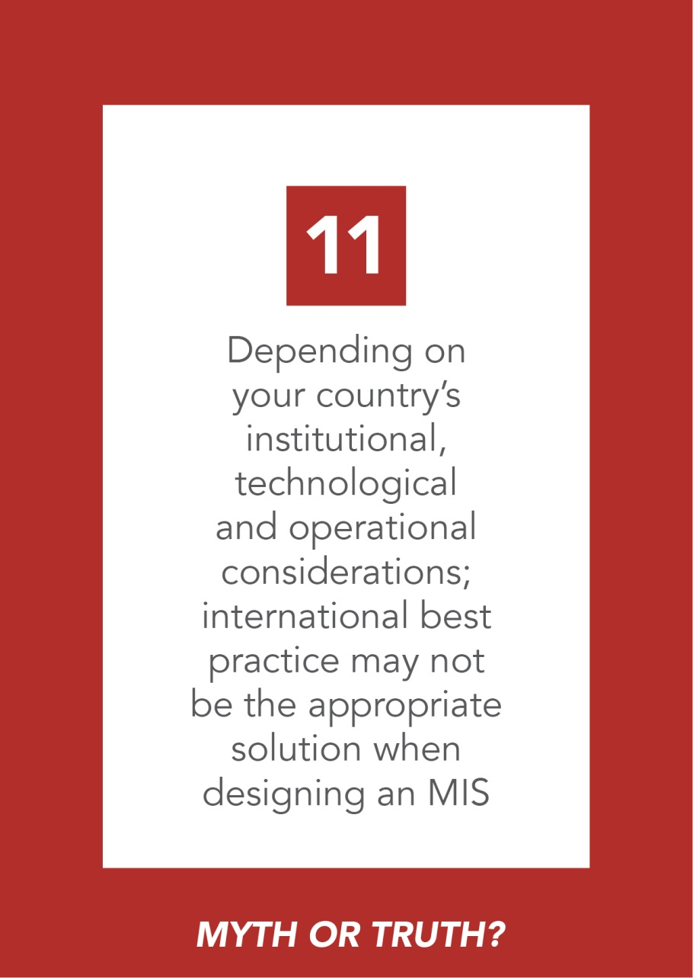
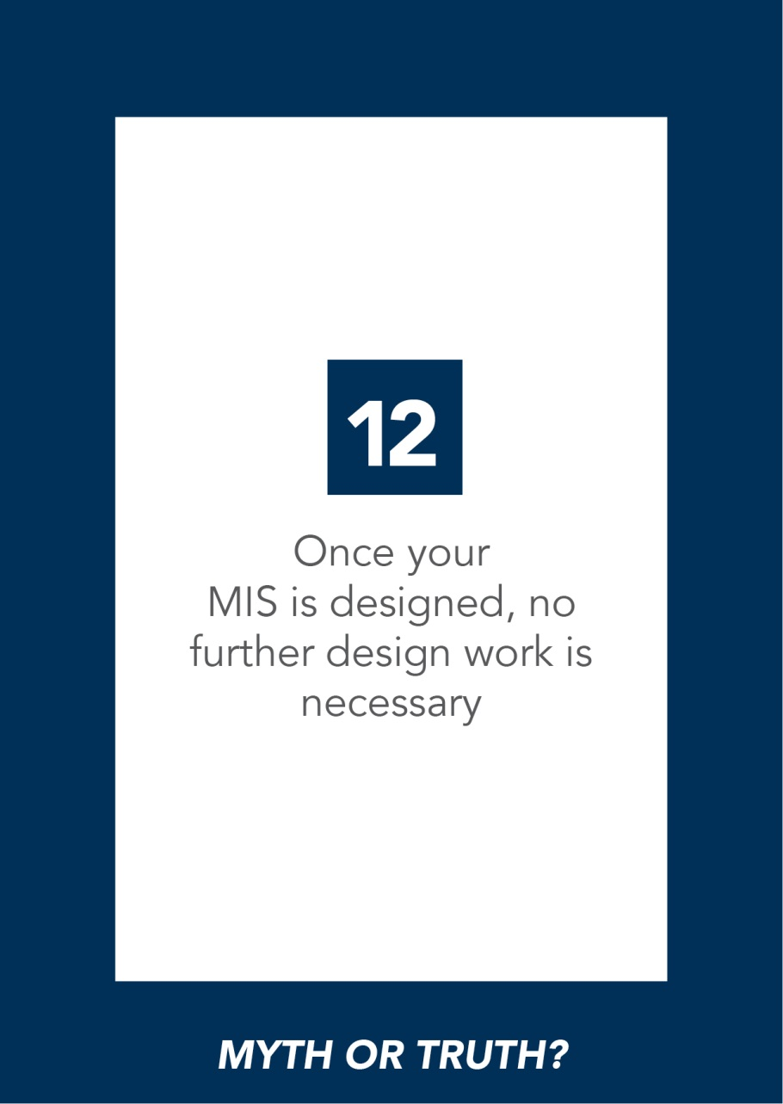
Notes:
Go through the slides to establish which cards the groups agreed (i.e. truth) with and which ones the groups thought were a myth. Use Cheat Sheet to guide answers

Slide 26
Integrated data and information management
for SP

Slide 27
An Integrated System for Information Management refers to the broader system that enables the flow and management of information within the Social Protection sector and sometimes beyond. Involves:
Integration of the underlying data repository, which can be achieved in 3 main ways:
  Integrated Beneficiary Registry
  Social Registry
  Virtual Social Registry
Integrating the wider information flow/use (through tailored application software, which we can call integrated MIS)
Notes:
Explain slide as it is written above, explaining when we think about integration we have to think about:
integrating the data itself into some form of an integrated repository (‘registry’) – we will look at this below
Integrating the wider information management flow and use (through the application software… which we can call ‘integrated MIS’ for ease of understanding
Same concepts as at programme level (database plus MIS)!

Slide 28
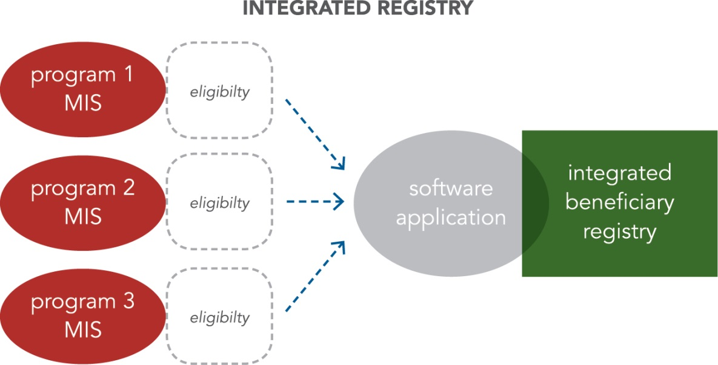
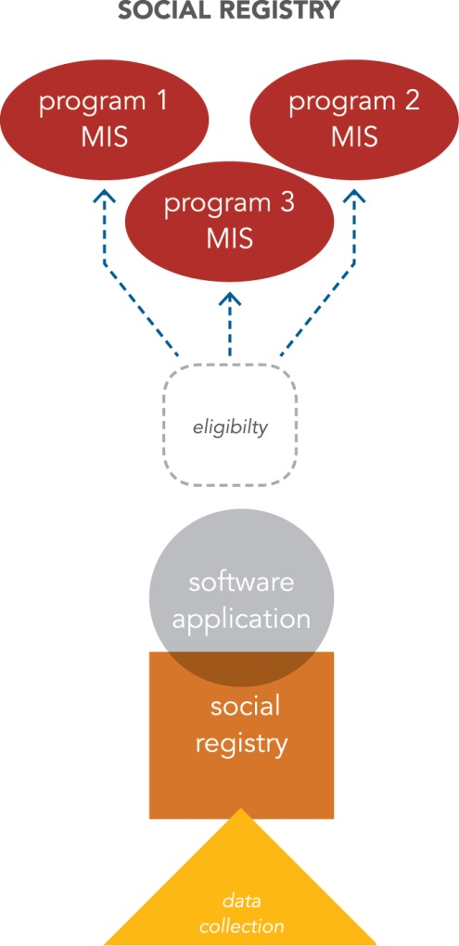
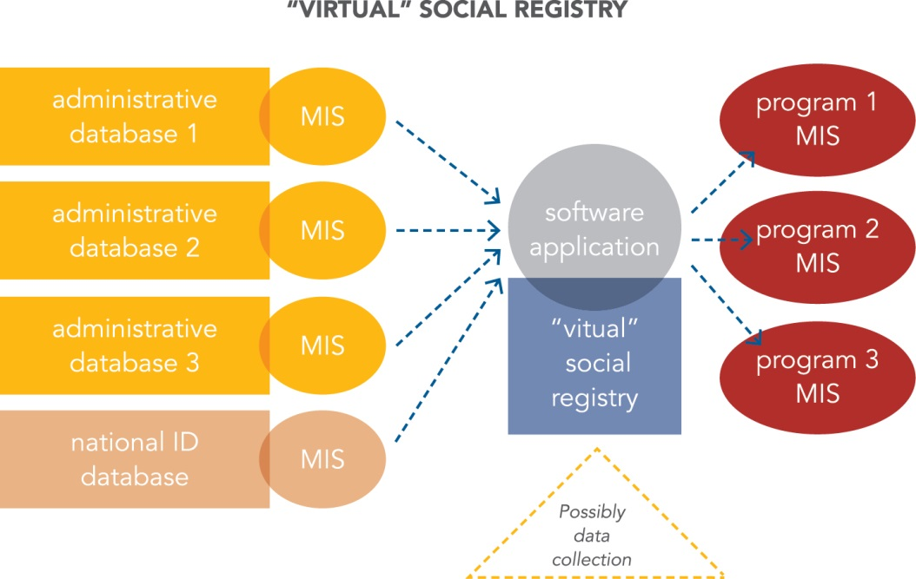
3 Key approaches to developing an integrated data repository
Notes:
Please note that these diagrams (also in your base and summary docs) represent the most basic formulations, what can actually be achieved depends on what you set out to do with it and how you design that integrated MIS. For example we have represented all uni-directional data flows!
Let’s first take a look at the Integrated Beneficiary Registry.
If we relate it to our office manager example, this is what it would look like.

Slide 29
Integrated Beneficiary Registry
Office Manager Superior = Integrated MIS
Office Manager Superior’s filing cabinet = Integrated Beneficiary Registry
Notes:
The Integrated Beneficiary Registry
Multiple office managers all retrieving information from different filing cabinets (SP program databases), then giving that information to Office Manager Superior who sorts the information, takes out what’s not relevant, ensures consistency and then places the information on all beneficiaries across programs in his own filing cabinet = The Integrated Beneficiary Registry
Where is the data flowing from? i.e. where is it originally being collected.
Answer for integrated registry: From the programs to the registry
2) Where is it flowing to and between?
Answer for an Integrated registry: to whomever needs it (very often in basic form just one way data flow)
Further steps can then be taken by the Office Manager Superior to link and verify data from the Integrated Beneficiary Registry with other national databases, most importantly the population ID database or civil registry (for authentication)… this has been done in Kenya.
It could similarly link to existing social security databases to give an overview of beneficiaries across contributory and non contributory social protection. In some cases, the Office Manager Superior may also decide to use the Integrated Beneficiary Registry as a tool to integrate selected processes across programs… most usefully payments and grievances.

Slide 30


An Integrated
Beneficiary
Registry
What?
Why?
How?
Created by integrating Program MISs of several existing schemes.
To enable a good overview of who is receiving what across programs (avoid double dipping and fraud), comprehensive M&E and some scope for improved planning
They decentralise the collection of data but centralise certain services by consolidating existing data
Notes:
However, because the Integrated Beneficiary Registry only contains data on beneficiaries (data that has already been collected by existing programmes)… it can never be used as a tool to support the determination of eligibility across programmes.. Other types of registries are designed to do this… For example… (next slide)

Slide 31



Tells us:
Who is receiving what type of social assistance?
Where is the assistance received?
When is the assistance transferred?
Integrated
Beneficiary Registry:
a Data Warehouse
MIS I
MIS II
MIS III
MIS IV
MIS V
Old
Age
Grant
Disability Benefit
Orphans and Vulnerable Children Cash Transfer
Hunger
Safety Net Program
World Food Program
Notes:
EXAMPLE:
Kenya’s Registry was created as a data warehouse holding information on all the beneficiaries of the national social protection system and is continuously and automatically updated as individual program MISs update their information on beneficiaries. It acts as a single point of reference to give an overview of who is receiving what type of social assistance (and how much) and where the assistance is received and when the assistance is transferred.
It is now evolving…

Slide 32
Social Registry
Does own research to populate
his social registry
Office Manager Superior
SOCIAL REGISTRY
PROGRAM
MISs
PROGRAM DATABASES
Notes:
Let’s look at what a Social Registry looks like in terms of our office analogy:
The office manager superior sets off to research and write up his/her own documents to populate his/her filing cabinet (The Social Registry). He/ she then orders all the documents based on criteria he/she has developed (determining eligibility) and shares selected contents with his/ her office managers (program MIS) so that they can populate their filing cabinets (program databases)

Slide 33
The Social Registry
is specifically designed to enable countries to determine eligibility for Social protection
Notes:
The key difference between the integrated beneficiary registry and the social registry is that the data flow goes in the opposite direction.
In a basic integrated beneficiary registry the flow of information is from programme databases to the centralised registry and in a basic social registry the flow of information is from the central registry to programme databases

Slide 34
A Social Registry
A database which collects and houses comprehensive (i.e. not program specific) information on potential beneficiaries in the country.
What?
Its primary function is to serve as a gateway to determine eligibility for enrolment in selected social programs.
Why?
Centralised approach to data collection (either on demand or census survey) and sometimes centralised determination of individual/household poverty levels
How?
Notes:
Social registries also have their limitations! If they do not ensure a data flow back from the various programme MISs they do not enable an overview of who receives what! No tools for M&E and planning!

Slide 35
Virtual Social Registry
DATABASES
FROM OTHER ORGANISATIONS
VIRTUAL SOCIAL REGISTRY
PROGRAM
MIS
PROGRAM
DATABASES
Notes:
The virtual social registry is a variant to the social registry.. Where data is primarily (and sometimes entirely) sourced from existing government databases.. In our analogy..
The Office Manager superior requests documents from other organisations’ filing cabinets. He/ she assesses whether that information is sufficient for his / her purposes and will do additional research if not 9additional data collection). This information goes into the superior office manager’s filing cabinet = The Virtual Social Registry. The superior office manager orders the docs based on criteria that he/she has developed (determining eligibility) and then shares selected contents with his/her subordinate office managers (program MIS) so they can use them to populate their own filing cabinets (program databases).

Slide 36
Virtual Social Registry
A registry (which is not necessarily physical) created by interoperability of exiting databases through web service access
What?
Why?
How?
When linked to a National ID and / or Civil registry, this approach can ensure a comprehensive (100% population) cross sector and ‘pro active’ (link to life cycle events) overview of a country’s population.
These registries can maintain a ‘federated’ data structure (i.e. data interrogated when needed, not stored in one place). For targeted eligibility determination they require additional data collection.
Notes:
Requires E-governance context, higher levels of formality… and very high capacity! Also, need for a national ID system..
Administrative databases that may be linked include tax authority database (to aid with means test), land cadastre etc

Slide 37



VIRTUAL REGISTRY: National Health
Insurance Registry
Private Employees: SOCIAL SECURITY SCHEME
EXISTING SOCIAL INSURANCE
Civil servants:
MEDICAL BENEFIT SCHEME
INTEGRATED MIS
NATIONAL
POPULATION DATABASE
Notes:
EXAMPLE: This slide illustrates: Thailand’s National Health Insurance Registry: A virtual social registry
Thailand’s national health insurance beneficiary registry facilitates access to health care for all.
Launched in 2001, the Universal Coverage Scheme (UCS) covers the 76% of the population who are not covered by existing social health protection schemes. UCS beneficiaries are identified by extracting data from the national population database maintained by the Ministry of Interior and – using the country’s 13 digit National ID number as a unique ID – removing individuals who already benefit from other schemes. The National Health Security Office was created and designated to compile and maintain the resulting registry.
Beyond helping to verify eligibility, the national ID number is also used by health care providers to track delivered services, settle claims and build a shared medical record for each patient.

Slide 38



Video’s showcasing examples of integration
http://bdt.tnp2k.go.id/
https://www.youtube.com/watch?v=S0dKtkpoL74&feature=youtube
https://www.youtube.com/watch?v=7ljnTFRi98w&feature=youtube
Indonesia’s
Social Registry
Kenya
Turkey

Slide 39
3 Key approaches to developing an integrated system for information management
Notes:
Taking a step back from these three approaches to creating a registry…
These 3 approaches to integrating information in the Social Protection System are not mutually exclusive and will evolve over time. For example, a country consolidating information from existing programs using an Integrated Beneficiary Registry approach may decide to coordinate data collection activities and move towards a social registry approach. This approach may increase its level of interoperability with other government databases through its integrated MIS and take on features of a virtual registry as has been the case in Chile, where the majority of data for the ‘Registro Social de Hogares’ is now sourced through existing administrative databases. Similarly, over time, social registries may start requesting data back from the programmes they serve to get an overview of beneficiaries across programmes and integrated M&E. These add-ons and evolutions all need to be designed into the integrated MIS application software…
Some form of integration can be achieved within all of the 3 approaches i.e. one is not necessarily better than the other – it all depends on your country’s needs and context…. And how the registry and its integrated MIS are set up in practice… and used.
However… Coverage of population and type of functionality achievable will vary quite highly across the approaches… FOR EXAMPLE (next slide)

Slide 40
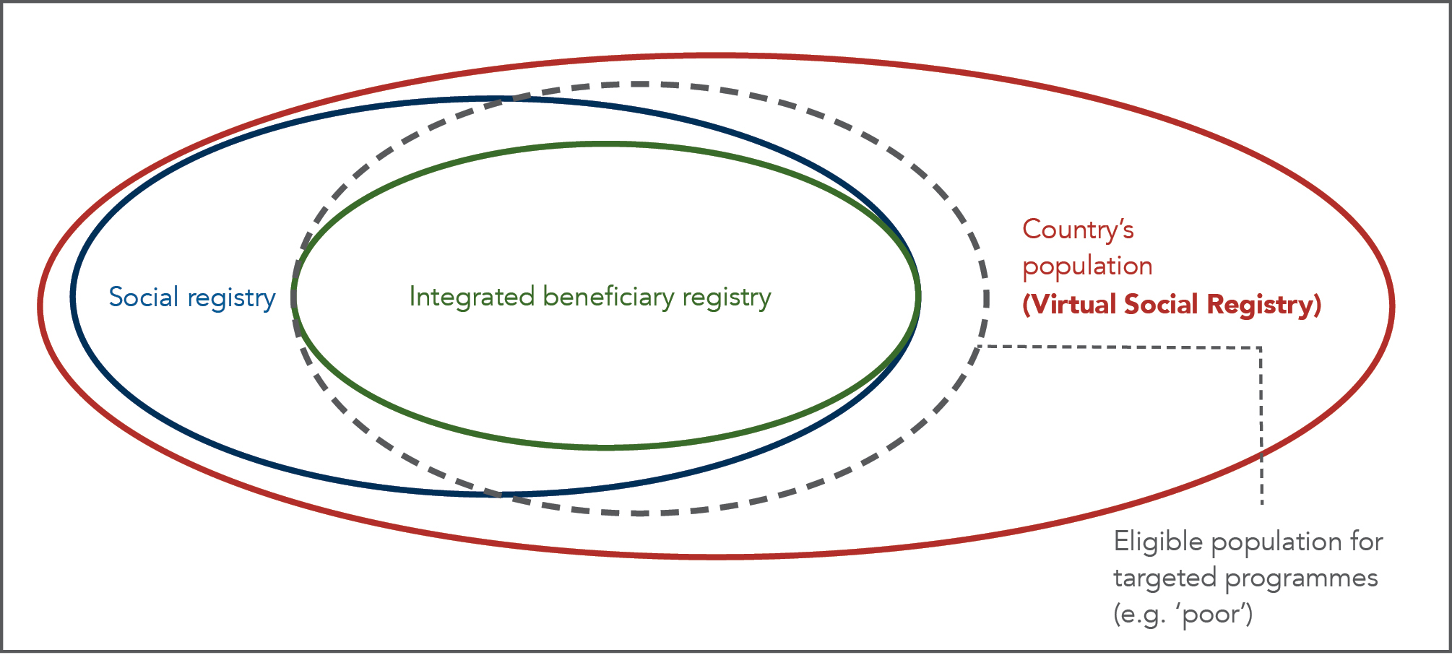
How comprehensively social, integrated and
virtual registries cover a country’s population
Notes:
Explain:
The dotted grey line = the country’s population who is eligible for social assistance based on the targeting criteria of any of the existing programs
The red circle is a country’s whole population (rich and poor). Any virtual registry could potentially reach 100% of this population by linking to a country’s national ID or civil service registry
The blue circle: If census surveys are 100% comprehensive then the social registry will include the whole eligible population but usually a social registry will only cover the large majority of eligible population – not all. The area that is outside the dotted line = people receiving assistance when they are actually not eligible for it.
The green circle (The integrated registry population) = the sum of all the beneficiaries of the social protection programs whose MISs have been integrated: a smaller population sub-group

Slide 41
Some Questions About Integrated Registries

Slide 42
If a country only registers 40% of it’s population, what might be the implications of this?
Integrated Beneficiary Registries only have data on registered beneficiaries. What are the implications of this?
If the Virtual Social Registries are purely based on existing data, what are their limitations?
Notes:
Answers:
1) If a country only registers 40% of it’s population, what might be the implications of this?
Less easy to guarantee integrated targeting across programmes and inclusive programmes that reach all of those in need.. also less potential for data to be used for shock-response.
2) Integrated Beneficiary Registries only have data on registered beneficiaries. What are the implications of this?
Not possible to use registry for integrated targeting (you only have data on who already receives, not potential beneficiaries);
B) cost implications: data on non-beneficiaries today could be data on beneficiaries tomorrow which we would have to re-collect;
C) no data source for horizontal shock response (disasters do not strike only those who have been assessed as ‘poor’ or ‘eligible’ by existing programmes)
3) If the Virtual Social Registries are purely based on existing data, what are their limitations?
They will only contain light-touch information (name, age, address – potentially land ownership and a few more variables) so the data cannot be used for ‘poverty targeting’ (more data would have to be collected). It can be used for universal categorical programmes.

Slide 43
What’s working well and what’s not?
Notes:
As we have discussed, this curriculum is called Transform and one of the key pieces to transformation is that we start to look at the beliefs we hold around certain issues. The beliefs we hold on something depend so much on our context and past experience that most beliefs can be argued from two perspectives i.e. there’s not necessarily a wrong or a right. What’s important is that we check in with our beliefs so that we can ascertain if our beliefs are still valid. This checking in is key to transformation. And so we are going to do an activity now that enables us to check in with our beliefs.

Slide 44
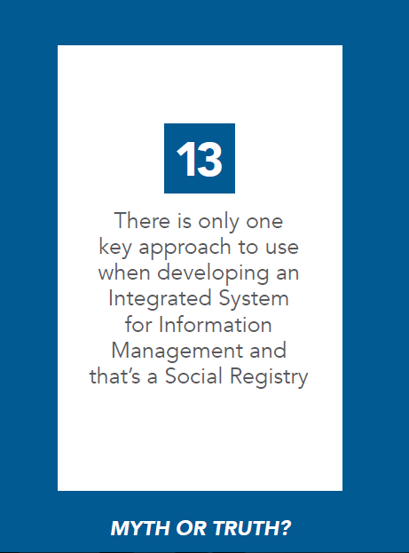
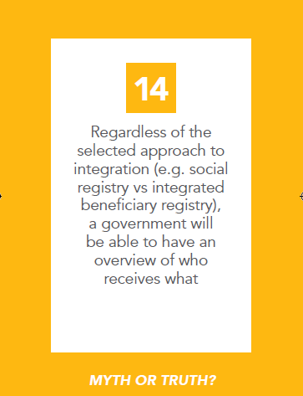

Slide 45
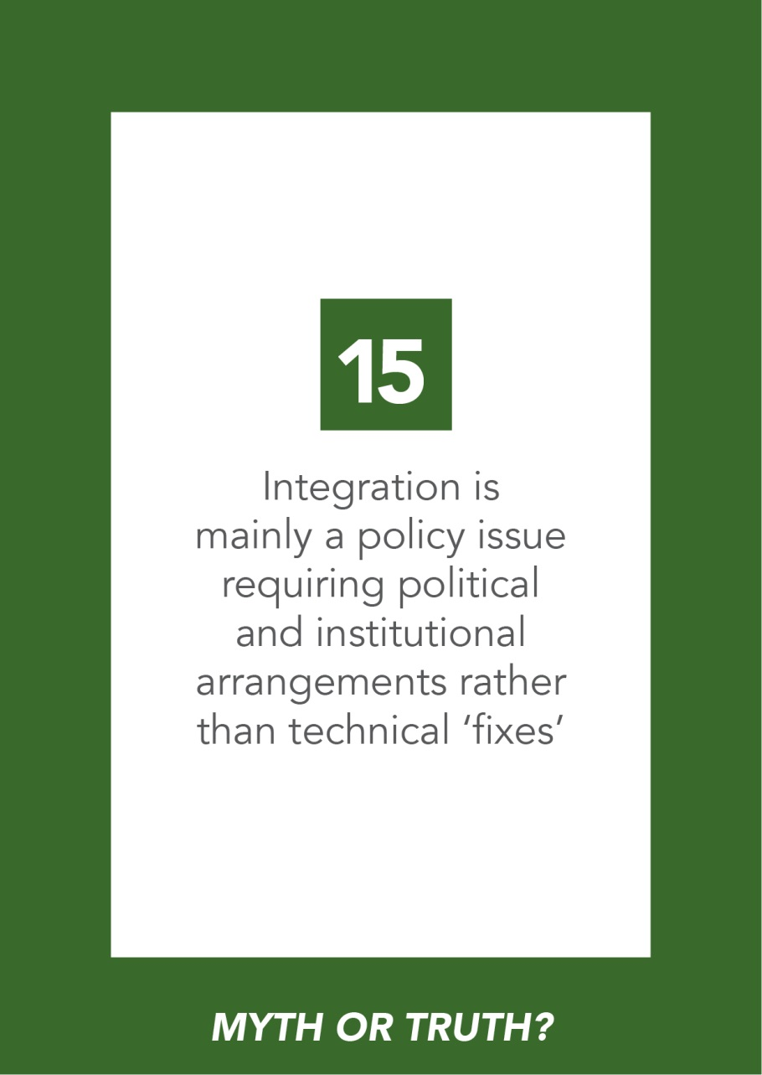
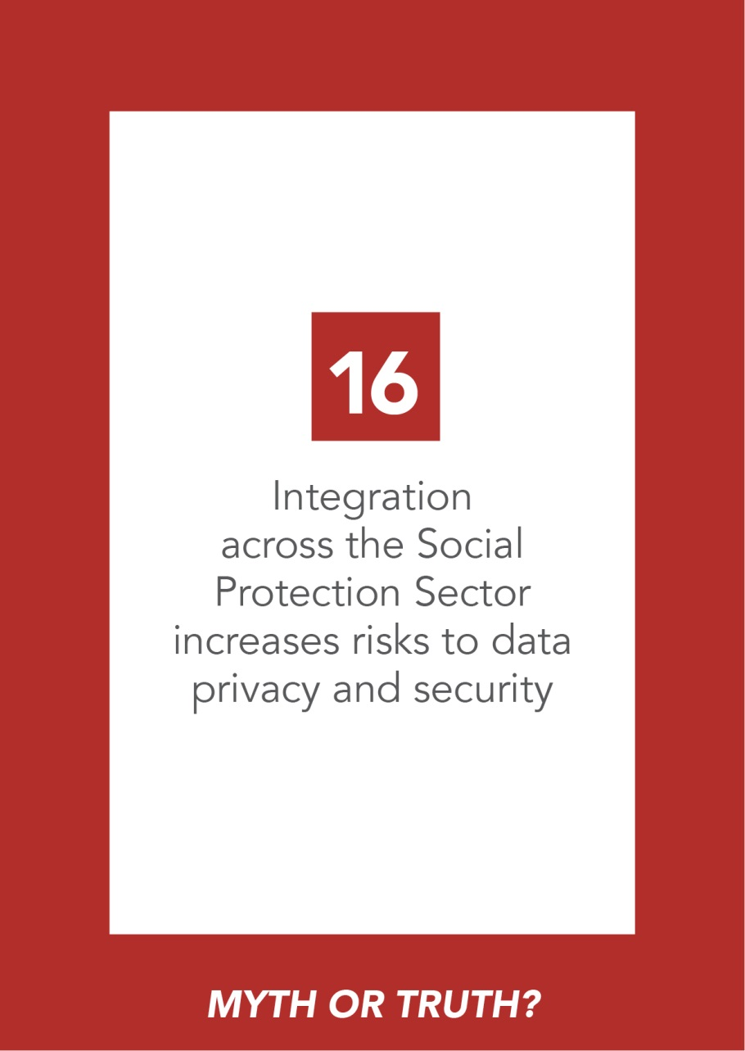

Slide 46
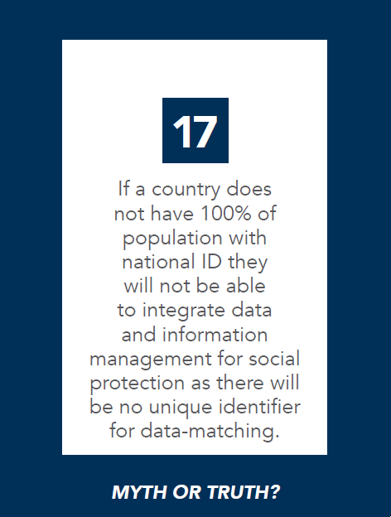
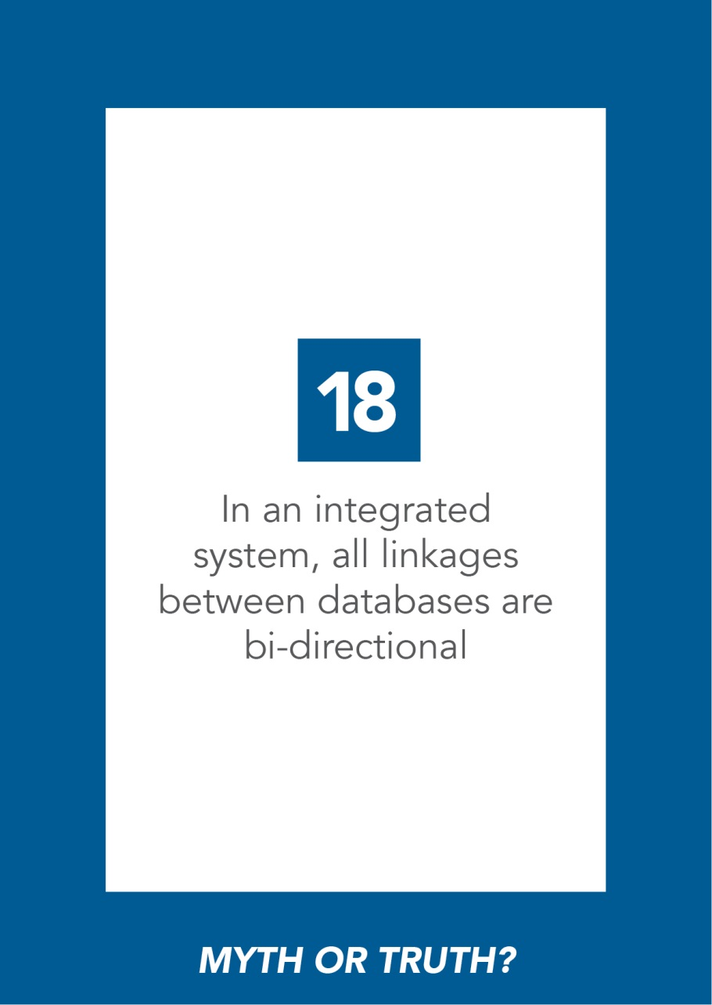

Slide 47
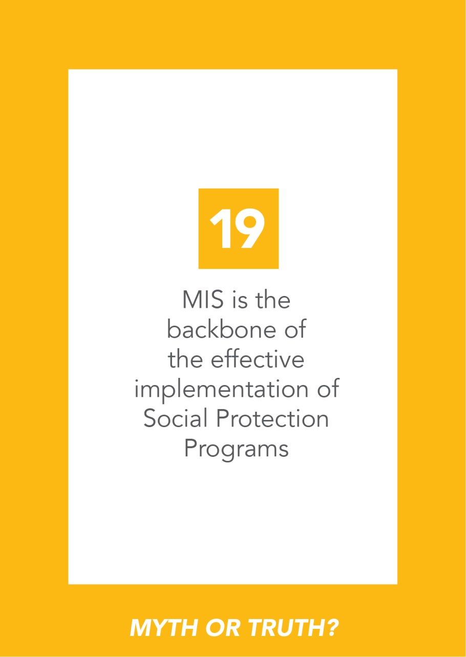
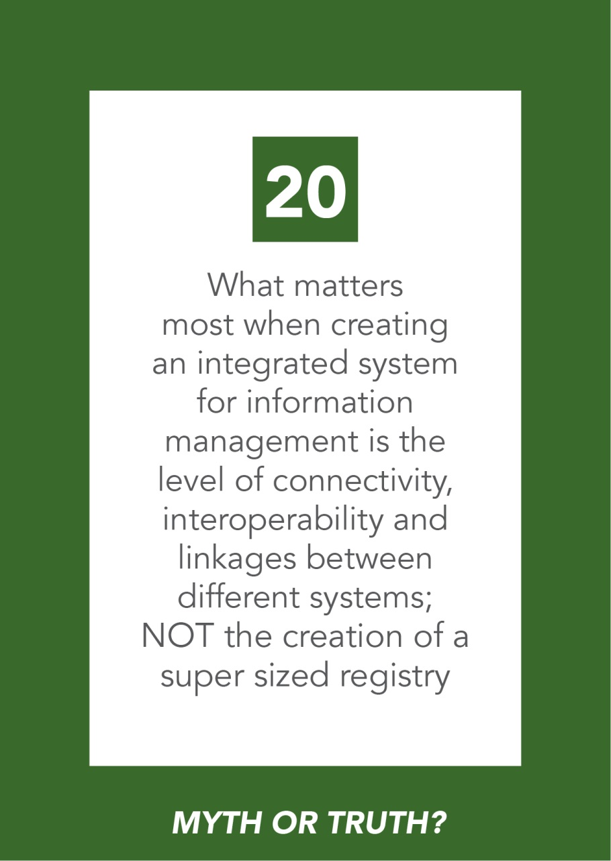

Slide 48
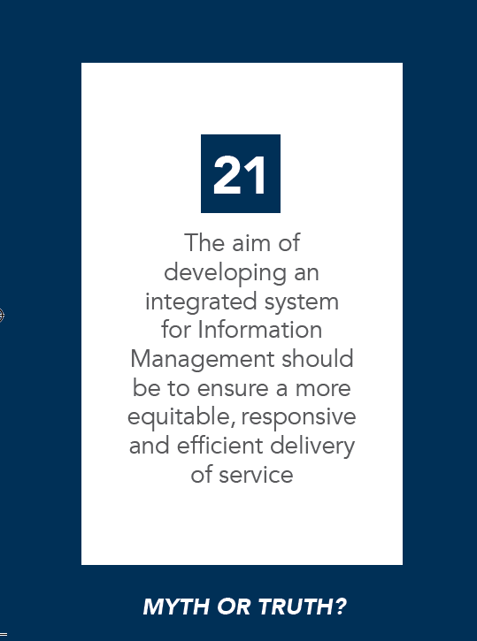
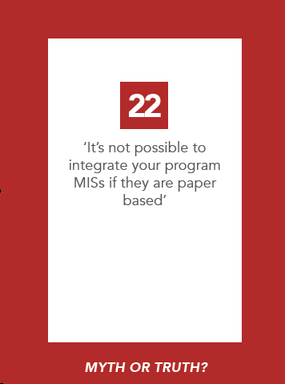

Slide 49
integrated data and information management
for SP (Lecture Part 2)

Slide 50



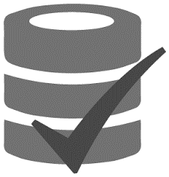
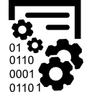



We have been talking about the ‘data repository’… and variations affect outcomes!
What % of population is covered
How data is collected and updated
Whose data is collected and stored
What data is being collected and stored
What other data sources are being used
How data is validated and stored
Who is responsible for data collection, storage and management
Level of data security/privacy guaranteed
Notes:
Briefly discuss how each variation affects outcomes
Coverage varies widely… depending on approach to data collection and policy choices, and affects:
· potential for targeting multiple programmes;
· potential for shock-responsiveness;
· potential for policy analytics (including planning and costing);
· use-cases for other sectors
How data is collected/updated happens in three key ways (on demand, census survey, data integration..) see base doc, affecting:
· inclusion errors;
· ease of access for applicants;
· data quality;
· up-to-dateness and usability of data
· fairness
Whose data: E.g. individual vs household level data, beneficiary vs non-beneficiary data, citizen vs non citizen, data on the ‘poor’ and ‘vulnerable’ or specific age groups (e.g. for a social pension) vs wider sub-sections of population
What data is being collected and stored. E.g. extensive dataset on household socio-economic condition vs limited dataset with key descriptors, operationally relevant data collected at enrolment (e.g. bank account) vs basic data for eligibility determination, biometric information or not, etc
What other data sources (e.g. databases) are being integrated. E.g. linked to other administrative databases for data sourcing/verification/deduplication using unique identifier (National ID or other) vs not
How data is validated, stored and managed. What procedures are in place to guarantee data validity, integrity and usability, affecting trustworthiness. This includes the type of data access granted to different stakeholders (e.g. national vs local level implementers)
Who is responsible for data collection, storage and management.
Level of data security/privacy guaranteed. Depends on existing legislation and provisions, including adherence to international standards.
All these –will affect what you can do with it!

Slide 51



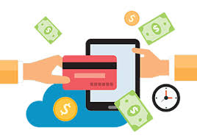

…the same applies to the ‘software application’!
Interoperability.. (with what?)
Data sharing agreements and protocols, especially with local level
Focus on ‘ranking’ or ‘classifying’ households
Focus on integrated programme management
Focus on M&E, planning, reporting, etc
Notes:
Same applies to the way in which the software application is designed and operayionalised…

Slide 52


All Social assistance
program MISs and
related databases
Social Insurance MISs and related databases
Needs provision for data security & privacy
Where possible data flow should be two-way.. And enabling access for key users!
Set up for full integration
(ideally using unique ID!)
Any other relevant government MISs and related databases
Notes:
Remember we said it was not just about the registry?.. The mythbuster activity may have also helped to stress that what really matters is how you set up the data flow and how that data is used, beyond your original set up for the ‘registry’ (data repository)
A system that guarantees full integration within the Social Protection sector and beyond, in accordance with the right to privacy, would establish a direct (e.g. web service) link to:
1) Social assistance program MISs: Why?
To keep track of who is receiving what
Potentially integrate selected services
Enable adequate M&E and planning
2) Social insurance MISs – Why?
To integrate social assistance and social insurance
To ensure as life cycle and comprehensive approach to Social Protection
3) Any other relevant government MISs and related database. Why?
To collect and cross-check data,
To enhance accountability
To enable a comprehensive approach to social policy planning
The backbone for such integration is ideally a unique national ID number… but often not the case (sometimes simply a data matching algorithm as in Brazil!)
Moreover.. Where possible data flow should be two-way.. And enabling access for key users!
Of course.. Such integration can only really take place in the context of sufficient provisions for data privacy and security.. I warmly invite you to read your summary document section on that!

Slide 53
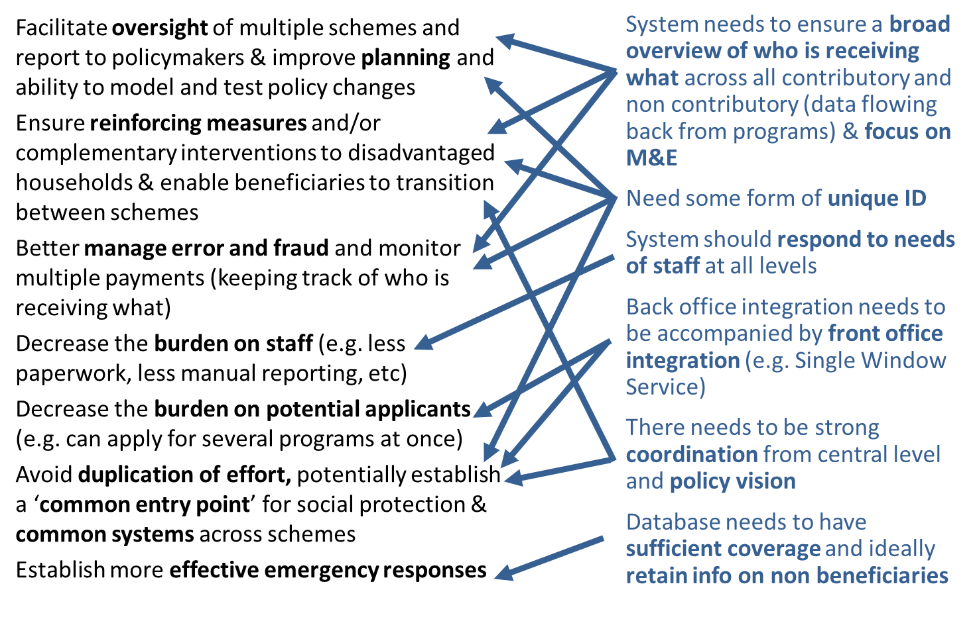

Operational advantages
Notes:
..and in the background what I ask you to always do is..
Break down potential advantages of data and information integration in the social protection sector to understand what needs to be set in place in order to achieve those advantages…
For example.. if I want to facilitate oversight of multiple schemes.. (first row)… what do I need to ensure? Get plenary to give their opinions… then gather thoughts on a few more… objective is not to go through each and every link but to get a sense that quite a bit of thinking needs to go into getting the right set-up…

Slide 54
Operational advantages
Notes:
Discuss some of these linkages..

Slide 55
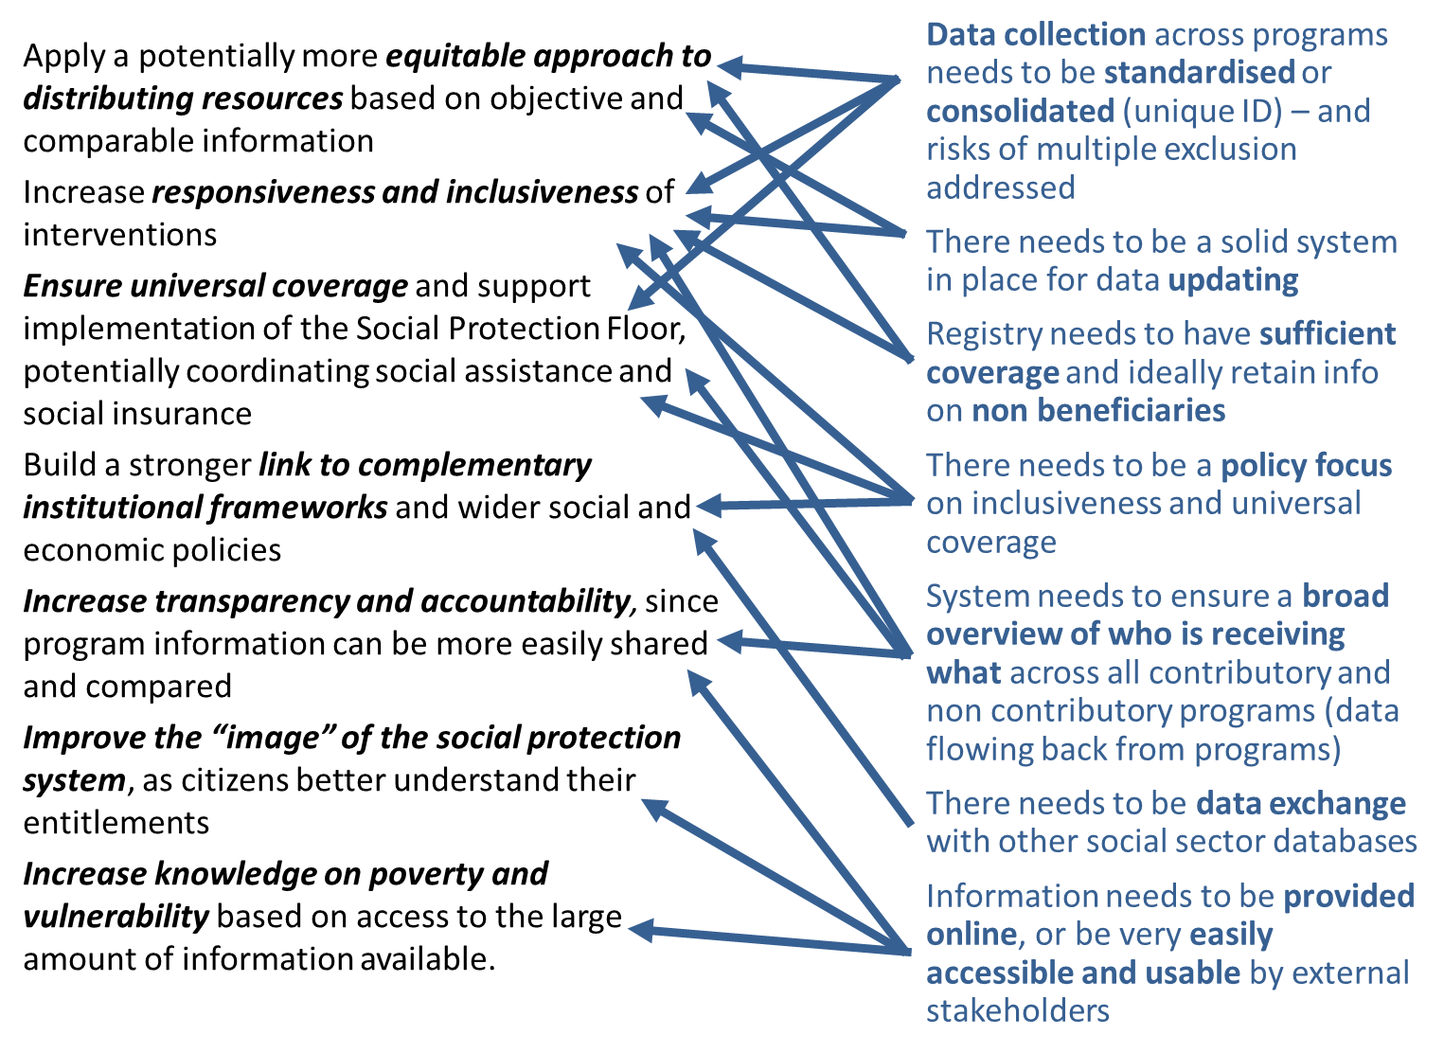
Policy level advantages
Notes:
What about from a Policy Level?

Slide 56
Policy level advantages
Notes:
Discuss some of these linkages..

Slide 57
Key Points to remember:
Potentially, the greater the interconnectivity, the greater are the gains in efficiency and effectiveness of service delivery.
However, the key issue is the level of co-ordination and interoperability achieved, not the creation of a super-sized system or database that serves all purposes
The most important aspects to consider when choosing your approach:
a) Does it respond to your country’s needs and ‘wish list’?
b) Is it ultimately focused on promoting social objectives?
c) Is it appropriate to its context?
d) Is it affordable and sustainable?

Slide 58

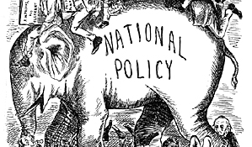
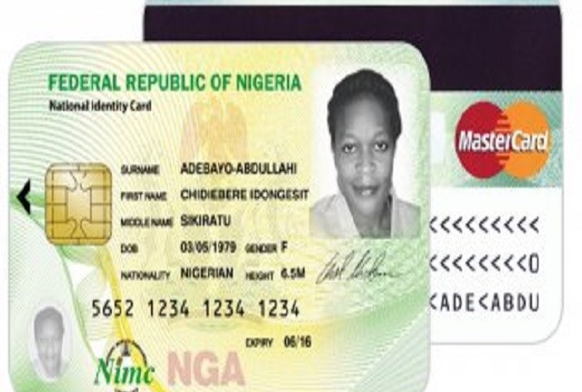




To fully integrate or not? That is the question….
Do you have a system of unique identification and if so how many people are covered by it?
Do you have budget?
Is full integration supported at National Policy level?
Do you have trained and knowledgeable staff?
Do you have strong governance and agreements between stakeholders ?
Do you have adequate hardware, software and telecomms resources?
Is there legislation to ensure data privacy?
Will the data be stored in your country?
Notes:
When considering full integration, there are a number of things to consider that will inform your decision. These are:
Do you have allocated budget for full integration?
Is full integration supported at a National Policy level?
Do you have a solid system for a unique ID for social protection?
Do you have strong governance and contractual agreements between stakeholders and other governing bodies?
Do you have trained and knowledgeable staff?
Do you have adequate hardware, software and telecommunications resources?
Is there legislation to ensure privacy and security of data?

Slide 59
Key take outs for MIS
Analogy for full integration
What do you know now that you did not know before?
What shift in your thinking did you experience?
What would you do differently now?
Notes:
Invite participants to contribute their major AHA moments, resulting in SP learning take-aways, insights and mind shifts on the topic of MIS – create one flip chart with the title MIS to record all the contributions
Use the following three questions to elicit participant contributions:
What do you know now that you did not know before?
What shift in your thinking did you experience?
What would you do differently now?

Slide 60
DAY 4 – Afternoon Session
SP FINANCE

Slide 61
Sceptics And Believers

Slide 62

“Social protection is not only an expenditure but also an investment. The Finance Ministry should therefore increase their budget for redistribution”
Notes:
Take turns to debate the statement above
Appoint a notetaker and facilitator in your group
Divide flip chart in a Sceptics and a Believers column
4 rounds of 6 minutes each (Sceptics-Believers-Sceptics-Believers)
See Activity Guide

Slide 63

You have been saying:
“LACK OF RESOURCES!”
Notes:
Refer to day 1 exercises forces driving against…

Slide 64
What should we be looking at?
Total expenditure | Benefit expenditure + administrative costs + other expenditure
Benefit | Transfer (in kind and cash) provided to an individual or household on the basis of an entitlement or need
Administrative costs | Any management and administrative expenditure incurred by the scheme directly responsible for the provision of social protection benefits such as salaries or the costs of running an office
Other expenditure | All miscellaneous expenditure incurred by social protection schemes such as interest on loans, taxes on income, and others not recorded elsewhere
Total revenue | General government contributions (including earmarked taxes and general revenue) and donor budget support
General government contribution | Contribution by the government to finance the cost of goods and services provided by the government to protected persons in the form of means tested or universal benefits
Earmarked taxes | This is a sub category of the above. They are levies and specially designated taxes raised to finance specific benefits
Donor budget support or grant | In countries where this is an important part of either benefit or administrative support
Other receipts | Interests or income from deposits, insurance claims, and other revenue not classified elsewhere
What should we be looking at?
Notes:
Income and expenditure statements of any social protection scheme should include the following items (excluding social security contributory elements):
We need to be measuring total expenditure vs total revenue!

Slide 65
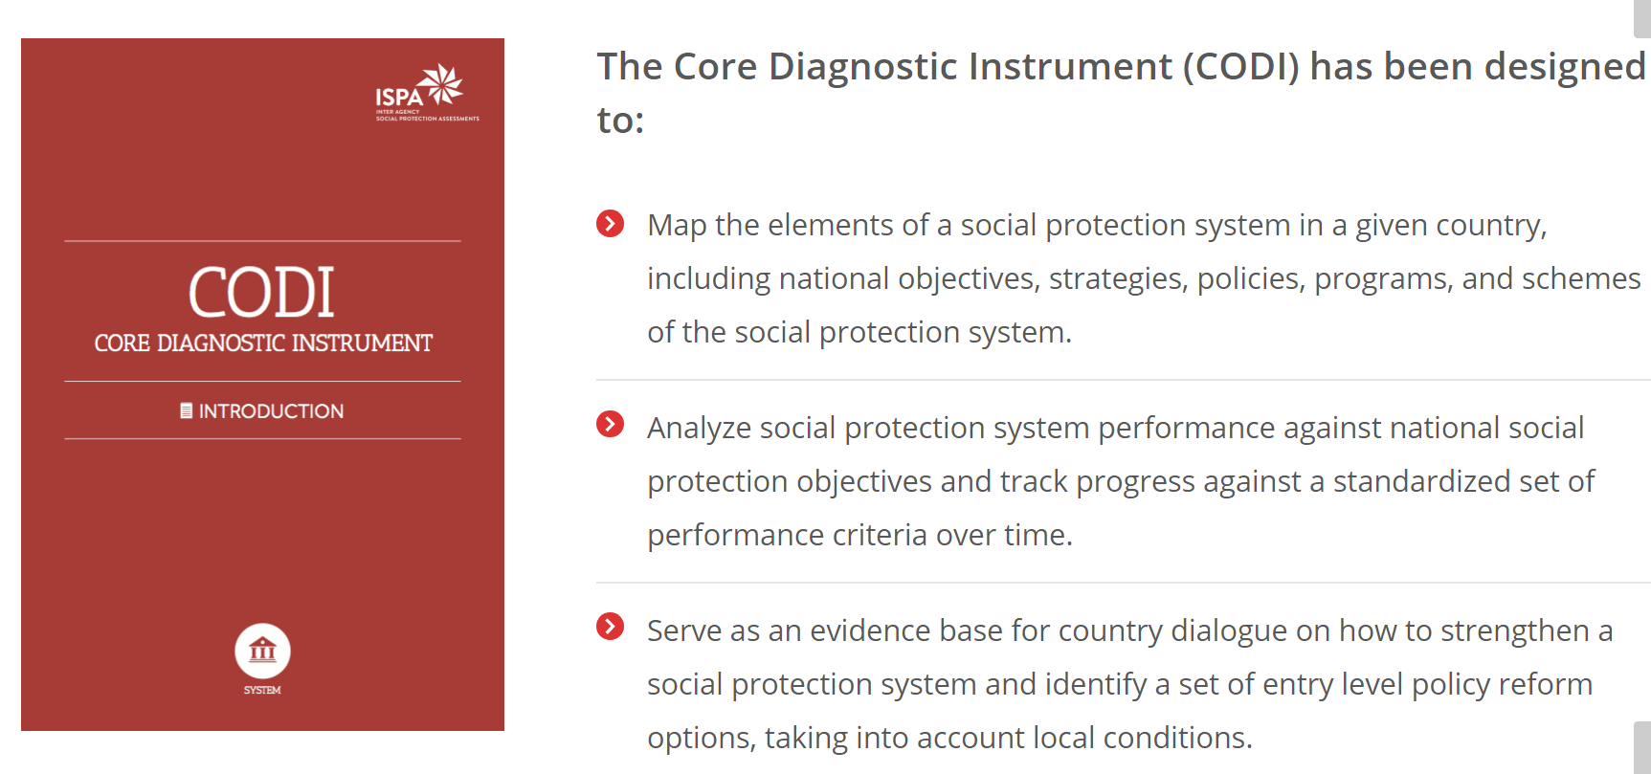
Useful tool!
http://ispatools.org/core-diagnostic-instrument/
Notes:
A useful tool to help you map this may be the Core Diagnostic Instrument developed by a group of international organizations and development agencies for the Inter-Agency Social Protection Assessment (ISPA) tools. http://ispatools.org/core-diagnostic-instrument/.
Assessing coverage, gaps and impacts of social protection/security programmes and their overall system requires, in addition to information from administrative sources, information collected through household surveys (e.g. income and expenditure/household budget surveys and labour force Surveys) including questions on the coverage of contributory and non-contributory programmes, information on recipients of specific existing benefits and programmes; nature of the benefits, periodicity and amounts/values of benefits.

Slide 66
How much do countries spend on SP?
Simple mean of GDP allocated to SP:
On average, 11%.
Weighted by population:
8.4 per cent of the GDP.
In SSA?
1.7% of GDP on average to non- contributory
Notes:
Reflect on these stats.. And how spending is much lower in SSA…

Slide 67
What should we be looking at?
Notes:
(non contributory spending in SSA!) Ask them to guess where they are and who is at the top and why? Try and guess!

Slide 68
What should we be looking at?
Notes:
Where are you? Did you guess right? What does this figure tell us?
At the top of the lists – in addition to countries with large size public works or similar programmes like Sierra Leone and Burundi - one can see countries with larger scale universal or quasi universal cash transfers – Lesotho, South Africa, Mauritius and Namibia.
There is certainly a correlation between the size of overall government expenditure in a country and the size of its social protection expenditure (both measured as a percentage of its GDP). The link works both ways: on the one hand a certain minimum fiscal space is needed to finance social protection programmes; on the other, the expansion of social protection creates further incentives to raise more resources. However, it is also clear that countries with a similar size of government resources (“small” or “big”) may take very different decisions as to the share of these resources allocated to social protection.
The size of social protection investment (and, it follows, the extent and level of coverage of the population of the country by social protection) depends to a significant extent on the prevailing political and social will (of the governments, of the taxpayers, of the electorate).

Slide 69
What does this depend on?
Investment in SP (and therefore coverage etc) primarily depends on prevailing political and social will
Policy space,
not fiscal space
Notes:
Go to next slide for Chinese proverb related to this.

Slide 70

“The sound of one tree crashing is much louder than the sound of a whole forest growing”
Notes:
Chinese proverb: the sound of one tree dying and crashing is much louder than the sound of a whole forest growing… the risk is that forces against social protection just focus on that one tree crashing (e.g. one person misusing their benefit versus thousands thriving)

Slide 71

How to fight this?
Reform coalition building (NGO, think tanks, legal, media, etc)
e.g. South Africa
Notes:
A Reform Coalition (formal or informal) is a political mechanism and process utilized and formed by state and non state actors, initiated by either, which enables them to work cooperatively to address specific state and collective action problems through the pursuit and implementation of a specific economic and social reform agenda, while retaining their independence from each other. At a minimum, actors in a reform coalition must have a shared perception of what the problem is that needs to be addressed, as well as the tools - within government, civil society, academia or private sector - that can be used to address it. While all actors must have incentives to work with each other in coalition, the nature of these incentives are likely to differ greatly between stakeholders. Reform coalitions often include top officials in the state; they are often initiated in circumstances of sudden and contingent crisis, threat or even opportunity (‘critical junctures’). They involve production and sharing of evidence, and building of trust and mutual beneficial relationships.

Slide 72
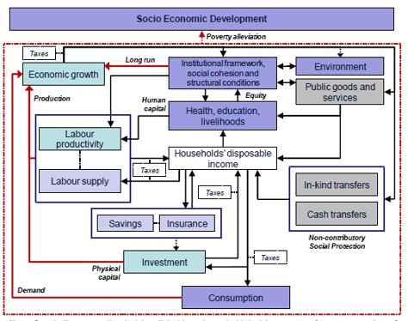
How to fight this?
View Social protection as investment
Notes:
Making an economic argument for social transfer requires an assessment of cost-effectiveness as well as cost-benefit in both the short- and long-term. Social protection is increasingly seen as “a source of resilience in tough times, as a support for growth and productivity in good times, and as a general mechanism for socioeconomic inclusion”
Three main channels through which social protection can support economic growth:
Individual level - Building and protecting human capital and other productive assets, empowering poor individuals to invest or to adopt higher return strategies.
Local economy effects - Enhancing community assets and infrastructure, positive spill-overs from beneficiaries to non-beneficiaries.
Overall economy level - Acting as stabilizers of aggregate demand, improving social cohesion and making growth-enhancing reforms more politically feasible.

Slide 73
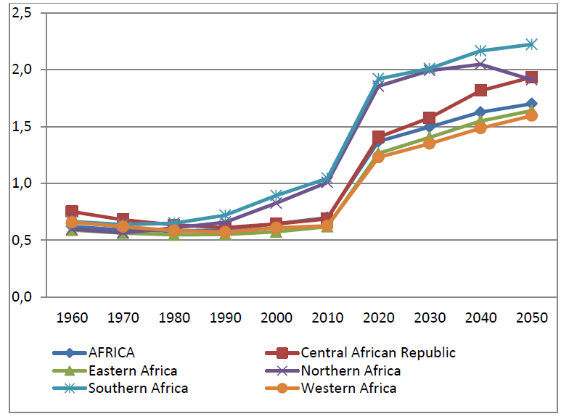
How to fight this?
Demographic trends… And dividend
Ratio of working age to non working age
Notes:
The majority of African countries have a very young population. This often implies rapidly growing school age population, a large proportion of young adults in the working-age population (over 40 percent) and high rates of workforce growth.
But the number of children a woman is likely to have in her lifetime - the total fertility rate - is still very elevated in the continent by global standards.. And is likely to decline..
The demographic transition consists of a growing workforce relative to the total population. It results from decline of the weight of children in total population and the slow growth of elderly. If countries manage well the demographic transition, the increase in the working age population and reduced total dependency ratio provides countries with a window of opportunity, which if properly tapped can generate a “demographic dividend” in the form of higher growth and funding for social protection.

Slide 74
How to fight this?
Staggered introduction of SP
Namibia:
Age cohorts
Notes:
Another interesting option is staggered introduction of social protection.. E.g. based on age cohorts. This figure is an example from Namibia..
…starting with children aged 0–4 in 2015 and including children aged 5–10 in 2017 and children aged 11–17 in 2019. This approach is justified by the fact that support to children in their early years of life is found to be crucial to breaking inter-generational poverty transmission. Moreover, younger children are more likely to be poor. As a result of decline in fertility, the cost per GDP falls over the years. The rise in spending for a specific age cohort phases down because of the reduction of child dependency ratios over time. This allows the introduction of a second cohort in the child grant scheme over time.

Slide 75
How to fight this?
Administrative costs over time
e.g. cost to transfer ratio and admin cost per recipient.. Depends! On size, maturity, context, etc..
Notes:
While it is impossible to adequately compare cost to transfer ratios across different programmes and countries because of comparability issues, what is clear is that.. These ratios decline over time as schemes mature..

Slide 76

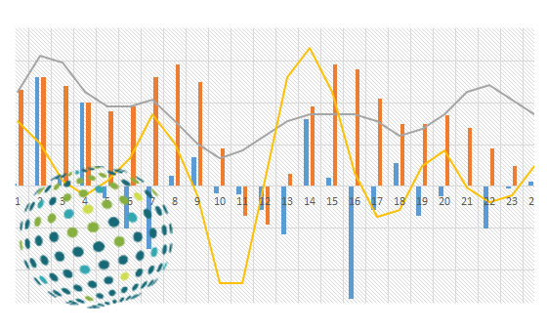
Tools for financial governance?
Social budgeting..
Microsimulations..
Notes:
Taking decisions about social protection systems today means to make more or less well informed “good guesses” about their future development with and without these decisions.
There are also many interesting tools that can help with financial governance and such decisions.. These include:
Social budgeting: Social budgeting establishes income and expenditure accounts for all existing social protection schemes in the country and then projects – using actuarial methods - those accounts into the future. But fully fledged social budgeting exercise is very demanding in terms of data requirements, as well as takes relatively long to implement.
Microsimulations (reference local ones if any eg Tazmod in Tanzania.. Namod in Namibia etc) Tax-benefit microsimulation models, which combine representative household-level data on incomes and expenditures and detailed coding of tax and benefit legislation, have proven to be an extremely useful tool for researchers and policy makers alike. The models apply user-defined tax and benefit policy rules to micro-data on individuals and households and calculate the effects of these rules on household income. The effects of different policy scenarios on poverty, inequality, and government revenues can be analysed and compared.

Slide 77
Is the pie fixed?
Revenue mobilisation
Tax revenue
Non-tax revenues (profit, fees, etc.)
Loans
Grants
Notes:
There are a number of alternative means through which countries can mobilize revenues to pay for social protection, each imposing differential burdens on different population sub-groups. Alternative expenditure patterns and levels distribute benefits unevenly throughout society, with some groups of people benefitting more than others. The particular distribution of burdens and benefits amongst various sections of a population defines a government’s fiscal policy. This uneven distribution of burdens and benefits can be designed to either financially favour or hurt the rich and poor, rural and urban, male and female, old and young…
Our last question is.. Whether the size of the pie (the ‘resource or fiscal envelope’) is actually fixed? We have been hinting over these past few days that it isn’t.. As we can be advocating for policy change that increases the size of the pie.. For this purpose we are going to be doing an exercise!

Slide 78
Triple A Activity: Expanding The Fiscal Envelope
Notes:
See next slide

Slide 79
Activity: Expanding The Fiscal Envelope
ACCEPTANCE
Will this change be ACCEPTABLE to the public and other institutions?
ACCEPTANCE
AUTHORITY:
Do you have the AUTHORITY to make this change or will you need further authorization from other institutions?
ACHIEVABLE
ABILITY
Do you have the resources / capacity etc to enABLE you to make this change?
AUTHORITY
ABILITY
Notes:
Remember we mentioned we would use the acceptance, authority and ability framework in more depth? Here is the chance! We are going to be considering various options for expanding the fiscal envelope.. And placing them on this graph based on the questions you see here..
Get participants to form 8 groups of 2-3 participants and distribute one Triple A card to each group
Now please take a moment to read p.22-23 in your Finance document before discussing where best to place your finance option card! Make sure that the delegates understand what each of the cards mean.
Explain to the delegates what each of the A’s mean. (It would be good to demonstrate with one of the cards)
To help you here is a further explanation under each of the As.
AUTHORITY: Does legislation allow to challenge the current situation?
Are institutional and administrations’ entrenched interests going to oppose to reform?
Do they have the correct incentives to support it?
Are political forces and public and private interests aligned and favourable?
Do informal norms allow reformers to do what needs to be done? Is tax authority subject to higher order pressures? Is the tax system transparent enough to ensure central authority and control? Can social partners and CSOs help?
ACCEPTANCE:
Is there acceptance of a need for change? Acceptance – Of the reform idea? Of its monetary costs? Of the social costs for affected? Of the political costs for decision makers? Can social dialogue help? Can accountability and transparency measures or communication improve accepatance? E.g. what do you think the public reaction would be if you raised taxes by 15% overnight? I doubt this would be easily accepted.
ABILITY:
Are there enough people with skills and readiness to conceptualize and implement reform? Are there sufficient information sources? Is there sufficient capacity from the administrative to supervise and ensure efficient implementation and institutionalization? Is tax administration efficient? Does learning needs to occur during the process of implementation?

Slide 80
What’s The Essence?
Notes:
See next slide

Slide 81

Activity: What’s the essence of budget programming and budget process?
Read pages 31-36 in section 3 of your Finance document on Budget programming and process, pages 31-36 (10 min.)
First summarize the essence in only 32 – 40 words. (7 min.)
Then in only16 - 20 words (3 min.)

Slide 82
Budget programming
Aspects: Budget preparation: Capital budgets, medium term expenditure frameworks, linking budgets to policy, programme and performance budgeting
Actors: Cabinet, Ministry of Finance, spending agencies, legislature
Ritualistic façade?
BUDGET
FORMULATION
(Y-1)
Aspects: Cash and commitment management, adjustments, payroll, procurement, transfers, internal control
Actors: Ministry of Finance, spending agencies
BUDGET
EXECUTION
(Y)
Aspects: Accounting, reporting, budget monitoring
Actors: Ministry of Finance, spending agencies
ACCOUNTING & REPORTING
(Y)
Aspects: Audit, legislative scrutiny, legal reform
Actors: Ministry of Finance, spending agencies, external auditor l
ACCOUNTING & REPORTING
(Y)
Notes:
To conclude.. I want you to spend one minute thinking about the actual budget process through which such decisions (e.g. changes to fiscal envelope we discussed before the break) get taken!
In theory.. This is the budget process that happens every year on a cyclical basis (quickly go through steps in slide).. Yet to some extent this is a ‘ritualistic façade’ masking the real allocation process of spending.. Which is often based on informal practices and agreements (often due to lack of transparency, lack of control and oversight and lack of an institutionalised negotiation process).
What can make it more effective is:
Citizen participation and consultation
Reforms that focus on outputs and outcomes rather than inputs.. And ideally input/output (efficiency and effectiveness).. We can call this Performance budgeting

Slide 83
Key take outs for Finance
Analogy for full integration
What do you know now that you did not know before?
What shift in your thinking did you experience?
What would you do differently now?
Notes:
Invite participants to contribute their major AHA moments, resulting in SP learning take-aways, insights and mind shifts on the topic of Finance – create one flip chart with the title Finance to record all the contributions
Use the following three questions to elicit participant contributions:
What do you know now that you did not know before?
What shift in your thinking did you experience?
What would you do differently now?

Slide 84

Closure Day 4
Analogy for full integration

