Slide 1

LEADERSHIP & TRANSFORMATION CURRICULUM:
BUILDING & MANAGING SOCIAL PROTECTION FLOORS IN AFRICA
DAY 3
Coordination / M&E and Accountability Systems

Slide 2


Leadership & Transformation Journey Check-in

Slide 3
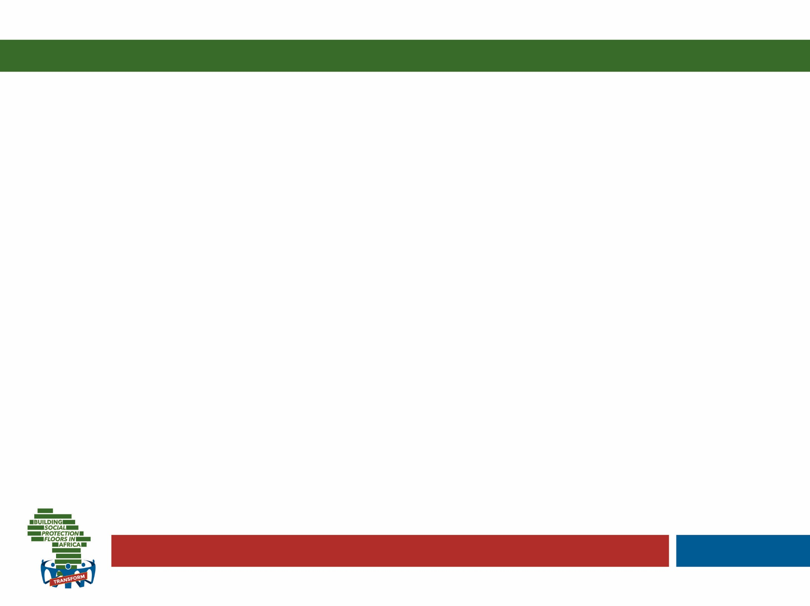

L&T Journaling
Over the past few days, what new aspects of yourself as a leader in the SP environment have you noticed? What new questions and topics have come up? (about 3 min.)
Adapted by Catherine Widrig Jenkins (IPK) from Theory U by Otto Scharmer
Notes:
Invite participants to take out their journals and spend a few moments going over the notes of the journaling done on the prior day to reconnect to where they left it off
Then talk and guide them through today’s set of questions on this and the next slides – always allowing for about as much time as indicated behind each question in brackets
Finish this activity off by allowing them to turn to the person next to them and take about 5 minutes to share a few insights relating to the journaling experience

Slide 4

L&T Journaling
Watch yourself from above (as if in a helicopter). What are you trying to achieve at this stage of your leadership journey to transform SP? (about 3 min)
Adapted by Catherine Widrig Jenkins (IPK) from Theory U by Otto Scharmer

Slide 5

L&T Journaling
Imagine you could fast-forward to the last year of work before you retire. Look back on your professional journey. What footprint in SP do you want to leave behind? What do you want to be remembered for? (about 4 min.)
Adapted by Catherine Widrig Jenkins (IPK) from Theory U by Otto Scharmer

Slide 6
SP Line-up

Slide 7

SP Line-Up Statements
Social protection programmes should primarily target the poorest households
Over 10% of SP budget should be spent on a complaints and appeals and communications
If a country has the right infrastructure, they should always adopt the most sophisticated technological administrative solution
If SP programmes want to have an impact on human capital, the best option is to impose conditionalities
Notes:
Read out one statement after the other and ask participants to take a stance on the line – collect a few voices along the line moving from one extreme to the other
Take about 5 minutes in total per question

Slide 8
SP COORDINATION

Slide 9


Ensuring policy coherence.. To avoid fragmentation
Pregnancy
& ECD
Active-Age
Adults
Disabled
Elderly
Families
Childhood
Youth
Cash Transfers (UCT or CCT)
Public Works
Disability Assistance
Social Pensions
Food Stamps/ vouchers
Birth, Child Allowances
Scholarships
In-Work Benefits
Contributory Pensions
Maternity
Benefits
School Feeding, Supplies, Transport
Care-Giver
Allowance
Housing Subsidies
Unempl.
Assistance
Disability Insurance
Survivor & Death Benefits
Nutrition Supplements
Services for At-Risk Youth
Unempl.
Insurance
Utility Subsidies
Food Stamps/vouchers
Parenting Services
Sickness & Injury
Utility Subsidies
Transport Subsidies
ECD & Nutrition
Transport Subsidies
Training & Skills
Active Aging Services
Family Services
Child Care Services
ALMP / Activation Services
Financial & Productive
Inclusion Services
Source: Adapted from Lindert
Intermediation, Counseling, Psycho-Social Support Services
Disaster
Services
Child Protective Services
Legal services
Social & Long-Term
Care Services
Notes:
Remind them how we had mentioned yesterday that many countries may have a myriad of uncoordinated programmes…or insufficient programmes to address needs.. That is where coordination comes into the picture

Slide 10

What is SP coordination?
The alignment and harmonization of all stakeholder activities (at the programme and administration level) in a coherent and holistic way to reach clearly identified and shared objectives (at the policy level) - horizontal
A vertical link is also required between the policy and the operational levels
Notes:
Discuss the differences between vertical and horizontal coordination..

Slide 11


c
Brainstorm…
What are the advantages of coordination?
And the risks?
Notes:
Plenary brainstorm.. (10 minutes)

Slide 12
…why important?
Expands access and improves equity
Helps to convey ‘big picture’ strategic issues (sustainability)
Strengthens resilience to poverty
SP coordination
Reduces costs of service delivery
Allows for pooling best of resources and skills for better results
Reduces duplication and fragmentation
Notes:
Build on brainstorm..
Why important? Build on brainstorm
Also..
Provides potentially better results for the population (e.g. universal coverage).
Helps convey the ‘big picture’ or strategic goals (e.g. sustainable development), which are not always captured by individual agencies’ or ministries’ objectives.
Helps realize synergies and maximize the cost effectiveness of policy and/or service delivery.
Generates economies of scale (e.g. sharing of infrastructure, facilities, data and information, and property, among others).
Sets a precedent for the way a government operates that can be used in other areas beyond social protection.
Improves client focus and thereby service quality and user-friendliness.
Assists with prioritization, resolution of potential conflicts, and trade-offs in decision-making.
Improves working relations with other agencies and ministries that are likely to be critical to future successes, and the achievement of cross-cutting objectives (e.g. formalization).
Contributes to the empowerment of local administrations, and therefore to the success of decentralization processes

Slide 13
…but also risks!
less clear lines of accountability for policy development and service delivery
longer decision-making processes
greater difficulty in measuring effectiveness and determining impact
direct and indirect costs of management and staff time spent establishing and sustaining joint working arrangements
consensus and "lowest common denominator" at the expense of making tougher decisions about trade-offs to get better
Notes:
Build on brainstorm..

Slide 14



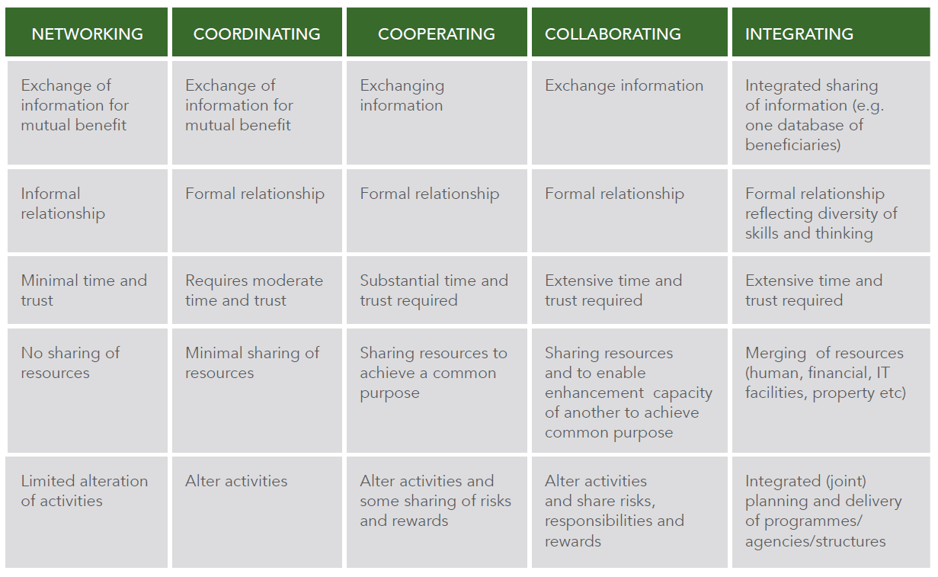
Increasing levels of trust
Increasingly sharing resources, risks and rewards
Notes:
Explain that..
Coordination can be seen as part of a continuum of relationships which require gradually increasing levels of trust and the sharing of resources, risks and rewards. The continuum may start with networking (no sharing of resources), then move to coordination (minimal sharing of resources), to cooperation (some sharing of risks and rewards), to collaboration (sharing of risks, responsibilities and rewards) and finally to integration in the form of merging programmes and structures into one. This is captured in the table below

Slide 15
System goal: prevention & alleviation of poverty, vulnerability & social exclusion
Universal access
to basic health care & income security for all
children, working age population & older persons
Horizontal coordination: Administration level
Health
Social insurance
Social assistance
Employment services
Other sectors…
Horizontal coordination: Programme level
Vertical coordination
Horizontal coordination:
Policy level
Adequate budget financed
by national resources (contributions and taxes)
Integrated National Social Protection Policy and Strategy
Notes:
Now we go into the detail! We could see coordination as a Greek temple where the pillars are the wide variety of services offered (social assistance and beyond).. the core objective represented as the ‘roof’ is universal access to basic health care and income security for all.. And the coordination elements cutting across are:
Vertical
horizontal.. At three levels: administration, programme and policy..
We will look at these coordination dimensions in turn.

Slide 16
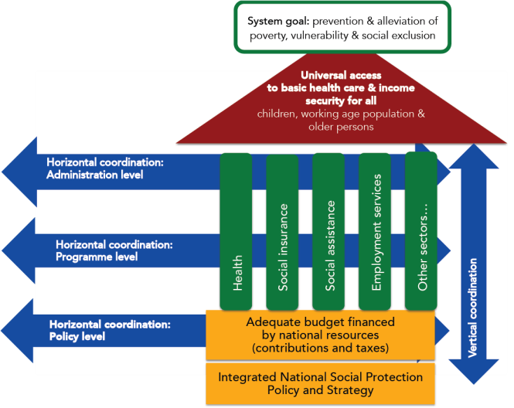
Horizontal co-ordination at policy level
Aim: Ensuring overall policy coherence across government bodies
strategic vision to improve integration and coordination
development of policies and legal frameworks
choice of programmes and mandates
mapping financial and institutional arrangements
Horizontal coordination at policy level
Notes:
Horizontal coordination at the policy level
The policy level is the highest level of engagement, where the objectives and functions of the social protection system are defined in the context of national goals and parameters.
It includes the overall strategic vision to improve integration and coordination across programmes and functions.
Policy and legal frameworks are developed to establish guiding principles to support social protection and inter-sectoral coordination.
The choices about programmes and their mandates are made at this level.
It assists in mapping out the financial and institutional arrangements that need to be put in place to facilitate coordination between different ministries and sectors.
(if there is interest go into details below)
Step 1: stakeholder analysis - An initial step in improving policy coordination is to establish who the relevant stakeholders are with regards to social protection in order to include them in the process of policy development or review.
Step 2: SP working group - To ensure that the social protection policy is developed and reviewed in an integrated and comprehensive manner, preventing the various stakeholders from working in silos, a coordinating advisory structure could be established. This could be in the form of an inter-ministerial / inter-agency team or working group to provide a platform to share information and knowledge among social protection practitioners. The creation of such a team could also strengthen the impact of policy and technical advisory services provided to governments since this guidance would be collegially discussed.
Step 3: Develop/review SP policy – Note we have already discussed the importance of a legal framework… The definition of shared priorities for the extension of social protection and the implementation of a SPF should be enshrined in a national social protection policy and strategic framework. The adoption of a national social protection policy and strategy is an efficient way to maintain priorities despite changes in the government. It also provides official support to formalize the vision of the country in terms of social protection development and its implementation path. The preparation of such a policy and strategy also forces a country to ensure the coherence of social protection development policies with other national policies, notably with respect to available funding (fiscal space allocation).

Slide 17
Horizontal co-ordination at program level
Aim: improving design of existing programmes and promoting harmonization across the portfolio of programmes.
Integration of similar SP schemes and programmes
Maximizing synergies and strengthening linkages with programmes
in different sectors.
Notes:
Horizontal coordination at the programme/institutional level – explain we have actually discussed this a lot already, for example when we were talking about selection and identification..
Aim: improving design of existing programmes and promoting harmonization across the portfolio of programmes.
When social protection programmes are aligned with poverty reduction as well as social inclusion strategies, this results in more multi-sectoral coordination which is better able to provide solutions in a more holistic and development-oriented manner.
A key element of an integrated social system is its ability to identify and maximize synergies between programmes in the social protection space and in different sectors (e.g. health, education and child protection), and thus enhance long term, human development outcomes.
Main instruments to achieve this.. Are:
Set up a social protection coordination unit/agency at national level (as programmes often implemented by different ministries/institutions)
Select the relevant programming approach suitable for the country
Develop an integrated programme plan with clear outcomes for social protection in line with the SPF and the national priorities
Ensure the needs of beneficiaries are included in the programme plan
Install a common monitoring and evaluation system for the implementation of the plan

Slide 18
Four approaches to strengthening coordination
 | Design or adapt stand-alone interventions
 | Simultaneously
 | Sequenced over time
 | Aligned and harmonising existing programmes
Notes:
But what level of harmonisation is possible between programmes? Four potential approaches..
Design or adapt standalone interventions
This is where freestanding programmes can be designed or adapted to maximise coordination between two sets of objectives. For example, agricultural programmes can be designed to incorporate social protection into their designs; and social protection interventions can be designed to be coordinated with agricultural livelihoods programmes. Discuss pros and cons based on base doc..
Combine multiple interventions into one programme (simultaneously or over time..)
Two sets of interventions can be combined into one programme so that targeted households participate in both interventions. The single programme is implemented by a single agency. Different components/programmes can be provided to the same household simultaneously (e.g. including public works and agricultural support components in a food security programme; providing access to health insurance scheme to cash transfer beneficiaries) or sequenced over time depending on what the household needs. When interventions are sequenced over time, as a household’s welfare status improves, the package of interventions could expand from social transfers to include a broader menu of complementary interventions.
Coordinate and align multiple programmes and policies
Synergies between many different social protection interventions can be established even when these interventions are not delivered in the same locations or targeted to the same beneficiaries. It could involve interventions being coordinated to reach the same households but through two independent programmes. For example, in Lesotho, agricultural livelihood and cash transfer interventions are being coordinated to reach the same households, but through two independent programmes and implemented by a number of agencies. The Government of Lesotho delivers the Child Grant Programme and FAO and partner non-governmental organizations complement this with support for kitchen gardening, which includes provision of seeds and training. Alignment involves ensuring that interventions are consistent and that, as much as possible, conflicts are addressed or avoided.

Slide 19
Horizontal co-ordination at administration level
Aim: improve efficiency in delivery, enhance quality of service from the perspective of users, reduce duplications and transaction costs
Focused on ‘nuts and bolts’
Notes:
Horizontal coordination at the administrative level
Aim: improve efficiency in delivery, enhance quality of service from the perspective of users, reduce duplications and transaction costs.
The separation of roles and responsibilities existing in the design of social protection policy and programmes, is often replicated within each layer of the subnational administration, including at the community level, where social protection delivery takes place, resulting in lack of coordination in the administration and implementation of social protection schemes both centrally and at the local level….This level therefore includes the coordination of systems that support the roll-out of one or more programmes. The focus is on the ‘nuts and bolts’ that facilitate the core business processes of social protection programmes.
Coordination at the operational level consists of the integration of the following administrative functions: provision of information; identification, selection and registration of recipients; provision of identification documents; collection of contributions; payment or benefit delivery mechanisms; provider contracting; M&E; and complaint and grievance systems. Depending on the country context, existing coordination efforts will cover only some of these functions.
Could include:
Coordination between different local administration departments
Coordination between the local administration and deconcentrated services (divisions and agencies)
Coordination between the local administration and relevant stakeholders working at the operational level (social partners, civil society organizations, development partners) as well as households and women

Slide 20
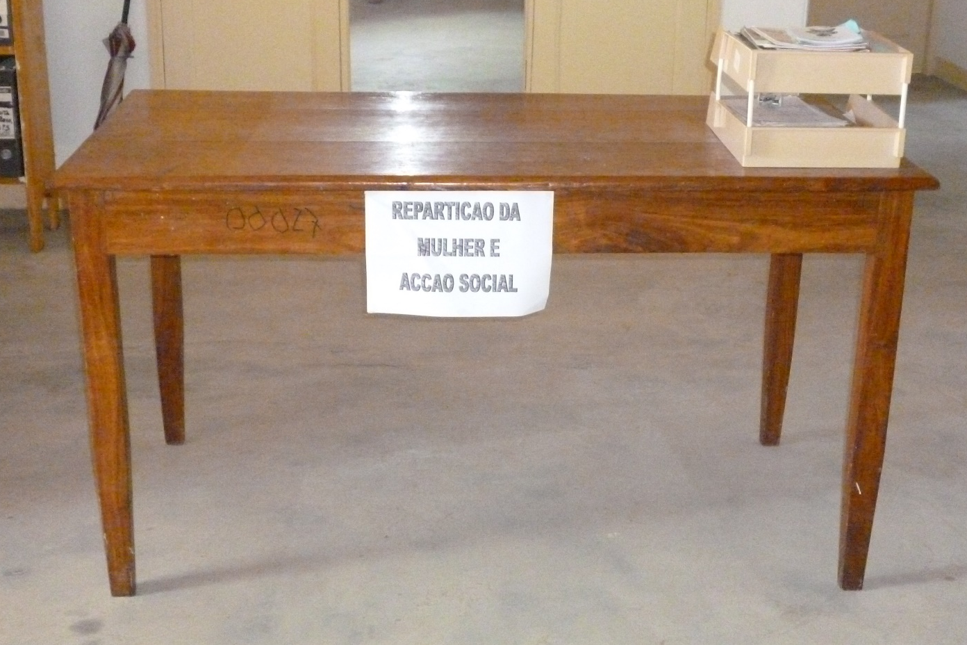

Tools for improving coordination:
Front and back office services
Notes:
Key instruments for improving coordination at this level? front and back office services
Back office integration (computer picture): ensuring coordination in the process of… Asking for information from responsible entities of different programmes; Check documents for validity, correctness and completeness; data entry and transfer to entities responsible for different programmes; Follow up of registration process and communication with responsible entities, further processing; Follow up on complaints and appeals with responsible entities for the respective programme
TOOLS to do this: shared MIS and related database.. shared registration and selection of beneficiaries across programmes..
Front office (desk picture, foto from Mozambique where that one table was the extent of the Ministry’s presence at decentralised level): ensuring coordination in the process of… providing Information and advice; Support of registration process (provision of registration forms, support to complete forms, submission of registration form, etc.); Acquisition and verification of identity and data; Notification and hand-out of identification documents (e. g. smart cards); Receive complaints and appeals and communicate results.
TOOL to do this: Front office integration does not necessarily require a shared facility by various ministries and service providers but should have as its primary objective to coordinate and provide effective service delivery to its clients. This requires willingness by the various ministries and service providers to come together and map out how they can streamline the services. Single Window Services or One Stop Shops (have they ever heard of these words?) are one example solution… Noting integration can happen at different levels..

Slide 21
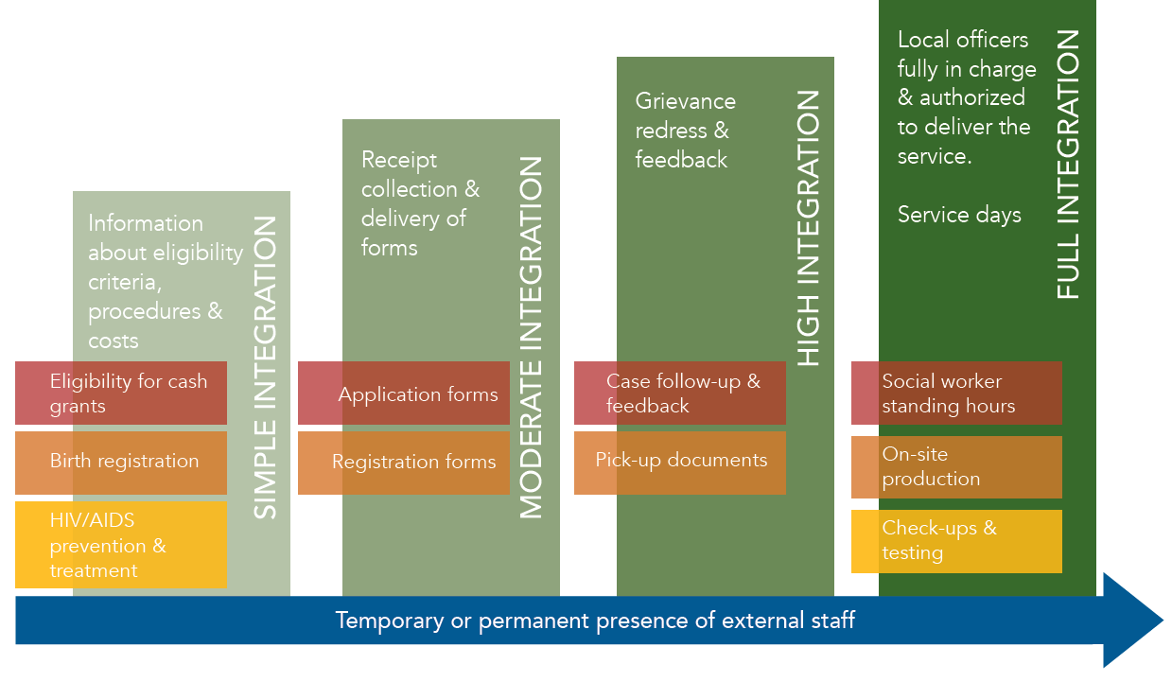
Level of integration of front office
Notes:
Especially at the front office level full integration and coordination at local level can only happen where there are staff in place (capacity!).. And in increasing degrees of integration from simple information sharing to creation of an ad-hoc office integrating functions autonomously..

Slide 22
…Linking services, an overview
Health
Education
Housing, water and Sanitation
Nutrition
Access to medical services
Nutritional support
Clean water & safe latrines
Reproductive health
Ensuring enrollment/ attendance
Fees/barriers to entry
Social protection & promotion
Complementary SP programmes (contributory and non)
Decent living conditions
Scholarships etc
Welfare and safety
Social care services, including psychosocial support
HIV-AIDS
Legal assistance
Birth registration/ legal documents
Protection from abuse/assault
Case management
& Referral System
Source: Adapted from unpublished
Oxford Policy Management work in Zambia
Notes:
Critical for the harmonization between social protection programmes is an effective referral system… the assumption being that those households who are covered by social protection face a wide variety of risks and challenges that are catered for by other services in other sectors.. A referral system ensures these are catered to holistically through one touch-point at local level.
Mention examples of One-stop shops in Lesotho and South Africa from Base Doc.

Slide 23
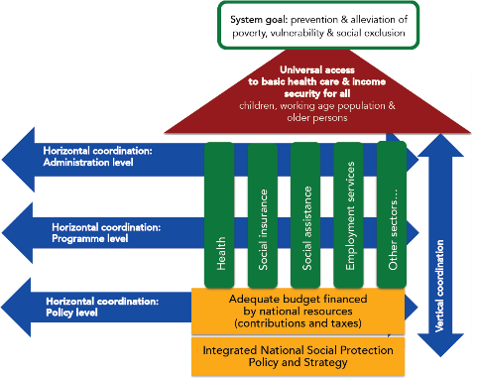
Aim: ensure consistency,
responsiveness to local context &
accountability in programme implementation
Takes place between the different levels of government (federal, national, provincial/regional, district, and commune/village)
Each layer of the social protection system depends on the other layers to perform its own duties.
Vertical co-ordination
Notes:
Vertical coordination
Aim: ensure consistency, responsiveness to local context and accountability in programme implementation
Coordination is considered to be ‘vertical’ when it takes place between the different levels of government (federal, national, provincial/regional, district, and commune/village) in order to guarantee the implementation of the defined policies, the financial sustainability of the social protection system, and the decentralized delivery of social transfers to beneficiaries.
Vertical coordination is based on the recognition that each layer of the social protection system depends on the other layers to perform its own duties. For instance the operational layer needs to respect the parameters of the schemes defined at higher level. Reversely, the planning layer requires certain types of information from the field to be accurately completed.
Objectives of vertical coordination are to:
Ensure consistency with policy vision and programme design during the implementation
Improve efficiency of the administration through the principle of subsidiarity by empowering local administrations and other structures at the local level
Improve the level of information, accountability and ownership at all levels
Ultimately, the social protection system needs to be consistent with deconcentration and decentralization policies, as well as with local administrative capacities….

Slide 24

Tools and processes to improve vertical
co-ordination
Streamline vertical coordination structures
Clarify the roles and responsibilities of the different administrative layers
Ensure that coordination mechanisms have necessary mandates and capacity to coordinate
Develop guidance/operational manuals to guide vertical coordination of social protection
Create incentives for coordination
Ensure info flows both ways!
Notes:
Go through slides asking delegates if they have any examples of this they can think of..

Slide 25
Activity: Stakeholder Mapping
Notes:
Remind delegates we have told them step 1 of their assessment of coordination at policy level.. But also at other levels should be an understanding of key stakeholders.
This exercise aims to do that, applying a useful framework.. (Go to next slide)

Slide 26
WHO ARE OUR STAKEHOLDERS?
Map key stakeholders, including those necessary at policy, programme and administrative level.. Against interest and influence/power
HIGH
KEEP
SATISFIED
MANAGE
CLOSELY
POWER
MONITOR
(MINIMUM EFFORT)
KEEP
INFORMED
LOW
LOW
INTEREST
HIGH
Notes:
Give them an explanation of each to help them understand… brainstorm one example all together and then divide into groups as per activity description.
Low interest, low influence
These are relatively unimportant people, but keeping in touch with them is a good idea, just in case their status changes.
High interest, low influence
These people can be difficult in that it is easy to ignore them as they apparently do not have a voice, although if sufficiently upset they may gain influence by low-level blocking and other techniques of resistance... They may also be essential stakeholders to us.
Low interest, high influence
People with a low interest will not be particularly worried about what you are doing, so are are not too much of a problem. A problem can appear when they are persuaded to act for those who oppose your actions/proposed change. It is thus important to keep them onside, for example with regular meetings that explain the truth of what is happening.
High interest, high influence
These people are both significantly affected by your actions/proposed change and most able to do something about it, either supporting or opposing actrions/changes. It is particularly important to engage these people, ensuring both that they understand what is going on and also creating buy-in as they feel a sense of ownership of what is being done.
USE next slide for debrief…

Slide 27

Where is your beneficiary placed?
And what about others who are
non-beneficiaries?
Notes:
DEBRIEF SLIDE
Use to trigger debate and discussions on who might be missing here..
Eg. CLICK: Bens and eligible non bens.. Most probably HIGH INTEREST LOW INFLUENCE..
In the case of Social Protection they are often the people we are trying to serve: the poorest and most vulnerable citizens who are potential beneficiaries of social protection.

Slide 28
Co-ordination:
Application to Home Country

Slide 29

Co-ordination: Application to Home Country
Step 1: Identify the most important horizontal and vertical co-ordination gaps in your country’s system (15 min.)
Step 2: Discuss and then draw or build a model that addresses these gaps (15 min.)
Remember: creating additional coordinating bodies is often not the answer!
Step 3: Prepare to present the three most important features of your model and appoint a spokesperson (5 min.)
Step 4: Presentation in plenary (10 min.)

Slide 30
Co-ordination: Application to Home Country
Step 1: Use the What? and Why? cards to reflect on different coordination challenges and needs in your country. (You don’t need to work through all questions only pick the ones that spark most interest) (15 min.)
Step 2: Discuss solutions on how coordination could be improved (15 min.)
Step 3: Pick your top three solutions and record one per card (5 min.)
Step 4: Appoint a spokesperson to share your top
three suggestions in plenary. (10 min.)

Slide 31
Key take outs for Co-ordination
Analogy for full integration
What do you know now that you did not know before?
What shift in your thinking did you experience?
What would you do differently now?
Notes:
Invite participants to contribute their major AHA moments, resulting in SP learning take-aways, insights and mind shifts on the topic of Coordination – create one flip chart with the title Coordination to record all the contributions
Use the following three questions to elicit participant contributions:
What do you know now that you did not know before?
What shift in your thinking did you experience?
What would you do differently now?

Slide 32
DAY 3 – Afternoon Session
SP M&E and ACCOUNTABILITY SYSTEMS

Slide 33
Ability of the system to provide reliable, quality information
SUPPLY
Improved outcomes:
Inwards-facing: management
• Improving programme design
• Solving problems in programme
implementation
• Prioritising and budgeting
Outwards-facing: accountability
• Improved accountability
• Provision of public information
Indicators & targets
Data
sources
Institutional arrangements
MESO:
Implementing agency (central & local offices)
MACRO:
National policy
enviroment
MICRO:
individuals
Whether there is actual demand for and use of M&E info to support core programme/government activities at all levels
Source: OPM (2015)
DEMAND
Notes:
The value of M&E does not come simply from conducting M&E or from having such information available”, but from “using the information to help improve government performance”. That often means placing more importance on the M (monitoring) than the E (evaluation) than is currently done.. (see table on page 6 of summary doc for M vs E description)
When set up appropriately, monitoring and evaluation (M&E) systems can support policymaking, performance budgeting and planning; help to manage activities; and enhance transparency and accountability.
In the context of social protection programmes (as shown in the grey square on the right..), M&E can play a critical role in improving programme design (including building synergies with other sectoral policies), solving problems in programme implementation and aiding decision-making (e.g. prioritising and budgeting), while also fostering the political and social support needed for scaling up from pilots to nationally owned programmes…
So which key factors play a role in successfully introducing and embedding M&E in social protection programmes? And how to establish a comprehensive system that goes beyond the undertaking of a few specific ad hoc external studies, to provide systematic and continuous information for internal improvement and external accountability?
This graph shows there are two sides of the coin that need to be tackled together:
the SUPPLY side: Ability of the system to provide reliable, quality information
The DEMAND side: Whether there is actual demand for and use of M&E info to support core programme/government activities at all levels…
Let’s take a quick look at each..

Slide 34
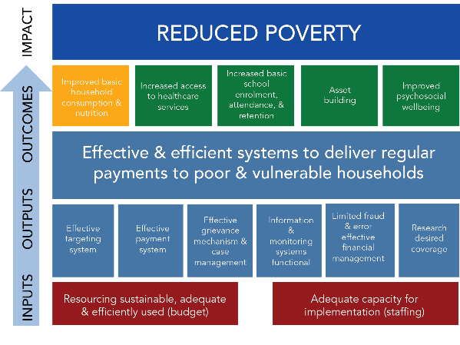


SUPPLY
Indicators & targets
Institutional arrangements
Data
sources
Prioritised, refined and organised as an iterative process!
Information needs of all stakeholders
Reflecting objectives, Theory of Change…
Reflecting Business Processes
Source: OPM (2015)
Notes:
On the supply side, this will be the case when Indicators:
have been agreed on, prioritised and refined as the result of a participatory and iterative process that accounts for the information needs of stakeholders at all levels (we will do an exercise on this later!),
reflect the programme’s objectives, Theory of Change, Logical Framework and Service Standards (measuring input, output, outcome/impact.. And performance or effieciency)
Reflect the programme’s core business processes 
Indicators should also be prioritised, refined and organised as an iterative process (an extensive mapping of information needs can lead to a number of indicators that is extremely large and unmanageable). This includes:
prioritising indicators based on a realistic assessment of their feasibility and usefulness (e.g. during participatory workshops with all key stakeholders)
refining each indicator to make sure it fulfils the ‘CREAM’ criteria and can be effectively calculated. This involves mapping each indicator back to its constituting formula (numerator and denominator) and potential data source, as well as defining how often that indicator will be collected and by whom.
organising indicators based on their use. For example, distinguishing between those focusing on programme operations (‘management’ or ‘operational’ indicators, that could be used by managers at all levels to assess the overall functioning of the policy/program), and those focusing on results (‘analysis’ or ‘results’ indicators, used by high level managers to measure progress against outcomes and for external accountability). Within each of these, indicators can then be organised by process and by Logframe level (input, output, etc.).
CREAM is the acronym of Clear, Relevant, Economic, Adequate, Monitorable

Slide 35
IMPACT
REDUCED POVERTY
Increased basic school enrolment, attendance, & retention
Improved basic household consumption & nutrition
Increased access to healthcare services
Improved psychosocial wellbeing
Asset
building
OUTCOMES
Effective & efficient systems to deliver regular payments to poor & vulnerable households
OUTPUTS
Effective grievance mechanism & case management
Information & monitoring systems functional
Limited fraud & error effective financial management
Effective targeting
system
Effective payment system
Research desired coverage
INPUTS
Resourcing sustainable, adequate
& efficiently used (budget)
Adequate capacity for implementation (staffing)
Notes:
See example Logframe linked to Theory of Change… for a cash transfer

Slide 36



SUPPLY
Indicators & targets
Institutional arrangements
Data
sources
Assess focus, accessibility, frequency, sample size, cost..
Build on existing sources
Ensuring
triangulation
Minimising burden and cost of data collection
Source: OPM (2015)
Notes:
On the supply side, this will be the case when a range of data sources (both internal and external) is adopted, ensuring:
these build on existing sources… both internal and external
Programme or integrated MIS! Standard periodic reporting! Existing administrative databases! Existing official statistics (maybe with some adaptation eg adding a question)! But also… qualitative ad-hoc data collection, using community monitoring, externally contracting an evaluator.. (see pros and cons on page 9 and 10 of summary doc)
ensuring triangulation of several types of data sources, both internal and external to the programme. This can enhance analysis potential. For example, while data from programme MISs provide substantial information, they do not necessarily help to understand how and why a programme is delivering and meeting beneficiaries’ needs (or isn’t). Qualitative research and approaches to participatory monitoring, triangulated with other sources, can help to address these fundamental issues.
minimising the burden of data collection and analysis: ensuring the data for the system is primarily designed to be generated as an integral part of normal administration rather than as an additional task. This also implies automating reporting functions where possible (for example within a program MIS).
a country wishing to set up an M&E framework should also consider each data-source’s: main uses and focus (which areas and indicators within the framework it would address); accessibility (how easy is it to use in practice, especially in the short and medium term); recommended frequency (frequency with which data from that source should be collected and analysed); sample size and; potential cost.

Slide 37


SUPPLY
Indicators & targets
Institutional arrangements
Data
sources
Aligning and working with existing structures & systems
Filling gaps…
(takes time
& effort!)
Source: OPM (2015)
Notes:
The institutional arrangements for Social Protection M&E clearly describe the roles and responsibilities of different organizations and actors within the system, while also outlining ‘how’ the information will be collected, compiled, analysed, reported and used. Guiding principles include the following:
Aligning..
Ensuring the institutional arrangements of the M&E system reflect the overall institutional structure of the implementing organisations (at all levels of decentralisation), while filling any gaps.
Aligning all activities with the National Planning Framework, with guiding legislation based on the government-wide monitoring and evaluation framework.
Working as much as possible with existing systems, staff and processes and helping improve them (build capacity, etc), based on an initial Capacity Assessment
Filling gaps..
Building institutional arrangements with new actors for M&E purposes: requires time, dedication and in some cases legal frameworks or memoranda of understanding (e.g. adding an extra question on benefit receipt to national survey by Statistics Bureau)
Explicitly budgeting for M&E activities from the outset and thinking through related staffing needs
Tasking one person at all levels of management (central, province, etc) specifically with M&E duties as a priority and possibly not as an add-on to other responsibilities (creating role of M&E officer);

Slide 38
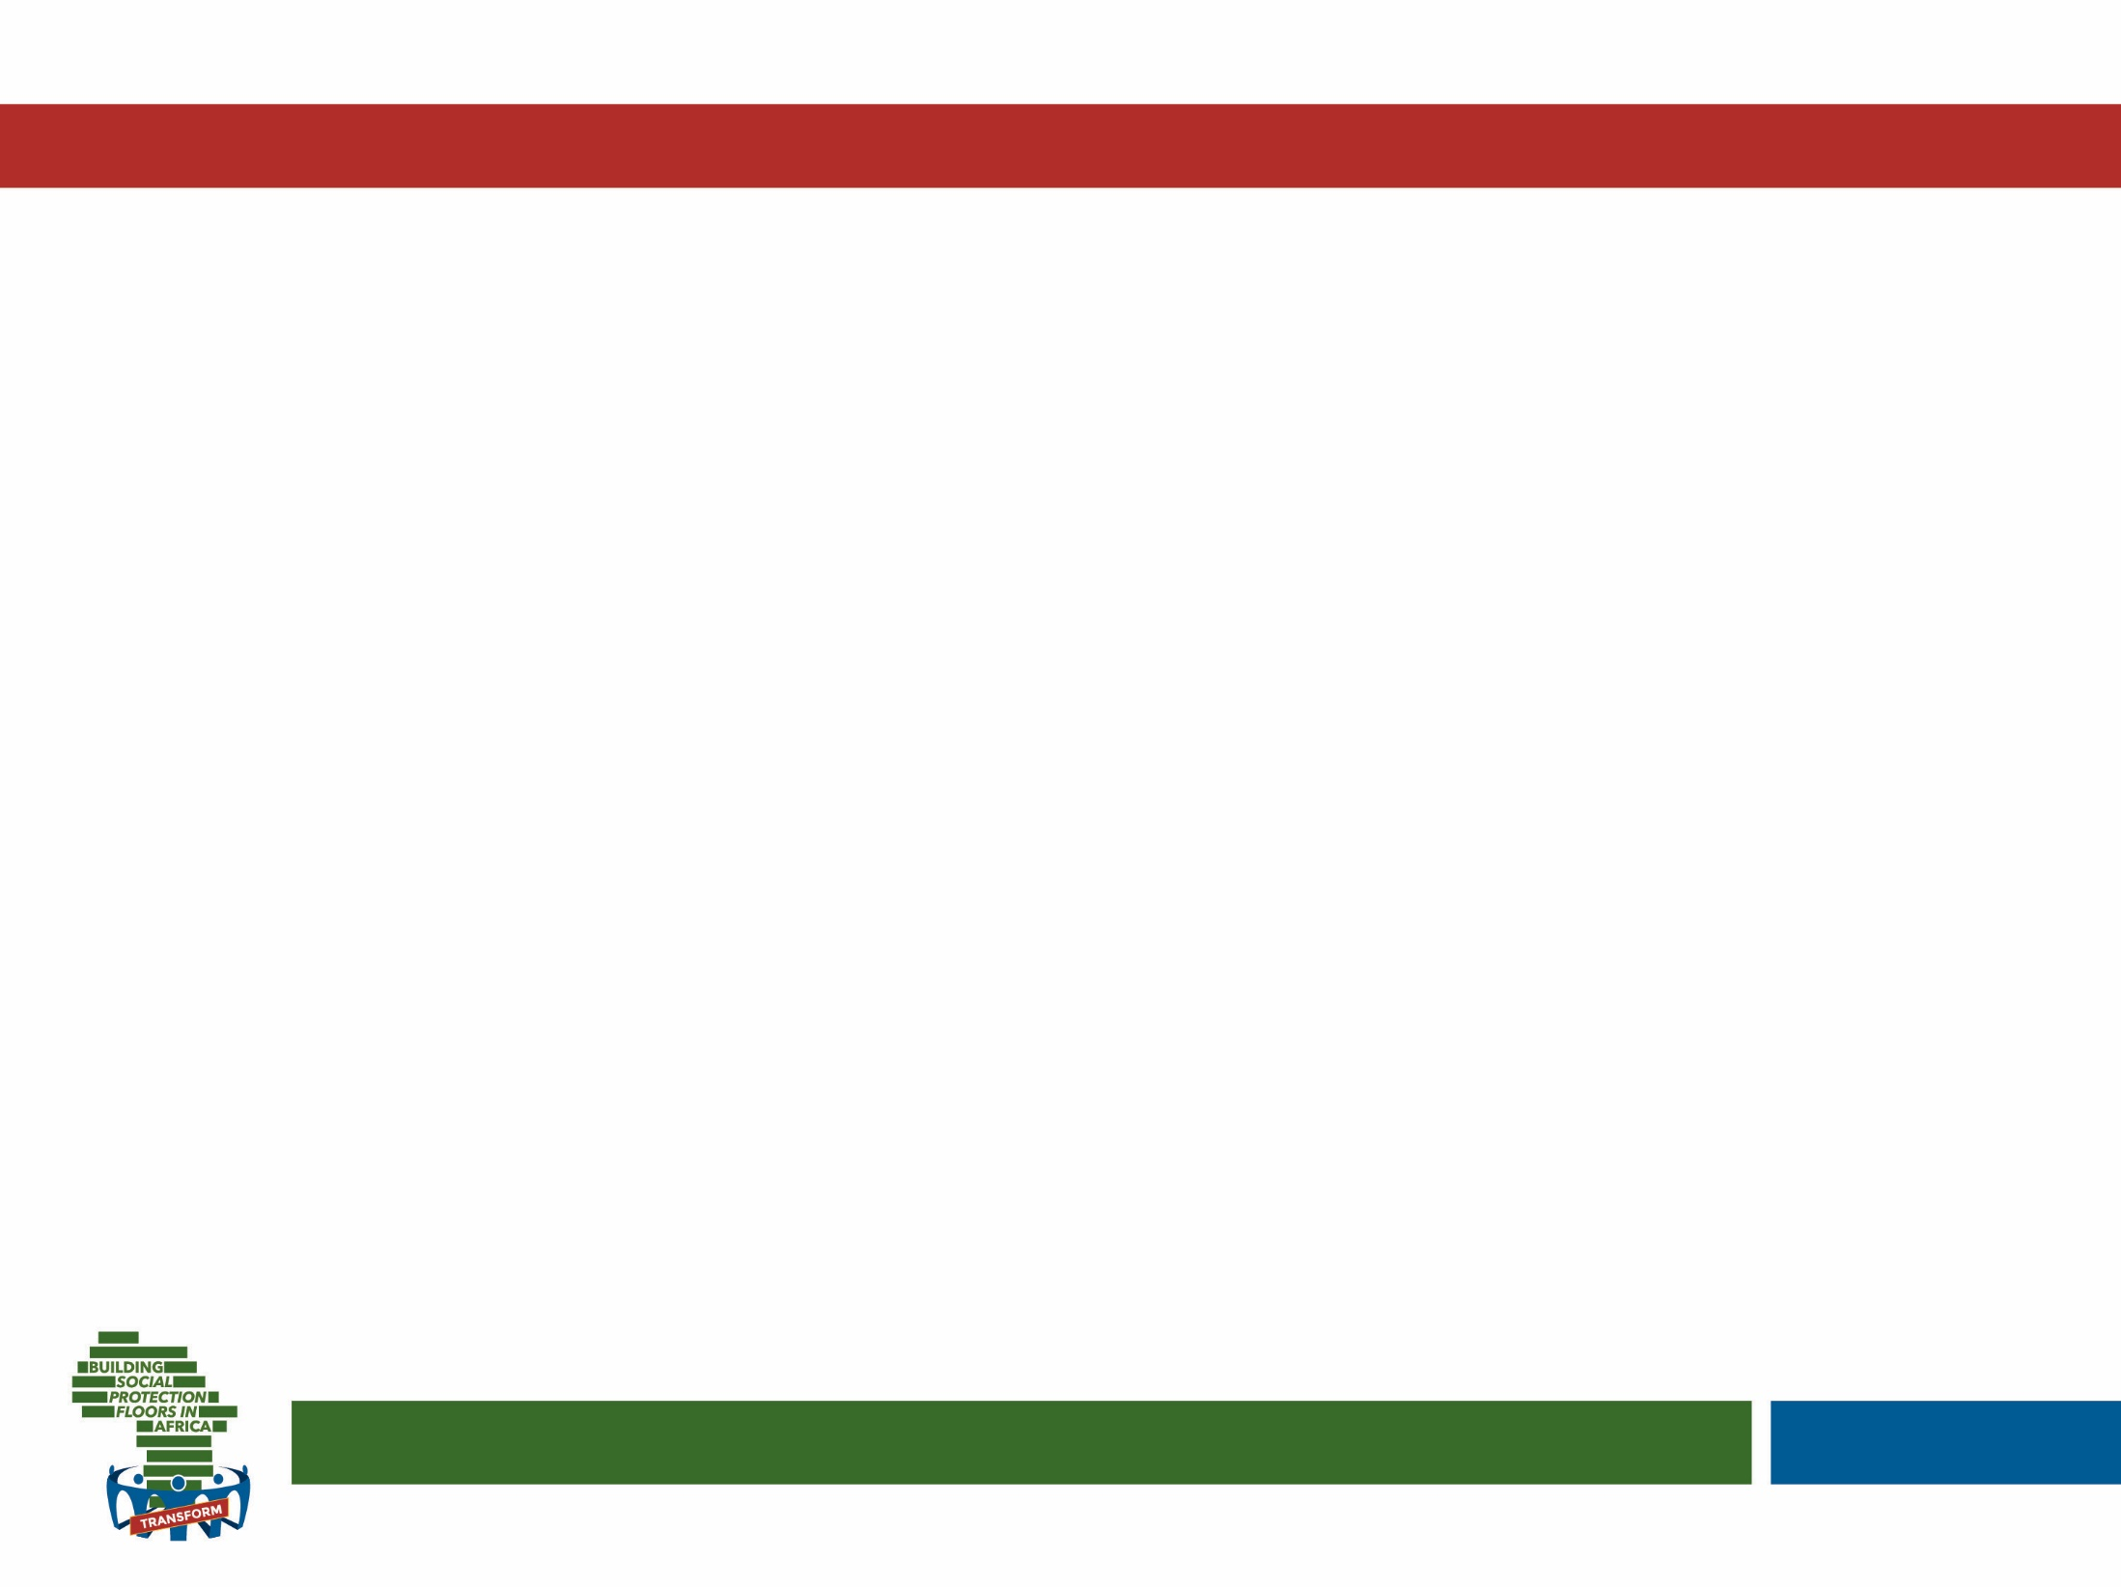
Quick brainstorm..
What do you think might be limiting demand for M&E? Why might institutions and staff oppose it?

Slide 39



Staff do not fear M&E and see it as learning opportunity
Performance-oriented policy environment
Feedback loops and buy-in from implementing agency
MESO:
Implementing
agency (central &
local offices)
MACRO:
National policy
enviroment
MICRO:
individuals
DEMAND
Source: Authors, adapted from Barca (2013)
Source: OPM (2015)
Notes:
We often forget and don’t invest in the demand side!
On the demand side, use of M&E data will be enhanced when:
 the macro-level national policy environment is ‘enabling’ (performance-oriented and with a strong focus on Standard Assessment Procedures, offers an overall institutional culture that fosters linkages between different ministries and has actors focused on planning, and allows for donors and civil society to play an active role in fostering M&E practice; 
the meso-level implementing agency has a sufficient level of autonomy in decision-making to ensure M&E activities are perceived as useful and not frustrating, has backed the process of developing an M&E system in the first place, and has a culture of benchmarking performance across different locations. This is especially the case where there is strong liaison between central and decentralised levels, based on mutual feedback and awareness of location-specific constraints (M&E perceived as learning rather than judgement) and where standard service agreements help to transparently frame objectives in terms of service delivery; and
 at the micro-level, individuals responsible for M&E understand its potential usefulness, do not ‘fear’ M&E as a ‘controlling’ function and have sufficient capacity to perform their duties. To achieve this, managers need to shift the focus of M&E from ‘controlling’ to ‘learning’ and build forums for local and central-level administrators to compare and contrast their experiences and learn from each other.

Slide 40
Cross-questioning: M&E
Notes:
See next slide

Slide 41

Activity: Cross questioning
Cross questioning
Read pages 8-14……And the challenge is on:
Create your questions and be ready to answer too!

Slide 42



Service standards, performance management
Service standards, performance management..
Outline delivery targets
Set of commitments
What can user expect to receive and how?
Intrinsically linked with a system for Performance Management
Notes:
We now move on to a topic which is related.. And which we have already touched upon when discussing legal frameworks.. And complaints and appeals mechanisms.
Explain:
Service Standards outline the specific delivery targets established by an organization,
made up of a set of commitments that an organization promises to honour when delivering a service.
They also describe what a client or user can expect to receive from the service, and the manner in which the service will be delivered.
They can be ‘crystalised’ in operational manuals that become the backbone of programme implementation
A well-designed performance management system associated with those Standards (and adequately monitored by the M&E system…) is essential to ensure a cost-effective and high-quality service that meets the needs of service users.
Of course a system can still operate without service standards.. But these help to operationalise legislation and replace it where it does not exist.. Guaranteeing rights of all stakeholders involved
Service standards are important as they:
support the provision of consistently high quality service delivery
encourage continuous improvement and identify specific areas for improving service quality
assist service providers to self-audit the quality of their service
foster a collective commitment to quality through a common set of clear and measurable criteria
assist users in knowing what to expect from service providers in relation to the quality of service delivery
maximise staff satisfaction and confidence with the service
meet reporting, transparency and accountability requirements
assist with monitoring and evaluation processes.

Slide 43
Accessibility
Privacy, dignity, confidentiality
Cultural awareness
Complaints and appeals..
Ensure they guarantee..
Timely
Measure what matters
Involving staff
Balanced
Some flexibility
Some flexibility
Notes:
But in order to work they need to satisfy some key principles.. See summary doc page 16 & 17

Slide 44
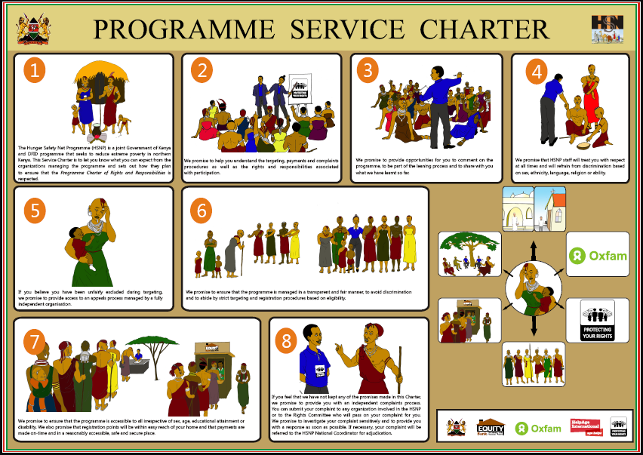
Notes:
Sometimes service standards can be incorporated into a Service Charter.. This example is from Kenya’s HSNP programme rollout and shows the rights and responsibilities of beneficiaries and other community members (this was shared during community meetings during registration).

Slide 45

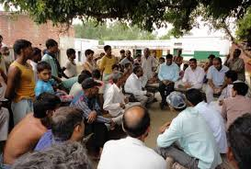
Internal: C&A + Spot-checks, supervisions and inspections e.g. SA ‘Inspectorate’
External:
Tribunals, courts, ombudsmen e.g. SA
Financial audits
Social audits e.g. by CSO (India)
Integrity frameworks and anti-fraud campaigns
Scrutiny by parliament
NGOs and media
Other accountability mechanisms
Notes:
…Yesterday we mentioned that complaints and appeals are only part of the picture when it comes to setting up accountability mechanisms for social protection…
In this slide we briefly outline other internal and external mechanisms… (see summary doc page 18-20 for details on each)

Slide 46
M&E And Accountability Stakeholders
Notes:
Stay on this slide and use Activity sheet to guide you.. (you are adding stakeholders to the stakeholder map already created, if any are missing)

Slide 47
M&E Needs At Three Levels
Notes:
See next slide

Slide 48
1) Use the handout to brainstorm information needs at your level: What do these stakeholders need to know? Transform these into indicators if possible…(10 min.)
2) How can these be obtained in practice (data sources, actors, institutional arrangements) (15 min.)
Appoint a group’s spokesperson to present the five most important features of your groups’ system
M&E needs at 3 levels
Notes:
Distribute the three work group signs at three flip charts around the room
Invite participants to gather in 3 different similarly sized groups according to their interest: 1 Central level policy/strategic, 2 Central level managerial, 3 Local level (as described in more detail here below) and distribute the relevant handout to each group
Central level policy/strategic stakeholders: eg. Donors, Planning Ministry, Parliament.. Those that are only interested in high-level indicators that are useful for planning and strategy
Central level managerial stakeholders: e.g. Programme managers in implementing Ministry.. These are actors that need to be managing day to day operations and business processes effectively.. Across the country!
Local level stakeholders: e.g. local level implementers, NGOs/Civil Society etc.. These are actors that need in depth knowledge of local level information
CLICK for 2nd half of exercise half way through!

Slide 49
Key take outs for M&E and Accountability
Analogy for full integration
What do you know now that you did not know before?
What shift in your thinking did you experience?
What would you do differently now?
Notes:
Invite participants to contribute their major AHA moments, resulting in SP learning take-aways, insights and mind shifts on the topic of M&E – create one flip chart with the title M&E to record all the contributions
Use the following three questions to elicit participant contributions:
What do you know now that you did not know before?
What shift in your thinking did you experience?
What would you do differently now?

Slide 50

Overnight assignment and closure Day 3
Analogy for full integration

