Slide 1
LEADERSHIP & TRANSFORMATION CURRICULUM:
BUILDING & MANAGING SOCIAL PROTECTION FLOORS IN AFRICA
DAY 2
Selection & Identification / Administration
Notes:
Today we will be covering selection and identification in the morning, and SP administration in the afternoon

Slide 2

^{DAY 2}
^{Morning Session}
^{SP SELECTION & IDENTIFICATION}
Notes:
Briefly introduce the mornings agenda overview

Slide 3


Leadership & Transformation Journey Check-in
Notes:
Set up a semi-circle of chairs facing the front of the room and invite all participants to take a seats with their journals/ pen and paper.
We have had a first look at the Theory U model yesterday afternoon in preparation for your Dialogue Interview Walk Exercise. We will be following the same model throughout all the morning check-in Leadership & Transformation training sessions. This will offer you an opportunity to start each training day with some reflection time and space to explore where you are at and where you would like to go on your own personal transformation & leadership journey as an SP leader. It is a journaling exercise – so please take out your journals, or notebooks now.
I will now read out one question after the other to guide you in their journaling, and I will move to the next question when I sense that the majority of you is ready. I won’t give you too much time, because it is important that you keep going and do not overthink the questions too much. I will leave the questions up on a slide should you need to have sight of them, but please focus your attention on my spoken questions and guidance rather than the slide.

Slide 4
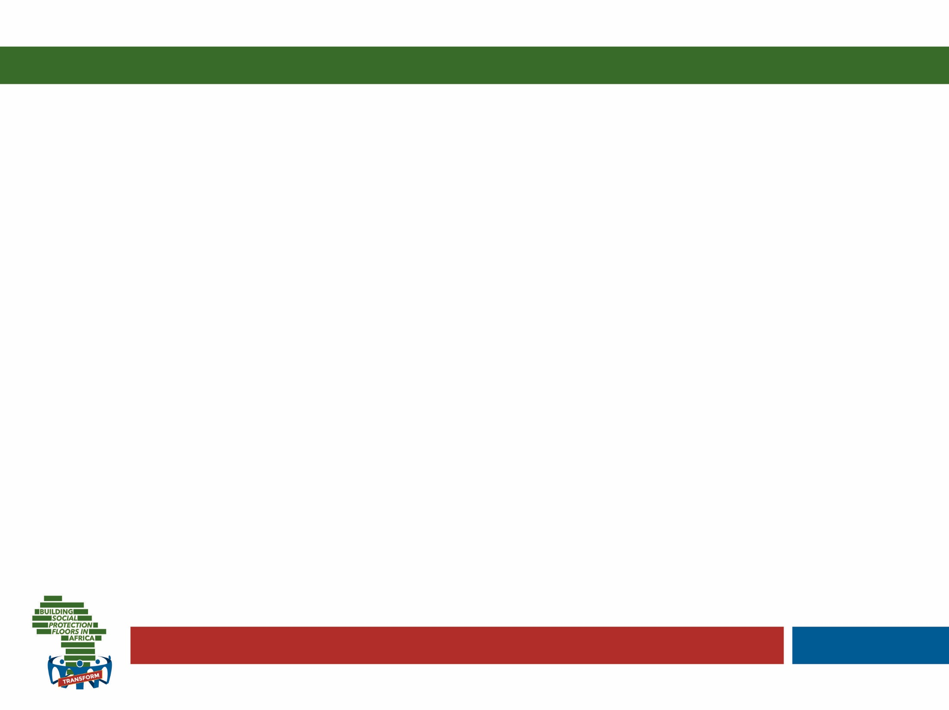


L&T Journaling
Thinking back about what you would like to focus on to develop your leadership & transformation role in social protection… What about your current work frustrates you the most? (about 3 min.)
Adapted by Catherine Widrig Jenkins (IPK) from Theory U by Otto Scharmer
Notes:
Invite participants to take out their journals and spend a few moments going over the notes of the journaling done on the prior day to reconnect to where they left it off
Then talk and guide them through today’s set of questions on this and the next slides – always allowing for about as much time as indicated behind each question in brackets
Finish this activity off by allowing them to turn to the person next to them and take about 5 minutes to share a few insights relating to the journaling experience

Slide 5

L&T Journaling
L&T Journaling
And what about your work gives you most energy?
What do you love? (about 3 min.)
Adapted by Catherine Widrig Jenkins (IPK) from Theory U by Otto Scharmer

Slide 6

L&T Journaling
L&T Journaling
What is holding you back in your work? Describe 1 or 2 recent situations when you noticed a voice of judgement or fear in yourself, preventing you from exploring the situation more deeply. (about 4 min.)
Adapted by Catherine Widrig Jenkins (IPK) from Theory U by Otto Scharmer

Slide 7

^{SELECTION} ^{AND IDENTIFICATION (S&I)}
Lecture Part 1, Policy and Fiscal Choice

Slide 8
Four stages of the “selection” process
Policy Choice
Fiscal choice
Design Choice
Implementation
Governments makes decisions on which categories of population to prioritise..
..it will be important to understand what proportion of that category can be covered.. And whether policy choices need refining based on available finances
..need to design an appropriate selection methodology that can help identify desired beneficiaries.. And design approach to implementation
..once design is agreed, this methodology needs to be implemented: registration, enrolment.. And strong complaints and appeals
Notes:
Discuss why the word targeting is problematic.. Military association.
Also, we often talk about ‘targeting’ as if it were one compact activity, but actually it can be broken down into four key stages.
Discuss the four stages as outlined here..
And stress two way relationship between policy and fiscal choice: they go hand in hand
We will be discussing these four stages in turn,

Slide 9
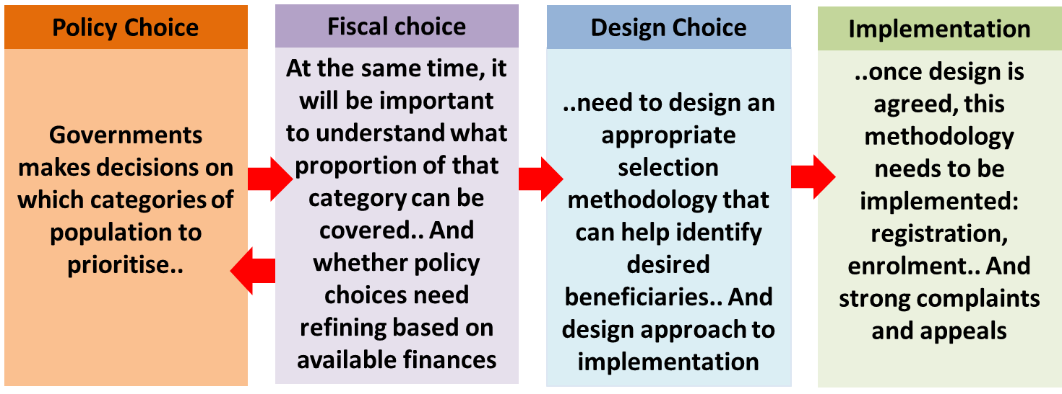
Step 1 - Policy Choice: Two main approaches
Poor relief
Provides transfers to the “poor”
Addresses symptoms of poverty (protective more than preventive)
Coverage relatively low, usually a maximum of around 20% of pop
Lifecycle & universal
Schemes developed to address contingencies in the lifecycle (childhood, disability, old age, unemployment, etc)
Based on a broader concept of vulnerability – entitlement
Addresses key causes of poverty
Notes:
Step 1, Policy Choice
Governments always make policy choices on which categories of the population to prioritise for all types of public services, not just social transfers. However, when deciding their policy approach to social transfers, governments tend to make choices between two approaches. They either decide to direct their social transfers to the category of the population regarded as “poor”; or, they follow a more complex policy direction by designing their social transfer systems to address challenges and risks faced by individuals across their lifecycle. The former can be referred to as a “Poor Relief” approach while the latter can be categorised as a “Lifecycle” approach.
Discuss differences between the two, based on base doc info. And info on slide. Also stress that many call lifecycle approaches ‘universal’ though they are not entirely: they do not redistribute to 100% of population but to specific categories e.g. all over 65s in a universal social pension
Poor relief: E.g several in the region…. And elsewhere Philippine’s Pantawid Pamilyang Pilipino Program (PPPP) scheme, Pakistan’s Benazir Income Support Programme (BISP), Mexico’s Oportunidades programme and Indonesia’s Program Keluarga Harapan (PKH)
Lifecycle: E.g. South Africa

Slide 10
Lifecycle risks addressed…
• Stunting
• Cognitive development reduced
• Miss out on immunization
• No access to ante-natal and
post-natal care
• Loss of parental care from
bereavement or migration
• Child labour
• No access to school
• Malnutrition
• Loss of parental care from
bereavement or migration
EARLY CHILDHOOD
• Increasing frailty
• Inability to work
• No care from
family
• Discrimination in
labour force
OLD
AGE
SCHOOL
AGE
COVARIATE
& HEALTH SHOCKS
• Unemployment &
underemployment
• Inadequate wages
• Debt
• Need to care for
children & parents
• No child care
• Gender
discrimination
• Domestic violence
• Dowry payments
• Inadequate skills
• Unemployment
• Inability to access
training
• Alienation
• Early motherhood
DISABILITY & CHRONIC ILLNESS
YOUTH
WORKING AGE
Notes:
Remind them of yesterday’s slide…

Slide 11
Example from South Africa
Child benefits
• Child Support Grant
• Foster Child Grant
• Care Dependency Grant
(disability)
Child benefits
• Child Support Grant
• Foster Child Grant
• Care Dependency
Grant
EARLY CHILDHOOD
Pensions
• Grant for older
persons
• War Veterans Grant
• Grant in Aid
OLD
AGE
SCHOOL
AGE
COVARIATE
& HEALTH SHOCKS
Disability
• Disability Grant
Unemployment
• Small workfare programs
Disability
• Disability Grant
• Grant in Aid
Unemployment
•Small workfare programs
DISABILITY & CHRONIC ILLNESS
YOUTH
WORKING AGE
Notes:
Remind them of yesterday’s slide…

Slide 12
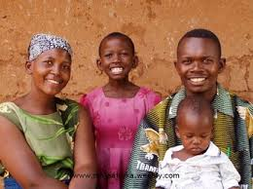

Ensuring policy coherence..
Pregnancy
& ECD
Active-Age
Adults
Disabled
Elderly
Families
Childhood
Youth
Cash Transfers (UCT or CCT)
Public Works
Disability Assistance
Social Pensions
Food Stamps/ vouchers
Birth, Child Allowances
Scholarships
In-Work Benefits
Contributory Pensions
Maternity
Benefits
School Feeding, Supplies, Transport
Care-Giver
Allowance
Housing Subsidies
Unempl.
Assistance
Disability Insurance
Survivor & Death Benefits
Nutrition Supplements
Services for At-Risk Youth
Unempl.
Insurance
Utility Subsidies
Food Stamps/vouchers
Parenting Services
Sickness & Injury
Utility Subsidies
Transport Subsidies
ECD & Nutrition
Transport Subsidies
Training & Skills
Active Aging Services
Family Services
Child Care Services
ALMP / Activation Services
Financial & Productive
Inclusion Services
Source: Adapted from Lindert
Intermediation, Counseling, Psycho-Social Support Services
Disaster
Services
Child Protective Services
Legal services
Social & Long-Term
Care Services
Notes:
Ensuring policy coherence across programmes (remind them of slide on day 1)

Slide 13
..and ensuring there are no gaps..
Pregnancy
& ECD
Active-Age
Adults
Disabled
Elderly
Families
Childhood
Youth
Cash Transfers (UCT or CCT)
Public Works
Scholarships
Contributory Pensions
Maternity
Benefits
Disability Insurance
Nutrition Supplements
Unempl.
Insurance
Sickness & Injury
Family Services
Training & Skills\
Child Protective Services
Source: Adapted from Lindert
Notes:
At another extreme you may have a country with very few programmes in place… in this case it will be important to think of social protection holistically and address the gaps!

Slide 14

Step 2 – Fiscal Choice
Investment in a program (or set of programs) depends on choice on:
Coverage
Value of the transfer/benefit provided to beneficiaries
Notes:
Step 2.. The fiscal choice.. In practice goes very much hand in hand with step 1: a country’s ideal policy choice gets measured against its fiscal sustainability.
The ultimate fiscal trade-off is between coverage of a programme (% of population reached) and value of the transfer (acknowledging that transfers below a certain level will not trigger significant impacts on intended areas – nutrition, human capital etc)….

Slide 15
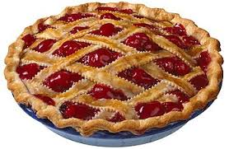
A) If the size of the pie is fixed, it makes sense to concentrate scarce resources on the poorest.. Or small sub-section of population e.g. 95+
B) However, the more people covered by a programme, the more popular it will be, and the more funding it may attract
Notes:
HOWEVER there is a basic political economy argument that the higher the coverage, the more popular a programme will be – and it will include politically more powerful groups – so that there is greater pressure to increase the value of the transfers…
We should not feel constrained by existing scenarios and budget allocations, the budget ceiling and overall size of the pie is not necessarily fixed, it can be expanded (and we will discuss this in module on financial management)!

Slide 16
 | Considerations in favour of Economic (poverty) Targeting | Considerations in favour of Lifecycle approach and universal coverage
Ideological
Fiscal Constraints and Efficiency
Political Economy
Social Acceptability and Social Cohesion
Targeting Accuracy and Administrative Costs
Perverse Incentives
Notes:
Ensure participants look at pages 9&10 in summary doc and engages with content for about 5 minutes and are given time to ask any questions or make comments…

Slide 17
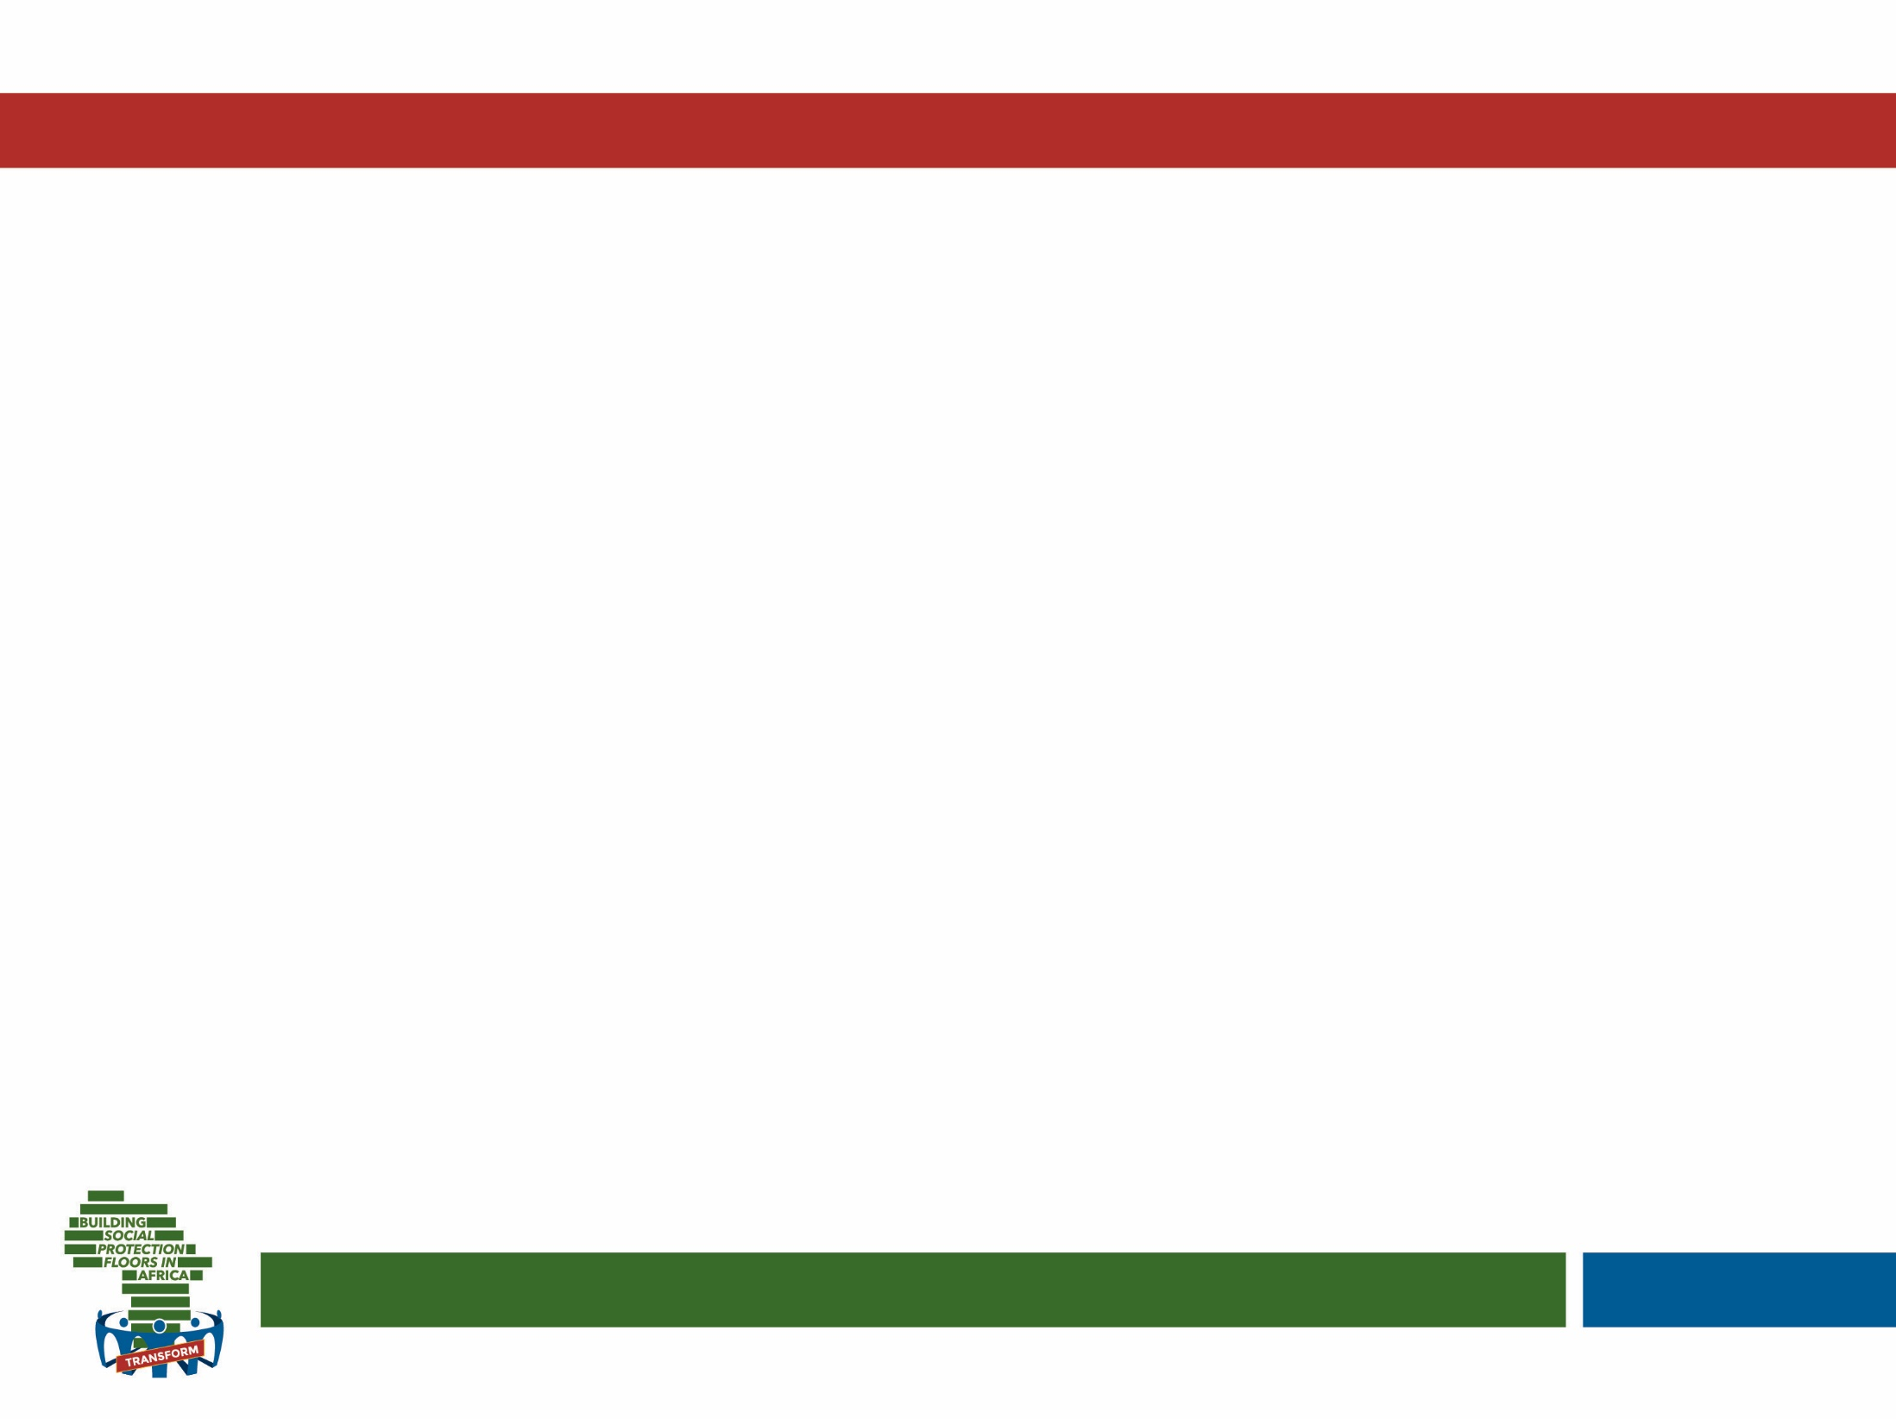


Stand on the number on this sliding scale that represents your preference.
Why have chosen to stand where you are standing?
1
2
3
4
5
6
7
8
9
10
Economic
Lifecycle
Notes:
Have teams discuss each word…and how they relate to each other. Then debrief.. Stressing core doubts and areas of confusion (see activity guide)
Explain that some of these words are effectively overlapping and used by different actors in different ways.. We should never get stressed over a word but always ask clarification on what that word means in any given context. Example of ‘Social safety net’ which is the word used by the World Bank to refer to social assistance..

Slide 18
Simulation: Understanding The Complexity Of Selection & Identification
Notes:
Introduce Simulation exercise as per the detailed description in the Activity Guide for Day 2

Slide 19

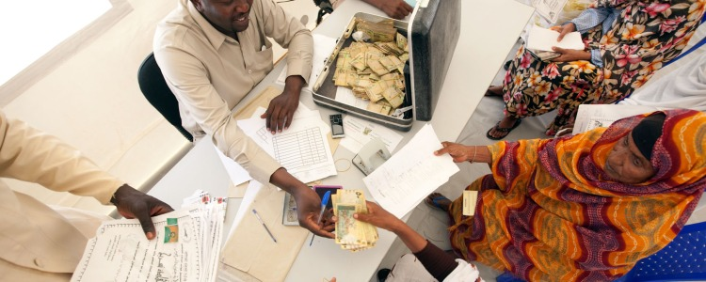
Decide amongst yourselves how social
protection will be allocated amongst you, and who will receive it for what reasons …
only 3 of you can receive it!
Notes:
Invite participants to carefully listen to each other’s contributions and try to agree as a group on which 3 players should receive SP and for what reasons
Invite them to appoint a spokesperson that will share their key insights in plenary

Slide 20
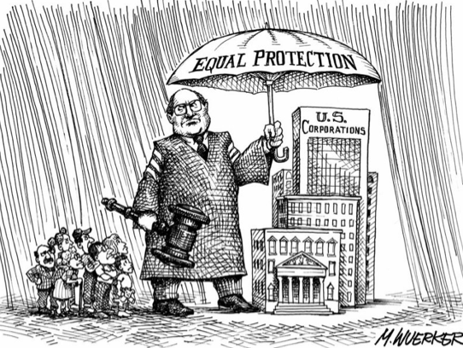
Simulation debrief
What happened?
Who received SP? Why?
How did you feel, and why?
What valuable lessons can you draw from this?
Did the groups make similar decisions?
Notes:
Possibly also use these further questions: How would you generalise this in terms of distributing social protection across a nation? And what design option would you consider to identify households like this one? And how would you implement this choice (e.g. registration)?

Slide 21
^{SELECTION} ^{AND IDENTIFICATION (S&I)}
Lecture Part 2, Design and Implementation Choice

Slide 22
Four stages of the “selection” process
Policy Choice
Fiscal choice
Design Choice
Implementation
Governments makes decisions on which categories of population to prioritise..
..it will be important to understand what proportion of that category can be covered.. And whether policy choices need refining based on available finances
..need to design an appropriate selection methodology that can help identify desired beneficiaries.. And design approach to implementation
..once design is agreed, this methodology needs to be implemented: registration, enrolment.. And strong complaints and appeals
Notes:
Last two phases.. just as important!

Slide 23
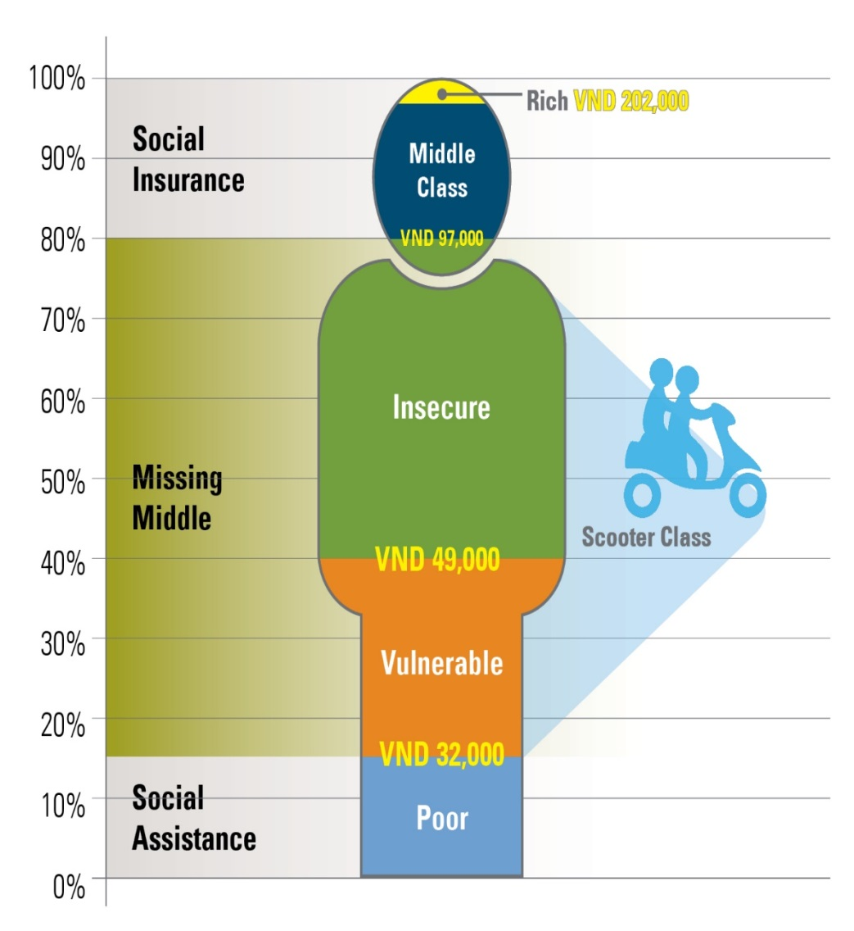
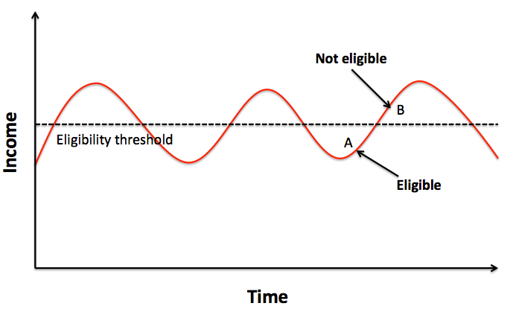
Step 3 – Design choice
Reaching the poor is
complex because….
No clear ‘cut-off’ and uniform definition
Risk: missing middle!
Constant churning (dynamic concept)
Multi-dimensional nature of poverty
Notes:
Even when solid decisions have been made from a policy and a fiscal perspective, the challenge is still to solidly design a system that operationalises those decisions.
Designing such a system is very complex because of the problems discussed on the slide.. See also summary doc and base doc.

Slide 24
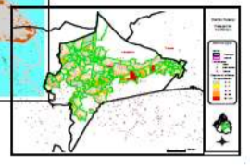

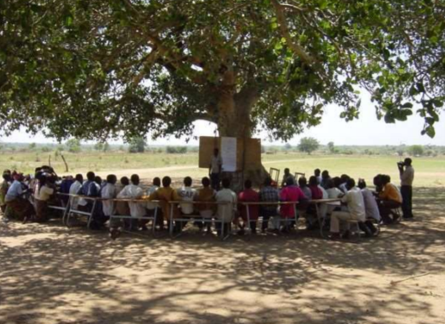
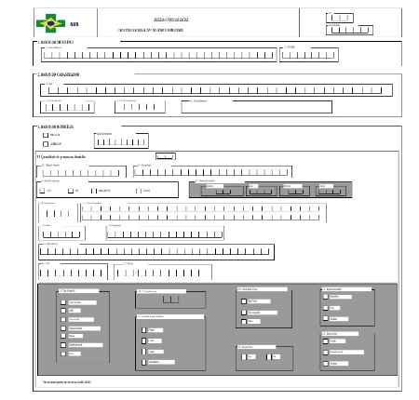
So how to design a system once policy and fiscal choices are made?
..Geographical and quotas
For life-cycle approaches.. Mostly categorical targeting (by age, disability status, life-cycle event, etc)
For poverty targeting.. Main options are:
Means test
Community based targeting
Proxy means test
Notes:
Several design choices available – see summary and base doc for description and spend one minute describing each…
many programs adopt some form of geographical targeting and/or quotas within each location
life cycle approaches adopt simple approaches to targeting, mostly based on age (social pensions, child grants).. But sometimes on other variables.
Poverty targeted programmes primarily adopt means testing (verified or unverified, discuss difference and examples), Community based targeting (briefly discuss process, pros and cons or attempts to establish means in other ways e.g. through PMT (explain process and briefly discuss pros and cons)

Slide 25
Summary of beneficiary selection methodologies
Geographic and quotas: Selected based on where beneficiaries live
Life-cycle approach:
Categorical targeting: Selected based on demographic characteristics (age, sex, disabilities, etc)
Poverty targeting:
Means testing: Selected based on how much beneficiaries earn
Proxy means testing: Selected based on what beneficiaries own (assets)
Community based targeting: The community decides on who should be selected

Slide 26
HYBRID
Categorical
Economic selection
Age
Geographic
Affluence, pension test
Means test
PMT
Other demographic criteria
CBT
“Targeted”
Notes:
In practice, we can classify these like this..
Briefly discuss each option highlighting strengths and weaknesses.. highlighting complementary role of social insurance (See pages 13-14 of summary doc on S&I):
Click 1: Categorical approaches vary widely, most often age related (old age pension, child benefit), often geographic (poorest areas of country prioritised) – but also other more complex approaches (e.g. labour-constrained..). These tend to be easier to implement..
Click 2: Economic selection (poverty targeting) can be achieved in many ways: means tests (establishing income and targeting on that basis) can be easy in contexts with high levels of formality (e.g. easily verifiable through tax database).. But is often unverified and complemented by strong processes for spot-checking; Community Based Targeting (CBT) implies the community itself setting the targeting criteria and guiding selection of beneficiaries); the Proxy Means Test is an approach that encompasses developing a formula based on observable household characteristics that are highly correlated with poverty (e.g. based on analysis if household budget surveys) and targeting on the basis of that formula; affluence and pension testing involves targeting ‘universally’ except for those who are very affluent or who already receive a pension (e.g. Thailand’s National Social Insurance targets anybody who does not have private or public sector insurance already).
Click 3: MOST APPROACHES ARE ACTUALLY HYBRIDS!
E.g. very often some form of economic selection + geographic targeting.. Sometimes categorical on age with some form of means test (e.g. south Africa’s child grant system)
You can also mention some type sof programmes adopt approaches to self-selection (e.g. public works where wage is low so only a few participate) – but we will not go into this
You can also mention a universal basic income would need none of these as everyone would receive… and be taxed accordingly

Slide 27
PMT vs CBT vs Categorical
Notes:
Explain purpose of this activity: critically think through three of the main design tools used to select social protection beneficiaries: Proxy Means Test (PMT), Community Based Targeting (CBT), and categorical targeting (incorporating both age and other categorical approaches, eg. labour constrained)

Slide 28

Activity: Divide into three groups,
according to interest!
Categorical
Economic selection
Age
Affluence, pension test
Geographic
Means test
PMT
Other..
CBT
See pages 13-14 of summary doc on S&I
Notes:
Ecah team will be discussing each option highlighting strengths, weaknesses and where that model may work best.. Explain three selected ‘leads’ that will take notes on flip chart and we will then debrief in plenary

Slide 29
Activity: PMT, CBT and Categorical…
Strengths | Weaknesses | Where it may work best
Notes:
TEMPLATE TO FILL by each working group on their flip chart

Slide 30
PMT
Strengths | Weaknesses | Where it may work best
Theoretical superior precision in identifying the poor as defined (e.g. often consumption poor) ‘Verifiable and objective approach’ In some contexts it can give an extra control over budget | Often not understood/ accepted by community Could lower accountability to citizen if not over-ridable Different definition of poverty than community Relatively large data requirements and administrative costs (and data quality essential) Standard PMT nation-wide may not reflect local poverty context May bias against certain groups (e.g. elderly with more assets accumulated over time) Can ‘reward’ dishonesty and requires monitoring Requires updating as circumstances change Predictive power not that good | limited poverty alleviation budget (helps to address trade-off between the number of beneficiaries covered by the intervention and the level of transfers) higher capacity for implementation: presence of continuous/regular household survey, administrative capacity Poverty and vulnerability profile: chronic poverty (problematic if ‘all poor’) Where policy objective is poverty alleviation: tool to use after pro tection floor
Notes:
SHOW THESE SLIDES DURING EACH DEBRIEF AND REFER TO SECTION IN BASE DOC WHERE THIS IS COVERED IN MORE DEPTH
We do not need to go into detail – key point emerging is that each approach has strengths and weaknesses.. That need very careful evaluation given country context

Slide 31
Strengths | Weaknesses | Where it may work best
Community members are more likely to understand the real situation of each member/ reflect their understanding of poverty Lower administrative costs | Risk of inter-community disparities Can require arbitrary quotas Can require extensive facilitation to be perceived as ‘fair’ by community members: independent and transparent process. Risks: social exclusion/ power relations/ elite capture/’unknown’ community members Potential hidden costs on administration (delicate trade-off between voluntary and paid support by community leaders) Potentially complex re-registration process Potentially complex process for redress/grievance and accountability Difficult in urban areas | Low formal administration presence Existing informal structures Relatively socially uniform and ‘knitted’ community
CBT
Notes:
SHOW THESE SLIDES DURING EACH DEBRIEF AND REFER TO SECTION IN BASE DOC WHERE THIS IS COVERED IN MORE DEPTH
We do not need to go into detail – key point emerging is that each approach has strengths and weaknesses.. That need very careful evaluation given country context

Slide 32
Strengths | Weaknesses | Where it may work best
Easy to implement (e.g low data requirements) Lower administrative costs Lower risk of people ‘playing the system’ Entitlement (clear, understood) … | Will include people who are not ‘poorest of the poor’ May cost too much if coverage is high … | Strong political will and commitment
categorical
Notes:
SHOW THESE SLIDES DURING EACH DEBRIEF AND REFER TO SECTION IN BASE DOC WHERE THIS IS COVERED IN MORE DEPTH
We do not need to go into detail – key point emerging is that each approach has strengths and weaknesses.. That need very careful evaluation given country context

Slide 33
Step 4 - Implementation…
Validation
Identification and registration
Eligibility determination
Enrolment
Labour intensive processes!
High risk of excluding poorest and most vulnerable as these face greatest barriers to access…
Complaints and appeals
Outreach and communications
Source: Adapted from Lindert et al (2016) and Barrett and Kidd (2015)
Notes:
What does it take to implement any given design, as just discussed? This will of course vary depending on the design, as your insights have shown in the previous exercise… yet the overarching phases will be the same:
Households will need to be initially registered
Eligible households will then be determined (in some cases these two phases will be concurrent, e.g. for CBT.. While for PMT socio-economic data is first collected on everybody, then once data is entered the formula can be run..
Selected households are then enrolled (e.g. additional data is collected, bank accounts opened, programme IDs shared, etc)
As briefly mentioned at the start of the day… even the best designed system will face challenges when it needs to be implemented. Moreover, implementation challenges will greatly depend on the underlying design choices…
At this stage, we will focus on the data collection process for registration… the process used for enrolment.. The structure of the complaints and appeals system (if any in place.). And the underlying communications.. As these are all areas that risk augmenting exclusionary forces.
Labour intensive.. Requires capacity at local level often missing in the region! Many countries rely on voluntary structures…

Slide 34
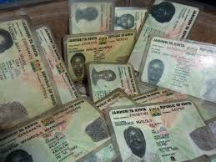




What are the main pitfalls at this stage, leading to exclusion?
data collection
requirements (e.g. ID, proof disability, etc)
communications
complaints/ appeals
Notes:
Data collection… implementation challenges will vary enormously depending on whether pull, push or data integration approach is adopted. The most important consideration to avoid exclusion is minimising the burden for potential beneficiaries.. Direct (cost of travel, documentation, etc), indirect (waiting, stigma, etc) and opportunity costs (e.g. time loss).. (Ask delegates to briefly read through table on page 21, 22).
One solution that many countries are starting to adopt – sometimes called ‘Single Window Service’ or ‘One Stop Shop’ – is the creation of units at decentralised level where applications for any social sector programme can be processed in one place.. Greatly reducing burden on applicants).
Requirements for enrolment may also enhance exclusion.. Whether the need for formal identification (very low in these contexts and especially among the most marginalised: which is why some countries have linked objectives of Social Protection and legal identification); or the need for proof of disability status; or the obligation to provide biometric data to enrol (manual labourers with ruined fingerprints, etc)
Communications.. If badly conducted.. Can increase stigmatisation or enhance exclusion (we will discuss this when looking at Administration in afternoon)
In the absence of a solid complaints/appeals system citizens have no way to claim their rights and correct malpractice in registration and enrolment (we will also discuss this in afternoon).

Slide 35
To summarise… Causes of exclusion
Exclusion in a program is a result of:
Under-coverage
“Targeting” design
“Targeting”
implementation
Political economy and budgets
Mechanisms and quotas
Effectiveness and robustness
Notes:
To conclude… the causes of exclusion are multiple! Not only a consequence of under-coverage but also of targeting design choices and implementation choices

Slide 36






So what is the way forward?
Increase the resources available and expand coverage
Think of coverage across programmes
Institute effective grievance procedures
Ensure regular recertification
Monitor targeting to improve implementation
Notes:
Click through explaining all…
Four images depict:
Ensuring system selected is appropriate to poverty and vulnerability profile in the country
Ensuring it is culturally acceptable and feasible
Ensuring it is aligned with existing resources and infrastructure (e.g. technology, ID cards etc)
Ensuring there is capacity to implement!
And in the background… (other slide elements)

Slide 37
Scenario Work: S&I
Notes:
Invite all participants to take out their Scenario materials and gather in their Scenario work groups

Slide 38

Activity: S&I Scenario work
Draw knowledge from 2 sources:
Your overnight reading on S&I
the notes you made during the mini-lectures
Your task (15 min): closely analyse the S&I approach used in your scenario (strengths, weaknesses?)
Think about:
Is coverage of all those in need guaranteed?
What about those at risk?
Are there dangers of exclusion and inclusion? How?
How does this situation relate to the one in your country?
Appoint a spokesperson
Notes:
Introduce the task to each scenario group – give them 15 min. each to complete and appoint a spokesperson
Debrief (15 min.) by inviting each group’s spokesperson to share their key insights

Slide 39
Key take outs for Selection & Identification
Analogy for full integration
What do you know now that you did not know before?
What shift in your thinking did you experience?
What would you do differently now?
Notes:
Invite participants to contribute their major AHA moments, resulting in SP learning take-aways, insights and mind shifts on the topic of S&I – create one flip chart with the title S&I to record all the contributions
Use the following three questions to elicit participant contributions:
What do you know now that you did not know before?
What shift in your thinking did you experience?
What would you do differently now?

Slide 40

DAY 2 – Afternoon Session
SP ADMINISTRATION
Notes:
Introduce afternoon agenda sessions

Slide 41
Monitoring & Evaluation, MIS and other management support functions
Validation
Payments/ delivery
Identification & registration
Eligibility determination
Enrolment
Exit …Graduation?
Beneficiary and Case Management
Conditionality?
Complaints and appeals
Outreach and communications
Source: Adapted from Lindert et al (2016) and Barrett and Kidd (2015)
Notes:
What do we mean when we say administration?
Introduce them to the ‘delivery systems’ framework, we will be using this throughout…. Explain that: the core section is the one in the middle, going from identification through to exit.. If you had just this you could deliver a programme at a push.. Yet functions at the bottom are fundamental to improve delivery and cut across all of these (arrows link throughout e.g. communications is not a one-off exercise). At the top, in green, we have M&E and other management functions enabled by management information systems etc – we will discuss these within other modules over the next two days.
CLICK: in blue, what we have covered in S&I module…
CLICK in red, what we will be looking at now (we already discussed the three blue ones and touched upon some of the others, now we tackle the others (except for M&E, MISetc which is another module) – we will look at the others one by one (CLICK for red circles)
These administrative functions are somewhat common to all social protection programmes, with minor differences.. For example a Cash Transfer will have a payment systems while a food transfer would need to set up logistics for food delivery.

Slide 42

…Evolving and adapting system! Learning loops..
Notes:
In the background… think of Social Protection as an evolving system which can slowly increase its scale and functionalities over time. As capacity builds up, pressure for accountability increases, and as funding is secured more sustainably, investments can be made to further increase capacity and focus on a wider range of performance-enhancing systems.
This requires a shift from a silo-based conception of social protection administration, where different functions may be delivered by different separate organizations or levels of government for example, to appreciating interlinkages across functions and departments, institutionalizing, adopting overall programme performance as a joint obligation/responsibility.
It also requires the acknowledgement that social protection systems require long-term planning and vision, as well as continuous adaptation. Ultimately, mature programmes often invest in systems that can help them integrate further with other initiatives in the social protection and social policy sectors…
The puzzle still holds if some pieces are missing, but it works its best when complete
Lets think of these as evolving and adapting systems, where what counts is ensuring sufficient learning loops..

Slide 43
Key steps for design/implementation of new systems
Taking stock of existing capacity and practice
Defining gaps/needs and assessing feasibility of different delivery options
Setting up task force that can drive the effort and coordinate with all relevant actors
Developing standard practices for new system (through participatory process)
Defining and formalizing key roles and responsibilities
Finalising supporting materials (Forms, Manuals, etc)
Conducting training of staff and extensive communications
Start running new system (pre-test, pilot, revise, implement)
Monitoring system to improve delivery
Ability
Acceptability
Authority
…Needs to be based on contextual, historical, institutional and capacity factors! And understanding of forces for and against
Notes:
(note to facilitator: no need to read through each step.. Just say that when systems are being changed there are many steps to go through.. And what matters is.. See below)
… what is needed in this continuous improvement process? Not copying other countries, but taking inspiration fro their achievements and adapting that to your own country’s contextual (e.g. legislation, technology, infrastructure), historical (current set up of social protection), institutional (e.g. which Ministries and entities involved) and capacity (staffing.. Especially at local level!) factors.
In the background: change management for the introduction of a new system does not happen in a policy vacuum..we need to consider three key factors when we embark on a reform process: ability (are we able to), acceptability (is this acceptable to key stakeholders) and authority (do we have authority- eg legal backing – to do this).. We will further play around with this useful framework on Day 4.

Slide 44
Monitoring & Evaluation, MIS and other management support functions
Validation
Payments/ delivery
Identification & registration
Eligibility determination
Enrolment
Exit …Graduation?
Beneficiary and Case Management
Conditionality?
Complaints and appeals
Outreach and communications
Source: Adapted from Lindert et al (2016) and Barrett and Kidd (2015)
Notes:
Let’s start with Payments/delivery.. Noting we will primarily focus on cash... Though base doc discusses challenges of in-kind delivery

Slide 45
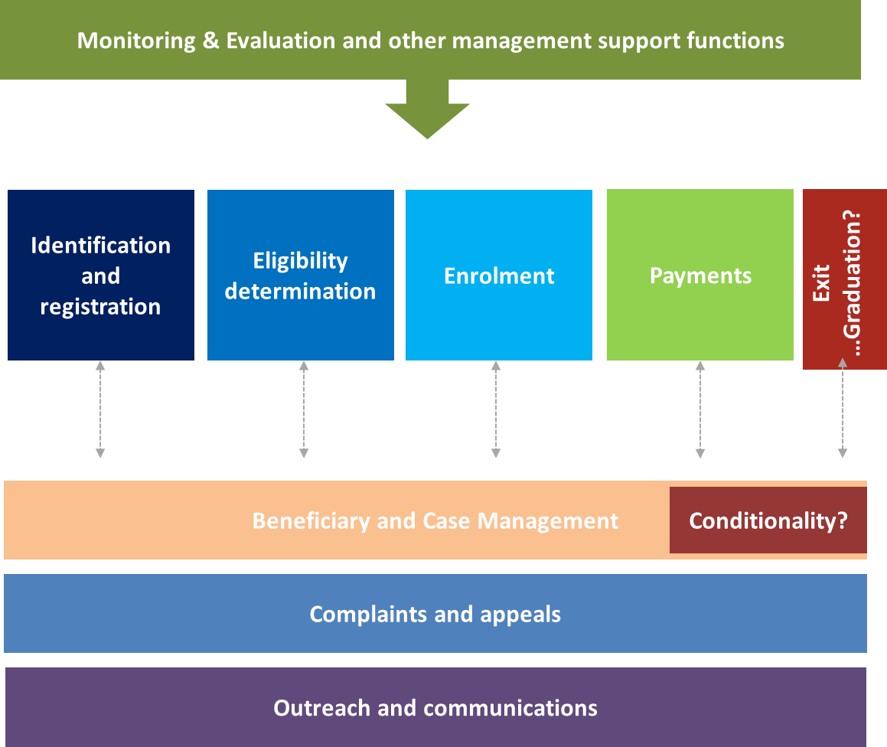
Payments and Delivery: Why important?
Ensuring transfers reach the right people, at the right time, in the right place, and in the right form… and the correct amount.
The way benefits are paid/delivered can:
mediate the impact of a program (e.g. spending patterns, financial inclusion)
affect the cost and risks faced by a program
affect burden on recipients.
Notes:
So, lets start with the detailed delivery systems.
We start with Payment/delivery systems and why these are important (explain slide – see base document for details)
Explain we will primarily focus on the delivery of cash payments as cash transfers are increasingly the preferred policy solution.

Slide 46


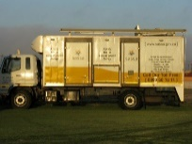

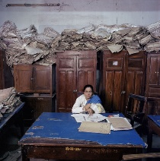
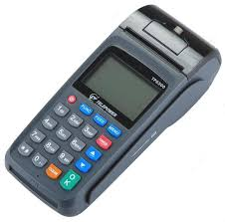
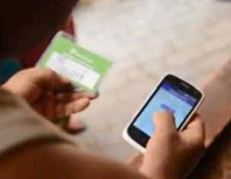


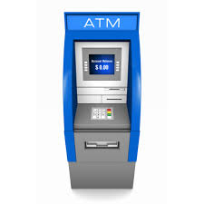
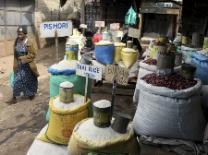
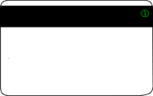


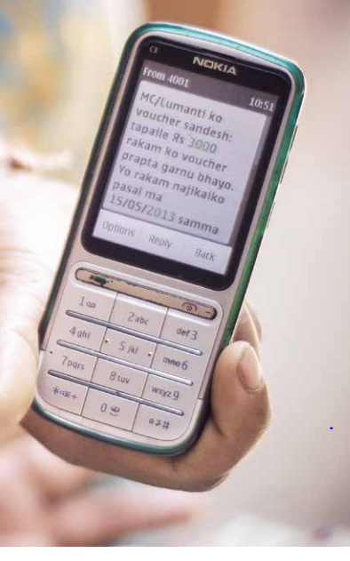
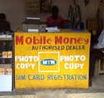
What are the main ways that payments are made?
Payment Instrument
Payment Device
Payment Point
Manual (pull)
Cash
Mobile Unit
None
Voucher
Gvt office/
building
POS
E-Voucher
Post Office
Electronic (push)
Local Shop
Pre-paid
ATM
Magstripe Card
Smart
Bank branch
Mobile Money
Phone
Mobile Money Agent
Notes:
..first of all it is important to clarify the terminology involved. We distinguish between:
Payment instruments, which can either be manual (cash or vouchers) or electronic (different types of cards, e vouchers and mobile money such as MPESA in Kenya)
Payment devices, through which the ‘transaction’ is made.. For cash transfers and non-electronic vouchers this will be an envelope or nothing! For electronic transfers it could either be a Point of Service device (POS), an ATM(most often at a bank) or even a phone..
These payment devices are used at different types of ‘payment points’: for cash delivery this could be a mobile unit with armoured vehicles travelling to a community. In Lesotho they used helicopters in some mountainous areas of the country! Government Office building such as local Social Welfare offices or sometimes schools have also been used in many countries, and post offices (which often have a wide network across the country) in several others. In many cases local shops can play a role in delivery of payments.. While increasingly bank branches and mobile money players are becoming bigger players.
If you follow the coloured dotted lines across you will see that different payment instruments can be used with different payment devices and delivered through different payment points. The combination of these three elements is the payment modality.
Next slide…

Slide 47
Developing a payment system
Each has strengths and weaknesses (discuss)
Key question: cost effectiveness given country-specific constraints (physical, financial and technological) and needs?
E-transfers not necessarily best option! So how to select? (discuss)
Source: Adapted from ISPA (2016)
Notes:
Developing a payment system is not easy as each option for payment instrument, device and point has strengths and weaknesses that all need to be evaluated against each other in light of the country’s context. In some cases, the ideal option may be for the system to offer different potential payment modalities to cater to all needs!
For example… payments through banks may be more secure.. But will require external subcontracting, need to be supported by a strong system for payment reconciliation (through MIS) and can only work if banks sufficiently distributed across the country (reducing travel time for recipients) Refer to table: Different 'payment channels', strengths and weaknesses
So how to select? mention some Recommendations for selecting a payment system
Remaining ‘technology agnostic’ when assessing pros and cons of different payment modalities
Choosing based on careful assessment of cost and quality (not just cost) – see Section 3.2
Making good use of any pre-existing delivery systems: e.g. choice is based on an assessment of a country’s financial infrastructure to verify the geographical coverage and efficiency of existing systems
Basing choice on a thorough understanding of local infrastructure (e.g. availability of electricity, frequency of power failures, availability and reliability of telephone lines and cell phones as well as the costs of using them), and legal framework
Considering expected size, timing, duration and objective of programme (e.g. high start-up costs worth it for larger/longer term or recurrent programmes; higher negotiating power if large/long term; if objectives include financial inclusion, need for ‘mainstream accounts’)
Selecting modalities that are flexible enough to respond to changing needs
Careful contracting and negotiating (including alternative payment systems in case of failure or discontinuity of a provider)
Up-front risk assessment and contingency planning
Institutionalizing monitoring and preparing to adjust when deemed necessary
Offering a choice of different payment modalities to beneficiaries as no single mechanism is able to serve all areas or respond to all needs

Slide 48
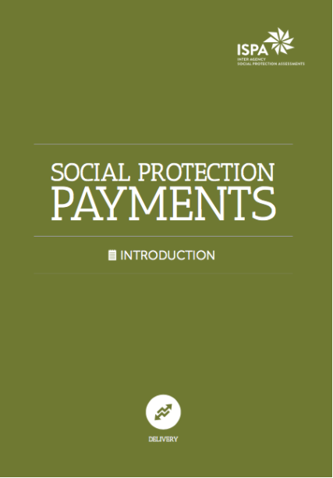

..ensuring ‘flexibility’ and ‘quality’
Essential to ensure flexibility and ‘quality’:
accessibility (low direct, indirect and opportunity cost of access, appropriateness to beneficiary needs, rights and dignity);
robustness (reliability, good governance and security)
integration (where possible a focus on financial inclusion and coordination)
Source: Adapted from ISPA (2016)
Notes:
See table: Payments: basic quality principles to be ensured.. And mention this can all be found in the ISPA payments tool, a very useful resource!

Slide 49

In-house (requires high capacity) or outsourced (requires careful development of contractual relations and ongoing monitoring)
Careful management of the overall flow of funds to guarantee timely disbursement
Management of the payment system
Notes:
It will also be important to think about whether payment system can be managed in house or can be outsourced.. See Box: Key contract features for payment providers
Whatever the scenario, it will be essential to ensure careful management of the overall flow of funds: you can have a fantastic payment system in place.. But if funds are not released in time from government then that will delay payments and reduce benefits of regular and predictable transfers
e.G in Mozambique financial year finishes exactly when lean season is.. And payments are always delayed exactly when people need it most

Slide 50
Monitoring & Evaluation, MIS and other management support functions
Validation
Payments/ delivery
Identification & registration
Eligibility determination
Enrolment
Exit …Graduation?
Beneficiary and Case Management
Conditionality?
Complaints and appeals
Outreach and communications
Source: Adapted from Lindert et al (2016) and Barrett and Kidd (2015)
Notes:
Next exit.. And graduation

Slide 51
Exit….or graduation….why important?
Can help focus on ultimate goal: moving ‘out’ of poverty and resilience
Can help ensure sustainability of program impacts – ideally in an inter-generational perspective.
...yet often driven by budget considerations and fear of creating dependency
Notes:
Discuss why important and risks as per slide… start clarifying that exit and graduation are very different things..

Slide 52


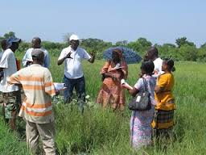
Defining key terms
Program Exit refers to the exclusion from the program of those that either passed away or no longer qualify
Graduation refers to the ability to exit a social protection programme by passing an eligibility ‘threshold’ (e.g. asset-based)
‘Developmental graduation’ can be pro-actively pursued through complementary activities
Notes:
Programme Exit refers to the exclusion from the programme of those that either passed away or no longer qualify (based on pre-determined programme criteria). Does not depend on a participant’s behaviour or economic status (e.g. age limits, time limits, etc)
MENTION that exit can greatly be improved through simple improvements to data management.. If there is a Civil Registration system in place that registers deaths reliably I the country (linking two databases)
Graduation refers to the ability to exit a social protection programme by passing an eligibility ‘threshold’ (e.g. asset-based). This is often intended as ‘graduating out of poverty’, or no longer needing external assistance.
‘Developmental graduation’ can be pro-actively pursued through complementary activities aimed to increase households’ income, skills, and human capital to promote better long-term welfare and self-reliance.

Slide 53
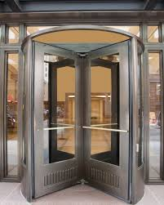

Guiding principles
Setting up systems to enable a ‘revolving door’
Facilitate movement into other support, as needed, including social insurance and social services.
Ensuring continuous receipt of support for those categories of beneficiaries and households for which ‘graduation’ or program exit is not an option (e.g. labour constrained).
Ensuring progress towards graduation outcomes
Notes:
However we set up our system we should keep these principles in mind..
Setting up systems to enable a ‘revolving door’ (rather than a ‘one-way door’) into the programme
Facilitate movement into other support, as needed, including social insurance and social services.
Ensuring continuous receipt of support for those categories of beneficiaries and households for which ‘graduation’ or programme exit is not an option (e.g. labour constrained).
Even when programmes do not have explicit graduation objectives, ensuring they facilitate progress towards graduation outcomes - for example by explicitly focusing on improving livelihood choices and productive income-generating investments

Slide 54
Monitoring & Evaluation, MIS and other management support functions
Validation
Payments/ delivery
Identification & registration
Eligibility determination
Enrolment
Exit …Graduation?
Beneficiary and Case Management
Conditionality?
Complaints and appeals
Outreach and communications
Source: Adapted from Lindert et al (2016) and Barrett and Kidd (2015)
Notes:
Next complaints and appeals

Slide 55
Complaints and Appeals: Why important?
Enshrined in Recommendation 202 on National Social Protection Floors
Outcomes of this process are fair, effective, and lasting and can contribute to:
Curb corruption and increase overall programme accountability
Increase citizen trust and involvement;
Solve operational issues on an on-going basis and standardise implementation (while reducing cost!)
Notes:
A Complaint and appeal Mechanism is a system that allows citizens to complain or provide feedback to the implementers of a given service, and allows implementers to respond to those complaints or feedback. By doing this, well-functioning Complaint and Appeal Mechanisms provide a predictable, transparent, and credible process to all parties, resulting in outcomes that are seen as fair, effective, and lasting.
Discuss why important based on slide text, explaining we often do not appreciate the fundamental role played by a strong ‘grievance system’ in increasing the credibility of social.protection and the state.. Good bang for the buck!

Slide 56
Complaints and Appeals.. challenges
Definitions: Complaints (informal and formal) vs Appeals vs Feedback..
Very few countries have effective systems guaranteeing:
Impartiality and consistency
Transparency, clarity
Effectiveness and rapidity
Accessibility and simplicity
Responsiveness
Proportionality
Confidentiality
And even where systems are in place, large demand and supply side barriers to complaining!
Notes:
Explain terminology:
Complaints: expression of dissatisfaction where the claimant is unhappy with the service rendered and potentially requests a changed outcome or action. These could in turn be:
‘Informal’ complaints that are easily solvable at point of contact, for example by providing additional information
‘Formal’ complaints that require action at higher level
Appeals: expression of dissatisfaction with a decision to provide or not provide a service/benefit. This is a quasi-legal procedure, involving a decision about the applicant’s statutory rights under legislation. By definition, these need solving at higher level.
Feedback: any comment, positive or negative, that any interested party wants to share to improve services. These need to be systematically collected, analysed and addressed.
Many different channels for complaints and appeals… some of them can be set up internally and some require external accountability mechanisms(ombudsmen, legal system, etc..)
NOTE for complaint and appeal mechanisms to be effective, Recommendation 202 specifies that they should be ‘impartial, transparent, effective, simple, rapid, accessible’, and ‘free of charge for applicants’. Other principles..
Impartiality and consistency: Each case has to be considered on its own merits and all evidence should be clearly documented and analysed. Decisions should be consistent.
Transparency, clarity: Complainants/appellants should be given a clear explanation of the criteria for accepting complaints/appeals and a guide to the way they will be addressed including speed of response and staff behaviour. Outcomes should be transparent.
Effectiveness and rapidity: Complaints should be resolved as quickly as possible. Local level points of contact should deal with simple complaints, while a system for regular internal reporting should facilitate escalation of unresolved complaints.
To facilitate easy use, complaints and appeal mechanisms should be simple and rapid.
Accessibility and simplicity: the service should be known, free to use, open, simple and available to all who need it. Awareness material should be available, personnel should be contactable by letter, e-mail and telephone, literacy and language barriers should not exist.
Responsiveness: The mechanism should respond to the needs of all complainants. Special measures may be needed for managing contacts with appellants who have particular needs and for responding to unreasonable demands or behaviour of complainants and appellants. This requires proper training of staff and adequate resources.
Proportionality: this implies an assessment of the complaint and a response to it that takes into account the nature of the issue and the effect it has had on the complainant/appellant. The depth of the investigation and the time taken may be proportional to the seriousness of the issue, however quality of evidence and investigation should remain.
Confidentiality: Complainants have a right to expect that their privacy will be respected and their complaint will be investigated in privacy.

Slide 57
Complaints And Appeals Force-field Analysis
Notes:
To get delegates to think through the demand and supply side barriers that inhibit any complaints and appeals system from working, even where it has been set up (which often isn’t even the case!). Especially, that we often forget about the ‘demand-side’ bariers, such as beneficiaries being too embarrassed to complain. Delegates should understand there are ways we can design systems to overcome these common challenges.

Slide 58
Lewin’s ‘Force Field’ Change Model
Forces for change
Forces resisting change
Driving forces
Restraining forces
Notes:
Introduce concept of a ‘force-field’. Kurt Lewin's force field analysis change model was designed to compare the driving and restraining forces that affect change in organizations. The 'force field' can be described as two opposite forces working for and against change. We will continue working with this concept over the next few days: it is a useful tool to analyse the potential for change in an existing system.
Explain that there is a supply side: administration resisting complaints, and a demand side: people not complaining.
And that solutions to these are multiple!
If we wanted to identify the driving forces for change and the restraining forces allowing us to improve the complaints & appeals system in your country, what would these be on both the supply and demand side?

Slide 59
Force Field Analysis: Complaints & Appeals
Brainstorm restraining forces on 1) the demand side and 2) the supply side (7 min.)
Now brainstorm driving forces on 1) the demand side and 2) the supply side (7 min.)
Prepare to present your two most important restraining and driving forces on both the demand and supply side and appoint a spokesperson
Demand driving
Demand restraining
Supply driving
Supply restraining
Notes:
Form three groups and take 15 min. to brainstorm and record your findings on your flip chart.
Ask participants to form three groups and give them the task as set out on the slide.

Slide 60
Supply… and demand side barriers
People may not complain as:
They don’t feel entitled to the service they receive
Lack of information/understanding
Not being able to afford the time and resources to make a complaint
Sceptical about the credibility of the mechanism and whether complaining changes outcomes in particular
Reluctant to challenge the authority of decision-makers
Concerns about the repercussions of giving negative feedback
Existing mechanisms not appropriate
Staff will oppose as:
Resistance to ‘criticism’
Resistance to additional work burden
Complaints difficult to address
Lack of training
Lack of process
Lack of capacity
Notes:
SLIDE FOR SUPPORTING DEBRIEF of supply and demand side barriers/restraining forces
Point out importance of understanding the “push and pull” nature or demand and supply side factors that affect a complaints and appeals system.
All these forces need to be tackled with system design.

Slide 61

Guiding principles
Accessibility and effectiveness of programme complaint and appeal mechanisms can be improved by…
Proximity
Multiple channels
Respond to barriers
Independent channels
Publicised
Notes:
Accessibility and effectiveness of programme complaint and appeal mechanisms can be improved by:
Resolving complaints and appeals at the point of service delivery where information and transaction costs are lowest.
Ensuring multiple channels for receiving complaints and appeals to guarantee complainants’ convenience, cultural preference, and ease of use
Ensuring channels respond to supply and demand-side barriers faced by complainants and appellants (see discussion above).
Enabling independent channels for redress and strengthening other systems for accountability
Ensuring that the system is widely publicised through communication strategies specifically targeted to the poorest and most marginalized households

Slide 62
Monitoring & Evaluation, MIS and other management support functions
Validation
Payments/ delivery
Identification & registration
Eligibility determination
Enrolment
Exit …Graduation?
Beneficiary and Case Management
Conditionality?
Complaints and appeals
Outreach and communications
Source: Adapted from Lindert et al (2016) and Barrett and Kidd (2015)
Notes:
Next outreach and comms..

Slide 63
Outreach and communications…why important?
Enshrined in Recommendation 202 and a right
Enhances programme implementation and performance – ultimately impact
Facilitates public dialogue, participation and social awareness
The quality of communications affects the functioning of programme processes, most notably targeting, benefit take-up and complaints and appeals – yet are often under-funded
Notes:
Go through slide.. Recommendation 202 says: : “when formulating and implementing national social security extension strategies, Members should (…) raise awareness about their social protection floors and their extension strategies, and undertake information programmes, including through social dialogue”.
This principle is also enshrined in the ‘Standards of Accessibility, Adaptability and Acceptability’ of the Committee on Economic, Social and Cultural Rights (CESCR) under the United Nations Economic and Social Council (ECOSOC), stating that: “beneficiaries of social protection programmes must be able to participate in the administration of the programme, as well as have the right to seek, receive and impart information on entitlements in a clear and transparent manner”.
More than merely providing information, communications facilitates public dialogue, participation and social awareness, and provides a mechanism to enhance program implementation and performance (e.g. increasing take-up).

Slide 64
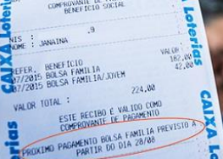
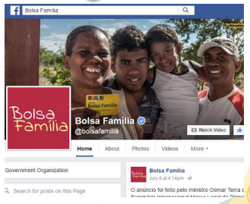
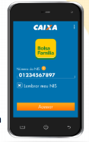
Core program communications: audiences
External audiences: Rights and responsibilities, practicalities of receiving SP, reach and impact of programmes
Many innovative ways of doing this!
Internal audiences: ensuring staff are motivated and well informed – just as important
Notes:
Communications need to cater to very different audience types..
External audiences typically include program beneficiaries (actual and potential), decision makers at all political levels, academia, the media, and civil society.
Many innovative ways to do this! Pictures on right so some examples, many from Brazil! E.g. Using bills, social media, a tailored application software, videos..
Internal audiences are primarily programme staff who have a right to be adequately informed of any changes to programme design and implementation! Yet this is rarely a priority: bulletins, internal newsletter etc,,,

Slide 65



Core program communications: principles
Overarching principles :
Budgeting for communications!
Developing a targeted communications strategy by audience, with focus on inclusion of illiterate, marginalised, etc.
Providing all materials in an understandable format and language, while avoiding stigmatising imagery and words.
Adopting a range of approaches to spreading information
Ensuring all communicating are an on-going and iterative effort
Notes:
Principles (details):
Budgeting for communications from the outset (see Brazil’s experience explained in Box of Base Doc)
Developing a targeted communications strategy by audience, focusing on the different information needs of programme beneficiaries vs. non-beneficiaries, literate vs. illiterate, village officials vs. normal citizens, urban vs. rural, men vs. women, etc. Special efforts will have to be made for minority groups (ethnic or religious minorities) and remote locations.
Providing all materials in an understandable format and language. Consider special approaches for low literacy rates and avoid stigmatising imagery and words. For face to face communications, translation services and sign-language specialists may be required in certain contexts.
Adopting a range of approaches to spreading information (see options listed above), noting that each communication channel is appropriate to a different population segment. For example, poor or remote households may not have televisions or radios. Moreover, often marginalised households only trust ‘local’ sources, so ensuring community-level information is important: training local leaders; leaflets in strategic places, such as places of cult, schools, hospitals, post offices, markets, waiting rooms, etc; face-to-face, informal meetings in local communities
Ensuring all communicating are an on-going and iterative effort, rather than a one-time launch and updating / adjusting messages over time.
Where possible, creating a ‘brand name’ and a unique identity for the program. Recognizable slogans and logos have the capacity to capture the attention of target audiences

Slide 66
Monitoring & Evaluation, MIS and other management support functions
Validation
Payments/ delivery
Identification & registration
Eligibility determination
Enrolment
Exit …Graduation?
Beneficiary and Case Management
Conditionality?
Complaints and appeals
Outreach and communications
Source: Adapted from Lindert et al (2016) and Barrett and Kidd (2015)
Notes:
Next complaints and appeals

Slide 67

Conditionality: Why important?
Steering the use of social transfers towards ‘socially relevant’ outcomes: can enhance programme impacts (especially first order)
‘Co-responsibility’ – can help increase programme support (e.g. among middle classes)
YET conditionality comes at high cost to beneficiaries and governments, and can effectively be achieved in other ways…
Source: Adapted from Pellerano and Barca (2014)
Notes:
conditional cash transfers (CCTs) are designed so as to incentivise ‘desirable’ behaviour through a set of ‘spelt-out’ conditions. If these conditions are not met, the transfers are not given.
Whether or not conditions should be imposed on cash transfer programmes is an open debate. In Latin America, a successful wave of CCTs has been implemented as of the late 1990s, but in Sub-Saharan Africa – where unconditional benefits (generally defined as unconditional cash transfer programmes or UCTs) have long occupied the social protection scene – the debate is not yet settled…
Why not? While CCTs have several advantages (beyond the obvious ones, they can also increase middle class support compared to unconditional cash transfers as they ensure ‘co-responsibility of the poor’) – they can come at a high cost to:
beneficiaries (in terms of compliance: direct, indirect and opportunity costs)
governments (in terms of implementation: monitoring and enforcing conditionality is very expensive and creates administrative burden).

Slide 68
How can behaviour be conditioned?
Four main approaches to conditioning behaviour:
Conditioning ‘on access’ (characteristics of those targeted)
‘Implicit’ conditioning (intrinsic design characteristics)
‘Indirect’ conditioning (complementary actions and labelling)
...Beyond ‘Explicit’ conditionality (CCTs.. monitored and enforced)
Cost-effectiveness of each needs to be carefully evaluated in light of country context and objectives!
Source: Adapted from Pellerano and Barca (2014)
Notes:
recent research is increasingly showing that conditionality can be effectively achieved in other ways.. Not just ‘explicit’ conditionality of CCTs!
Conditioning on access: beneficiaries of cash transfer programmes are explicitly targeted based on a defined set of socioeconomic characteristics aimed at filtering out non-poor households. These explicit eligibility criteria tend to target a set of beneficiaries who have particular needs and therefore display similar patterns in the use of their transfers.
Implicit conditioning: intrinsic characteristics of the programme design (e.g. the nature of the transfer, its delivery mechanisms, etc.) may also act as a conditioning mechanism. The decision to deliver transfers via electronic cards, for instance, may increase a household’s propensity to save – while delivering money through schools has been shown to affect schooling impacts. Also ‘labelling effect’: eg Child Grant Programme signals use for children even if not conditioned: had big impact in Lesotho on spending decisions!
Indirect conditioning: the use of cash transfers can be further conditioned by complementary policy actions that are implemented in conjunction with the transfer. This happens, for example, when beneficiaries are involved in training/education sessions where they are provided with information on the ‘best’ use of the transfers..

Slide 69


What does it imply?
Tailoring to country context
With no monitoring/enforcement explicit conditionality is ineffective and counterproductive. Yet in practice this requires:
agreements (MoUs, etc) and ongoing coordination
compliance verification (e.g. MIS integration)
cadre of staff at local level
Notes:
What does this mean for a country choosing whether conditionality may be useful in their context?
Understanding what form of conditionality may work best.. Given their situation- considering: existing supply of services and capacity for scale-up, poverty levels, implementation infrastructure and monitoring costs, beneficiaries’ compliance burden and political feasibility… In Sub-Saharan Africa conditionality may be less appropriate! For example a key precondition is ensuring conditionality goes hand in hand with adequate and quality provision of services… so as not to have a programme conditional on attendance in a school that is too far away or offering low quality education..
Understanding that if explicit conditionality is not monitored and enforced it is ineffective – in fact it could create perverse incentives. Yet that monitoring/enforcing requires a lot of work..
What does monitoring and enforcing explicit conditionality involve? What is best practice in this regard (see also Samson et al, 2010)?
Creating institutional agreements (MoUs, etc) and maintaining ongoing coordination with key stakeholders involved in the monitoring process – most often schools and health centres/hospitals/etc, through their respective line Ministries
Training a cadre of staff at local level to proactively monitor the enforcement of conditionalities (see also Section 6 on Case Management), provide warning and offer intermediation services and support to non-compliant beneficiaries. Rigidly imposed conditionalities are more likely to exclude the poorest most vulnerable. For example, automatic cuts in benefits implemented without adequate warning and direct intervention can compound shocks that may have led to the failure to comply. Moreover, in the absence of effective and appropriate controls, the incentive effects of conditionalities may encourage parents or guardians to send ill children to school or to otherwise make decisions that, in the absence of the cash transfer, would have negative consequences for the child, the household and the community.
Ensuring cost-effective mechanisms for compliance verification. The simplest conditionalities to monitor involve discrete choices, such as school enrolment. However, more effective conditionalities from a policy perspective require monitoring of continuous decisions over time, such as school attendance. Expecting schools to provide such data can be complex in low capacity settings, and this has been tackled by providing additional funding for schools. Where the supporting infrastructure exists and data is already collected, instant monitoring can be made possible by integrating programme MISs (or national MISS) with existing education/health MISs (see Module xxx ).
Developing a clear strategy for enforcing penalties which is widely communicated and understood by beneficiaries.

Slide 70
Conditionality:
Is It Feasible?
Notes:
To get delegates to think through the demand and supply side barriers that inhibit any complaints and appeals system from working, even where it has been set up (which it often isn’t!). Especially, we often forget ‘demand-side’ barriers.. such as beneficiaries being too embarrassed to complain. Delegates should understand there are ways we can design systems to overcome these common challenges.
IMPORTANT NOTE to facilitator: this exercise can be replaced by an identical one on graduation if that is considered more relevant. READ section on graduation and discuss how/what is feasible in country

Slide 71
Conditionality… is it feasibile?
Gather in small groups of 4-6 participants
Read Page 29 of your Summary Admin Document Consider your country context versus those considerations.. And discuss whether you feel conditionality is appropriate for your social protection programmes..
Why/why not?
What would you need to change?
What challenges do you expect?
Appoint a group spokesperson to feed your group’s findings back in plenary
Notes:
See Activity Guide and Facilitator guide

Slide 72
Monitoring & Evaluation, MIS and other management support functions
Validation
Payments/ delivery
Identification & registration
Eligibility determination
Enrolment
Exit …Graduation?
Beneficiary and Case Management
Conditionality?
Complaints and appeals
Outreach and communications
Source: Adapted from Lindert et al (2016) and Barrett and Kidd (2015)
Notes:
To conclude.. Lets remember this all happens at programme level

Slide 73

Programme 1
Synergies.. Cost saving!
Programme 2
Programme 3
Source: Adapted from Lindert et al (2016) and Barrett and Kidd (2015)
Notes:
Yet there may be synergies – and COST SAVING - in administering some of these functions commonly across different programmes! For example, a country could decide to create a common complaints and appeal procedure for all of its programmes (e.g. a national hotline and trained staff and mobile units at local level that work across programmes).

Slide 74
Scenario Work: Admin
Notes:
Invite participants to gather in their scenario groups and introduce task on next slide to them

Slide 75
Activity: Admin Scenario Work
Draw knowledge from your reading on administration
and notes made during the mini-lectures
Your task (15 min.): Analyse the administrative and delivery systems used in your scenario (strengths, weaknesses?). Think about:
Is there potential for integration across the administrative systems of different programmes? (e.g. to avoid duplication)
Is technology being used adequately?
Is there sufficient capacity to run these systems?
How does this relate to your home country?
Appoint a group spokesperson to feed your group’s findings back in plenary

Slide 76
Key take outs for Administration
Analogy for full integration
What do you know now that you did not know before?
What shift in your thinking did you experience?
What would you do differently now?
Notes:
Invite participants to contribute their major AHA moments, resulting in SP learning take-aways, insights and mind shifts on the topic of Administration – create one flip chart with the title Administration to record all the contributions
Use the following three questions to elicit participant contributions:
What do you know now that you did not know before?
What shift in your thinking did you experience?
What would you do differently now?

Slide 77

Overnight assignment and closure Day 2
Analogy for full integration
Notes:
Assign overnight reading in preparation for Day 3

