Slide 1

LEADERSHIP & TRANSFORMATION CURRICULUM:
BUILDING & MANAGING SOCIAL PROTECTION FLOORS IN AFRICA
DAY 3
Coordination / M&E and Accountability Systems

Slide 2
SP COORDINATION

Slide 3


Ensuring policy coherence.. To avoid fragmentation
Pregnancy
& ECD
Active-Age
Adults
Disabled
Elderly
Families
Childhood
Youth
Cash Transfers (UCT or CCT)
Public Works
Disability Assistance
Social Pensions
Food Stamps/ vouchers
Birth, Child Allowances
Scholarships
In-Work Benefits
Contributory Pensions
Maternity
Benefits
School Feeding, Supplies, Transport
Care-Giver
Allowance
Housing Subsidies
Unempl.
Assistance
Disability Insurance
Survivor & Death Benefits
Nutrition Supplements
Services for At-Risk Youth
Unempl.
Insurance
Utility Subsidies
Food Stamps/vouchers
Parenting Services
Sickness & Injury
Utility Subsidies
Transport Subsidies
ECD & Nutrition
Transport Subsidies
Training & Skills
Active
Aging Services
Family Services
Child Care Services
ALMP / Activation Services
Financial & Productive
Inclusion Services
Source: Adapted from Lindert
Intermediation, Counseling, Psycho-Social Support Services
Disaster
Services
Child Protective Services
Legal services
Social & Long-Term
Care Services
Notes:
Remind them how we had mentioned yesterday that many countries may have a myriad of uncoordinated programmes…or insufficient programmes to address needs.. That is where coordination comes into the picture

Slide 4
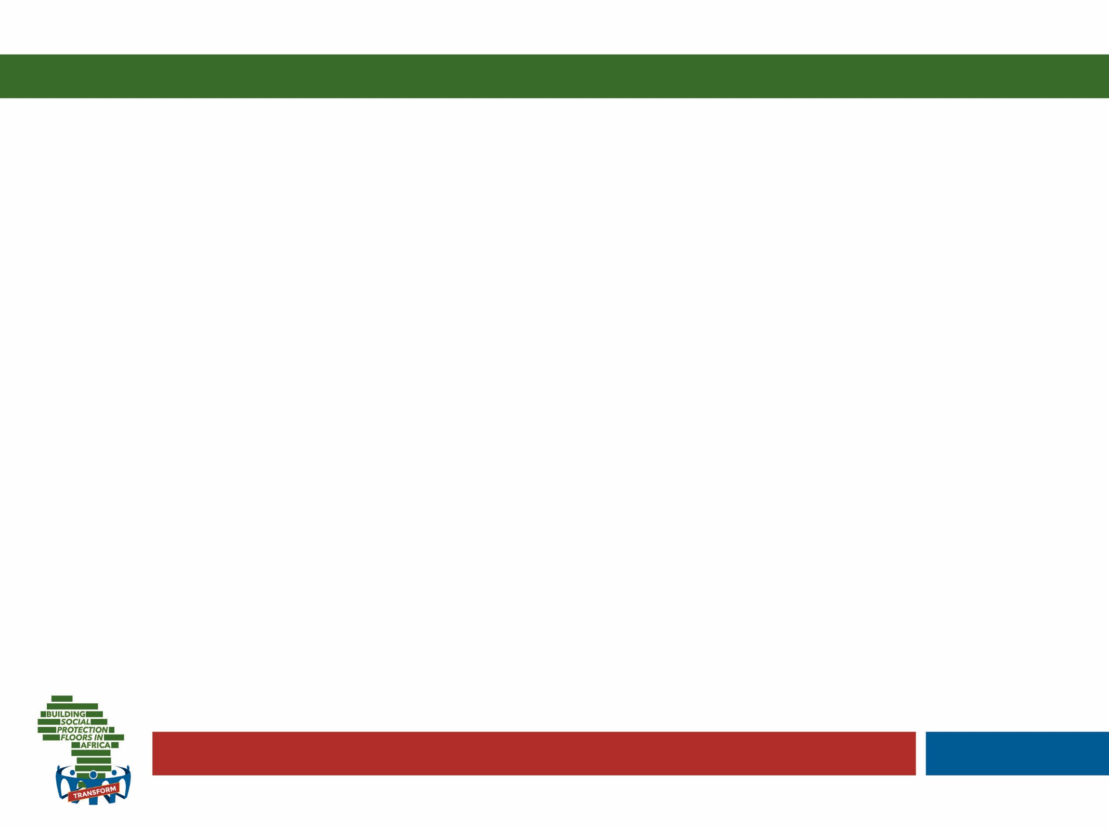
What is SP coordination?
The alignment and harmonization of all stakeholder activities (at the programme and administration level) in a coherent and holistic way to reach clearly identified and shared objectives (at the policy level) - horizontal
A vertical link is also required between the policy and the operational levels
Notes:
Discuss the differences between vertical and horizontal coordination..

Slide 5


c
Brainstorm…
What are the advantages of coordination?
And the risks?
Notes:
Plenary brainstorm.. (10 minutes)

Slide 6
…why important?
Expands access and improves equity
Helps to convey ‘big picture’ strategic issues (sustainability)
Strengthens resilience to poverty
SP coordination
Reduces costs of service delivery
Allows for pooling best of resources and skills for better results
Reduces duplication and fragmentation
Notes:
Build on brainstorm..
Why important? Build on brainstorm
Also..
Provides potentially better results for the population (e.g. universal coverage).
Helps convey the ‘big picture’ or strategic goals (e.g. sustainable development), which are not always captured by individual agencies’ or ministries’ objectives.
Helps realize synergies and maximize the cost effectiveness of policy and/or service delivery.
Generates economies of scale (e.g. sharing of infrastructure, facilities, data and information, and property, among others).
Sets a precedent for the way a government operates that can be used in other areas beyond social protection.
Improves client focus and thereby service quality and user-friendliness.
Assists with prioritization, resolution of potential conflicts, and trade-offs in decision-making.
Improves working relations with other agencies and ministries that are likely to be critical to future successes, and the achievement of cross-cutting objectives (e.g. formalization).
Contributes to the empowerment of local administrations, and therefore to the success of decentralization processes

Slide 7
…but also risks!
less clear lines of accountability for policy development and service delivery
longer decision-making processes
greater difficulty in measuring effectiveness and determining impact
direct and indirect costs of management and staff time spent establishing and sustaining joint working arrangements
consensus and "lowest common denominator" at the expense of making tougher decisions about trade-offs to get better
Notes:
Build on brainstorm..

Slide 8



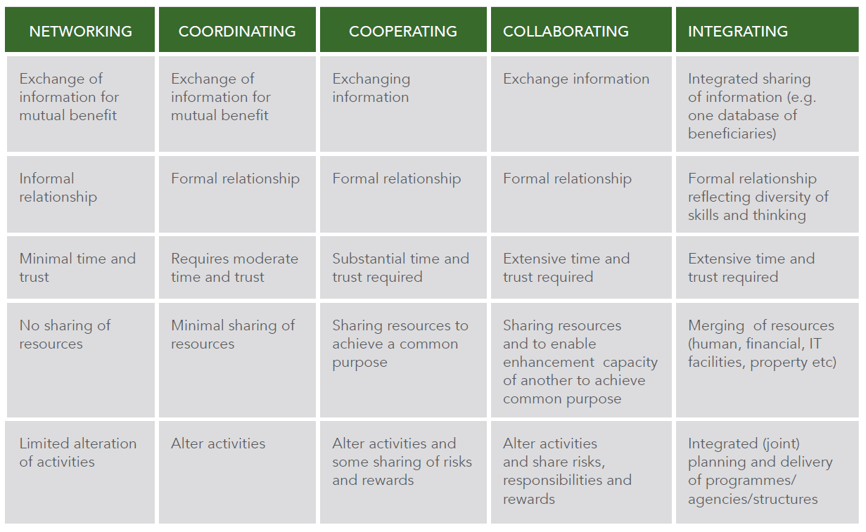
Increasing levels of trust
Increasingly sharing resources, risks and rewards
Notes:
Explain that..
Coordination can be seen as part of a continuum of relationships which require gradually increasing levels of trust and the sharing of resources, risks and rewards. The continuum may start with networking (no sharing of resources), then move to coordination (minimal sharing of resources), to cooperation (some sharing of risks and rewards), to collaboration (sharing of risks, responsibilities and rewards) and finally to integration in the form of merging programmes and structures into one. This is captured in the table below

Slide 9
System goal: prevention & alleviation of poverty, vulnerability & social exclusion
Universal access
to basic health care & income security for all
children, working age population & older persons
Horizontal coordination: Policy level
Health
Social insurance
Social assistance
Employment services
Other sectors…
Horizontal coordination: Programme level
Vertical coordination
Horizontal coordination: Administration level
Adequate budget financed
by national resources
(contributions and taxes)
Integrated National Social Protection Policy and Strategy
Notes:
Now we go into the detail! We could see coordination as a Greek temple where the pillars are the wide variety of services offered (social assistance and beyond).. the core objective represented as the ‘roof’ is universal access to basic health care and income security for all.. And the coordination elements cutting across are:
Vertical
horizontal.. At three levels: administration, programme and policy..
We will look at these coordination dimensions in turn.

Slide 10
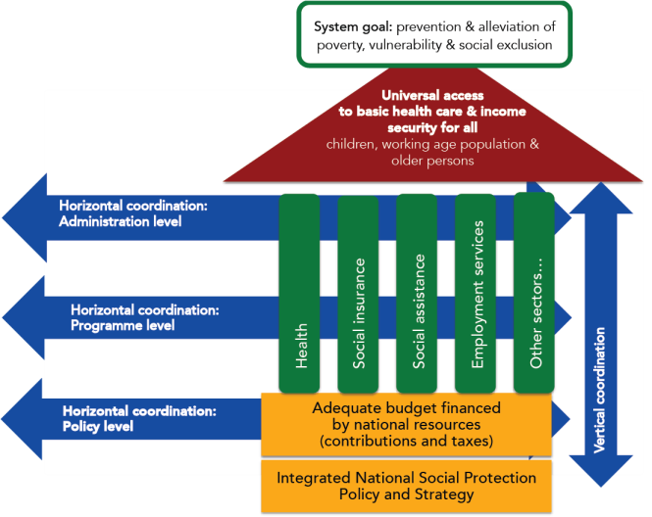
Horizontal co-ordination at policy level
Aim: Ensuring overall policy coherence across government bodies
strategic vision to improve integration and coordination
development of policies and legal frameworks
choice of programmes and mandates
mapping financial and institutional arrangements
Horizontal coordination at policy level
Notes:
Horizontal coordination at the policy level
The policy level is the highest level of engagement, where the objectives and functions of the social protection system are defined in the context of national goals and parameters.
It includes the overall strategic vision to improve integration and coordination across programmes and functions.
Policy and legal frameworks are developed to establish guiding principles to support social protection and inter-sectoral coordination.
The choices about programmes and their mandates are made at this level.
It assists in mapping out the financial and institutional arrangements that need to be put in place to facilitate coordination between different ministries and sectors.
(if there is interest go into details below)
Step 1: stakeholder analysis - An initial step in improving policy coordination is to establish who the relevant stakeholders are with regards to social protection in order to include them in the process of policy development or review.
Step 2: SP working group - To ensure that the social protection policy is developed and reviewed in an integrated and comprehensive manner, preventing the various stakeholders from working in silos, a coordinating advisory structure could be established. This could be in the form of an inter-ministerial / inter-agency team or working group to provide a platform to share information and knowledge among social protection practitioners. The creation of such a team could also strengthen the impact of policy and technical advisory services provided to governments since this guidance would be collegially discussed.
Step 3: Develop/review SP policy – Note we have already discussed the importance of a legal framework… The definition of shared priorities for the extension of social protection and the implementation of a SPF should be enshrined in a national social protection policy and strategic framework. The adoption of a national social protection policy and strategy is an efficient way to maintain priorities despite changes in the government. It also provides official support to formalize the vision of the country in terms of social protection development and its implementation path. The preparation of such a policy and strategy also forces a country to ensure the coherence of social protection development policies with other national policies, notably with respect to available funding (fiscal space allocation).

Slide 11
Horizontal co-ordination at program level
Aim: improving design of existing programmes and promoting harmonization across the portfolio of programmes.
Integration of similar SP schemes and programmes
Maximizing synergies and strengthening linkages with programmes
in different sectors.
Notes:
Horizontal coordination at the programme/institutional level – explain we have actually discussed this a lot already, for example when we were talking about selection and identification..
Aim: improving design of existing programmes and promoting harmonization across the portfolio of programmes.
When social protection programmes are aligned with poverty reduction as well as social inclusion strategies, this results in more multi-sectoral coordination which is better able to provide solutions in a more holistic and development-oriented manner.
A key element of an integrated social system is its ability to identify and maximize synergies between programmes in the social protection space and in different sectors (e.g. health, education and child protection), and thus enhance long term, human development outcomes.
Main instruments to achieve this.. Are:
Set up a social protection coordination unit/agency at national level (as programmes often implemented by different ministries/institutions)
Select the relevant programming approach suitable for the country
Develop an integrated programme plan with clear outcomes for social protection in line with the SPF and the national priorities
Ensure the needs of beneficiaries are included in the programme plan
Install a common monitoring and evaluation system for the implementation of the plan

Slide 12
Four approaches to strengthening coordination
 | Design or adapt stand-alone interventions
 | Simultaneously
 | Sequenced over time
 | Aligned and harmonising existing programmes
Notes:
But what level of harmonisation is possible between programmes? Four potential approaches..
Design or adapt standalone interventions
This is where freestanding programmes can be designed or adapted to maximise coordination between two sets of objectives. For example, agricultural programmes can be designed to incorporate social protection into their designs; and social protection interventions can be designed to be coordinated with agricultural livelihoods programmes. Discuss pros and cons based on base doc..
Combine multiple interventions into one programme (simultaneously or over time..)
Two sets of interventions can be combined into one programme so that targeted households participate in both interventions. The single programme is implemented by a single agency. Different components/programmes can be provided to the same household simultaneously (e.g. including public works and agricultural support components in a food security programme; providing access to health insurance scheme to cash transfer beneficiaries) or sequenced over time depending on what the household needs. When interventions are sequenced over time, as a household’s welfare status improves, the package of interventions could expand from social transfers to include a broader menu of complementary interventions.
Coordinate and align multiple programmes and policies
Synergies between many different social protection interventions can be established even when these interventions are not delivered in the same locations or targeted to the same beneficiaries. It could involve interventions being coordinated to reach the same households but through two independent programmes. For example, in Lesotho, agricultural livelihood and cash transfer interventions are being coordinated to reach the same households, but through two independent programmes and implemented by a number of agencies. The Government of Lesotho delivers the Child Grant Programme and FAO and partner non-governmental organizations complement this with support for kitchen gardening, which includes provision of seeds and training. Alignment involves ensuring that interventions are consistent and that, as much as possible, conflicts are addressed or avoided.

Slide 13
Horizontal co-ordination at administration level
Aim: improve efficiency in delivery, enhance quality of service from the perspective of users, reduce duplications and transaction costs
Focused on ‘nuts and bolts’
Notes:
Horizontal coordination at the administrative level
Aim: improve efficiency in delivery, enhance quality of service from the perspective of users, reduce duplications and transaction costs.
The separation of roles and responsibilities existing in the design of social protection policy and programmes, is often replicated within each layer of the subnational administration, including at the community level, where social protection delivery takes place, resulting in lack of coordination in the administration and implementation of social protection schemes both centrally and at the local level….This level therefore includes the coordination of systems that support the roll-out of one or more programmes. The focus is on the ‘nuts and bolts’ that facilitate the core business processes of social protection programmes.
Coordination at the operational level consists of the integration of the following administrative functions: provision of information; identification, selection and registration of recipients; provision of identification documents; collection of contributions; payment or benefit delivery mechanisms; provider contracting; M&E; and complaint and grievance systems. Depending on the country context, existing coordination efforts will cover only some of these functions.
Could include:
Coordination between different local administration departments
Coordination between the local administration and deconcentrated services (divisions and agencies)
Coordination between the local administration and relevant stakeholders working at the operational level (social partners, civil society organizations, development partners) as well as households and women

Slide 14
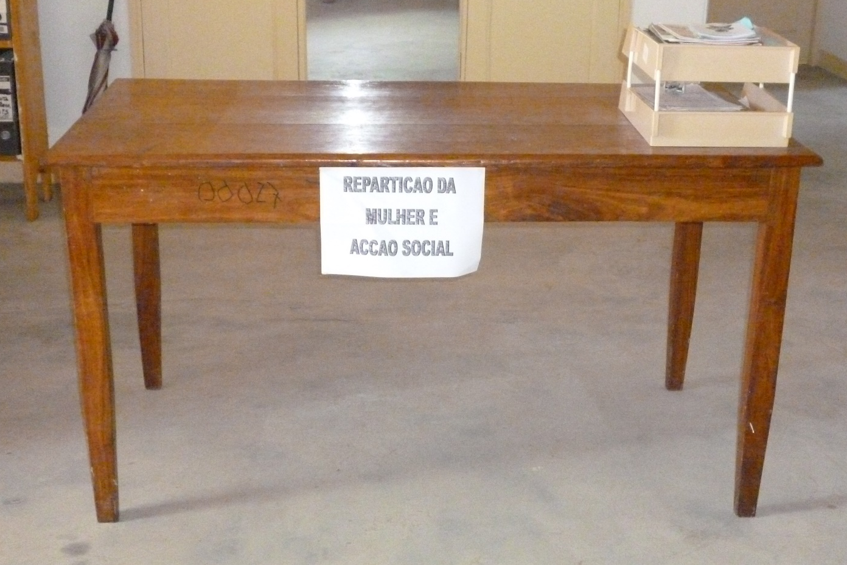

Tools for improving coordination:
Front and back office services
Notes:
Key instruments for improving coordination at this level? front and back office services
Back office integration (computer picture): ensuring coordination in the process of… Asking for information from responsible entities of different programmes; Check documents for validity, correctness and completeness; data entry and transfer to entities responsible for different programmes; Follow up of registration process and communication with responsible entities, further processing; Follow up on complaints and appeals with responsible entities for the respective programme
TOOLS to do this: shared MIS and related database.. shared registration and selection of beneficiaries across programmes..
Front office (desk picture, foto from Mozambique where that one table was the extent of the Ministry’s presence at decentralised level): ensuring coordination in the process of… providing Information and advice; Support of registration process (provision of registration forms, support to complete forms, submission of registration form, etc.); Acquisition and verification of identity and data; Notification and hand-out of identification documents (e. g. smart cards); Receive complaints and appeals and communicate results.
TOOL to do this: Front office integration does not necessarily require a shared facility by various ministries and service providers but should have as its primary objective to coordinate and provide effective service delivery to its clients. This requires willingness by the various ministries and service providers to come together and map out how they can streamline the services. Single Window Services or One Stop Shops (have they ever heard of these words?) are one example solution… Noting integration can happen at different levels..

Slide 15
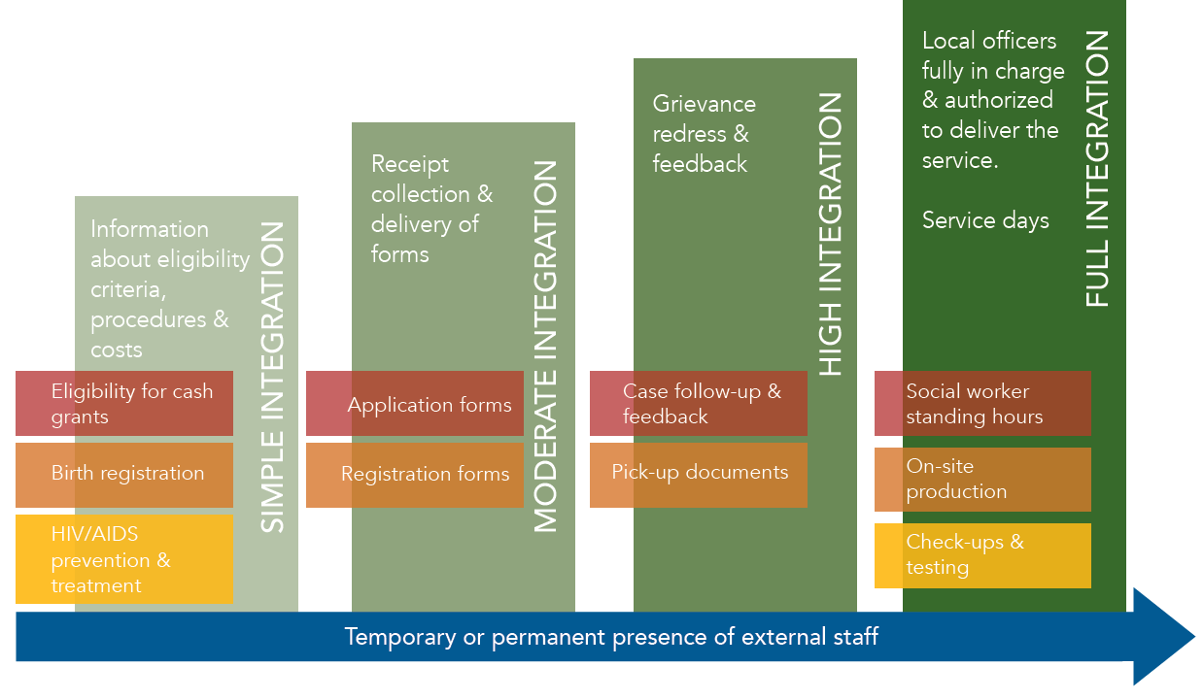
Level of integration of front office
Notes:
Especially at the front office level full integration and coordination at local level can only happen where there are staff in place (capacity!).. And in increasing degrees of integration from simple information sharing to creation of an ad-hoc office integrating functions autonomously..

Slide 16
…Linking services, an overview
Health
Education
Housing, water and Sanitation
Nutrition
Access to medical services
Nutritional support
Clean water & safe latrines
Reproductive health
Ensuring enrollment/ attendance
Fees/barriers to entry
Social protection & promotion
Complementary SP programmes (contributory and non)
Decent living conditions
Scholarships etc
Welfare and safety
Social care services, including psychosocial support
HIV-AIDS
Legal assistance
Birth registration/ legal documents
Protection from abuse/assault
Case management
& Referral System
Source: Adapted from unpublished
Oxford Policy Management work in Zambia
Notes:
Critical for the harmonization between social protection programmes is an effective referral system… the assumption being that those households who are covered by social protection face a wide variety of risks and challenges that are catered for by other services in other sectors.. A referral system ensures these are catered to holistically through one touch-point at local level.
Mention examples of One-stop shops in Lesotho and South Africa from Base Doc.

Slide 17
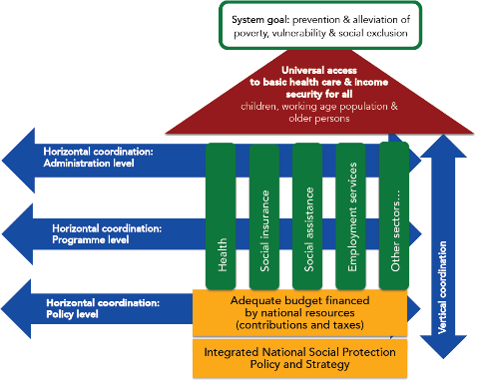
Aim: ensure consistency,
responsiveness to local context &
accountability in programme implementation
Takes place between the different levels of government (federal, national, provincial/regional, district, and commune/village)
Each layer of the social protection system depends on the other layers to perform its own duties.
Vertical co-ordination
Notes:
Vertical coordination
Aim: ensure consistency, responsiveness to local context and accountability in programme implementation
Coordination is considered to be ‘vertical’ when it takes place between the different levels of government (federal, national, provincial/regional, district, and commune/village) in order to guarantee the implementation of the defined policies, the financial sustainability of the social protection system, and the decentralized delivery of social transfers to beneficiaries.
Vertical coordination is based on the recognition that each layer of the social protection system depends on the other layers to perform its own duties. For instance the operational layer needs to respect the parameters of the schemes defined at higher level. Reversely, the planning layer requires certain types of information from the field to be accurately completed.
Objectives of vertical coordination are to:
Ensure consistency with policy vision and programme design during the implementation
Improve efficiency of the administration through the principle of subsidiarity by empowering local administrations and other structures at the local level
Improve the level of information, accountability and ownership at all levels
Ultimately, the social protection system needs to be consistent with deconcentration and decentralization policies, as well as with local administrative capacities….

Slide 18

Tools and processes to improve vertical
co-ordination
Streamline vertical coordination structures
Clarify the roles and responsibilities of the different administrative layers
Ensure that coordination mechanisms have necessary mandates and capacity to coordinate
Develop guidance/operational manuals to guide vertical coordination of social protection
Create incentives for coordination
Ensure info flows both ways!
Notes:
Go through slides asking delegates if they have any examples of this they can think of..

Slide 19


Activity: Stakeholder Mapping
Notes:
Remind delegates we have told them step 1 of their assessment of coordination at policy level.. But also at other levels should be an understanding of key stakeholders.
This exercise aims to do that, applying a useful framework.. (Go to next slide)

Slide 20
WHO ARE OUR STAKEHOLDERS?
Map key stakeholders, including those necessary at policy, programme and administrative level.. Against interest and influence/power
HIGH
KEEP
SATISFIED
MANAGE
CLOSELY
POWER
MONITOR
(MINIMUM EFFORT)
KEEP
INFORMED
LOW
LOW
INTEREST
HIGH
Notes:
Give them an explanation of each to help them understand… brainstorm one example all together and then divide into groups as per activity description.
Low interest, low influence
These are relatively unimportant people, but keeping in touch with them is a good idea, just in case their status changes.
High interest, low influence
These people can be difficult in that it is easy to ignore them as they apparently do not have a voice, although if sufficiently upset they may gain influence by low-level blocking and other techniques of resistance... They may also be essential stakeholders to us.
Low interest, high influence
People with a low interest will not be particularly worried about what you are doing, so are are not too much of a problem. A problem can appear when they are persuaded to act for those who oppose your actions/proposed change. It is thus important to keep them onside, for example with regular meetings that explain the truth of what is happening.
High interest, high influence
These people are both significantly affected by your actions/proposed change and most able to do something about it, either supporting or opposing actrions/changes. It is particularly important to engage these people, ensuring both that they understand what is going on and also creating buy-in as they feel a sense of ownership of what is being done.
USE next slide for debrief…

Slide 21
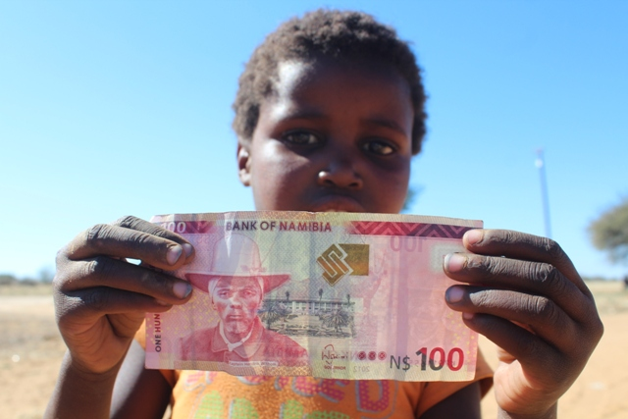
Where is your beneficiary placed?
And what about others who are
non-beneficiaries?
Notes:
DEBRIEF SLIDE
Use to trigger debate and discussions on who might be missing here..
Eg. CLICK: Bens and eligible non bens.. Most probably HIGH INTEREST LOW INFLUENCE..
In the case of Social Protection they are often the people we are trying to serve: the poorest and most vulnerable citizens who are potential beneficiaries of social protection.

Slide 22
Co-ordination:
Application to Home Country

Slide 23

Co-ordination: Application to Home Country
Step 1: Identify the most important horizontal and vertical co-ordination gaps in your country’s system (15 min.)
Step 2: Discuss and then draw or build a model that addresses these gaps (15 min.)
Remember: creating additional coordinating bodies is often not the answer!
Step 3: Prepare to present the three most important features of your model and appoint a spokesperson (5 min.)
Step 4: Presentation in plenary (10 min.)

Slide 24
Co-ordination: Application to Home Country
Step 1: Use the What? and Why? cards to reflect on different coordination challenges and needs in your country. (You don’t need to work through all questions only pick the ones that spark most interest) (15 min.)
Step 2: Discuss solutions on how coordination could be improved (15 min.)
Step 3: Pick your top three solutions and record one per card (5 min.)
Step 4: Appoint a spokesperson to share your top
three suggestions in plenary. (10 min.)

Slide 25
Key take outs for Co-ordination
Analogy for full integration
What do you know now that you did not know before?
What shift in your thinking did you experience?
What would you do differently now?
Notes:
Invite participants to contribute their major AHA moments, resulting in SP learning take-aways, insights and mind shifts on the topic of Coordination – create one flip chart with the title Coordination to record all the contributions
Use the following three questions to elicit participant contributions:
What do you know now that you did not know before?
What shift in your thinking did you experience?
What would you do differently now?

